Slide 1
Lecture 09
Statistics

Slide 2
Announcements

Slide 3
Statistics

Slide 4
Estimation
Statistical Inference:
Making conclusions based on data in random samples
fixed
Example:
Use the data to guess the value of an unknown number
depends on the random sample
Create an estimate of the unknown quantity

Slide 5
Terminology
Population: A collection of individuals
All flights out of SFO last summer
Variable: Something that varies in the population
airline (categorical variable)
amount of delay in departure (quantitative variable)
Sample: A subset of the population

Slide 6
Why take a sample?
You want to understand the variable in the population,
but
you don’t have the resources to measure the variable on all the individuals in the population,
so
you just measure it on a subset of them.

Slide 7
“Tickets in a box”
sample
population

Slide 8
Best way to draw the sample
At random!

Slide 9
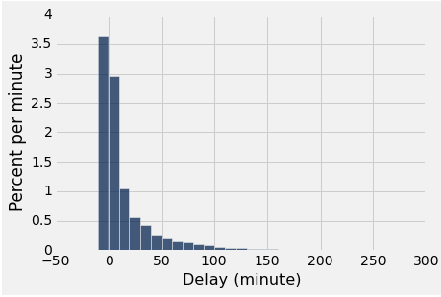
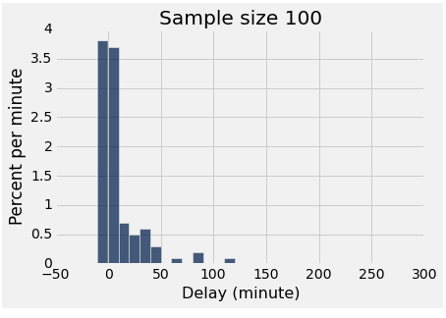
Two distributions
distribution of the population
empirical distribution of a sample

Slide 10
More terminology
Parameter: A number calculated using the values in the population
Median delay among all flights
Proportion of voters who are Republican
Statistic: A number calculated using the values in a sample
A statistic can be used as an estimate of a parameter.

Slide 11
Probability distribution of a statistic
Values of a statistic vary because random samples vary
“Sampling distribution” or “probability distribution” of a statistic consists of:
All possible values of the statistic
Corresponding probabilities
Can be hard to calculate
Need math
Or generate many random samples

Slide 12
Empirical distribution of a statistic
Empirical distribution of the statistic:
Based on simulated values of the statistic
Consists of all the observed values of the statistic,
and the proportion of times each value appeared
Good approximation to the probability distribution of the statistic if the number of repetitions in the simulation is large.

Slide 13
Why sample at random?
The empirical distribution
of a large random sample
is very likely to be close
to the distribution of the population.
That’s why.

Slide 14
The effect of sample size
Larger random samples are more likely to resemble the population than smaller ones.
However, if the method of sampling is not random, taking a larger sample isn’t necessarily better.
You could just end up with a big bad sample.

Slide 15
Simulating a Statistic
Figure out the code to generate one value of the statistic
Create an empty array in which you will collect simulated values
For each repetition of the process:
Simulate one value of the statistic
Append this value to the collection array
The array will contain all of the simulated values
(Demo)

Slide 16
Steps in Assessing a Model
Come up with a statistic that will help you decide whether the data support the model or an alternative view of the world.
Simulate the statistic under the assumptions of the model.
Draw a histogram of the simulated values. This is the model’s prediction for how the statistic should come out.
Compute the observed statistic from the sample in the study.
Compare this value with the histogram.
If the two are not consistent, that’s evidence against the model.

Slide 17
Jury Selection

Slide 18
Swain vs. Alabama, 1965
Talladega County, Alabama
Robert Swain, black man convicted of crime
Appeal: one factor was all-white jury
Only men 21 years or older were allowed to serve
26% of this population were black
Swain’s jury panel consisted of 100 men
8 people on the panel were black (8%)

Slide 19
Supreme Court Ruling
About disparities between the percentages in the eligible population and the jury panel, the Supreme Court wrote:
“... the overall percentage disparity has been small and reflects no studied attempt to include or exclude a specified number of [blacks]”
The Supreme Court denied Robert Swain’s appeal

Slide 20
Sampling from a Distribution
Sample at random from a categorical distribution:
sample_proportions(sample_size, pop_distribution)
Samples at random from the population
Returns an array containing the distribution of the categories in the sample

Slide 21
A Genetic Model

Slide 22
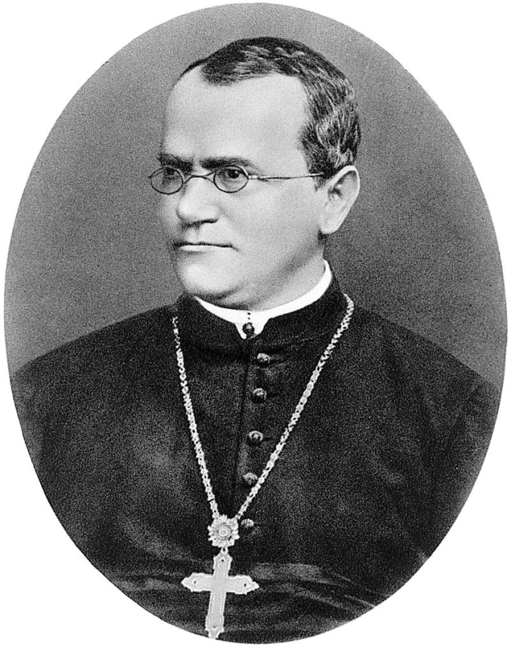
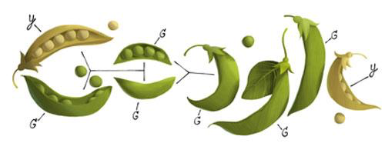
Gregor Mendel, 1822-1884

Slide 23
A Model
Pea plants of a particular kind
Each one has either purple flowers or white flowers
Mendel’s model:
Each plant is purple-flowering with chance 75%, regardless of the colors of the other plants
Question:
Is the model good, or not?

Slide 24
Choosing a Statistic
Start with percent of purple-flowering plants in sample
If that percent is much larger or much smaller than 75, that is evidence against the model
Distance from 75 is the key
Statistic:
| sample percent of purple-flowering plants - 75 |
If the statistic is large, that is evidence against the model

Slide 25
Testing Hypotheses

Slide 26
Choosing One of Two Viewpoints
Based on data
“Chocolate has no effect on cardiac disease.”
“Yes, it does.”
“This jury panel was selected at random from eligible jurors.”
“No, it has too many people with college degrees.”

Slide 27
Estimation

Slide 28
Perfect information
You want to know how many US voters support a particular policy.
You could ask everyone. That works.
But, sometimes we can't afford to do that. So, instead, we could ask some of them, and draw inferences about the general population.

Slide 29
A common scenario
You have to make a decision based on incomplete information.
The quality of your decision is affected by
the information that you have
the information that you don’t have
So, before making the decision, it is worth examining why and how your information came to be incomplete.

Slide 30
If you have the entire population...
Formulate a question you want to answer (a parameter of the population).
Visualize the data (the population).
Compute the answer.
Interpret the results, and explain them in language without statistical jargon.

Slide 31
If you don't...
Formulate a question you want to answer (a parameter of the population).
Select a method of inference.
Visualize the data (the sample).
Calculate the statistic on your sample, then apply the method to estimate the population parameter.
Interpret the results, and explain them in language without statistical jargon.

