Slide 1

Foundations of Data Science
190F
Spring 2020
Lecture 13
Confidence Intervals

Slide 2
Percentiles

Slide 3
Computing Percentiles
The 80th percentile is the value in a set that is at least as large as 80% of the elements in the set
For s = [1, 7, 3, 9, 5], percentile(80, s) is 7 The 80th percentile is ordered element 4: (80/100) * 5
Percentile Size of set
For a percentile that does not exactly correspond to an element, take the next greater element instead

Slide 4
The percentile Function
The pth percentile is the value in a set that is at least as large as p% of the elements in the set
Function in the datascience module:
percentile(p, values)
p is between 0 and 100
Returns the pth percentile of the array

Slide 5
Discussion Question
Which are True, when s = [1, 7, 3, 9, 5]?
percentile(10, percentile(39, | s) s) | == == | 0 percentile(40,s)
percentile(40, percentile(50, | s) s) | == == | percentile(41,s) 5

Slide 6
Estimation (Review)

Slide 7
Inference: Estimation
How big is an unknown parameter?
If you have a census (that is, the whole population):
Just calculate the parameter and you’re done
If you don’t have a census:
Take a random sample from the population
Use a statistic as an estimate of the parameter

Slide 8
Variability of the Estimate
One sample ➜ One estimate
But the random sample could have come out differently
And so the estimate could have been different
Main question:
How different could the estimate have been?
The variability of the estimate tells us something about how accurate the estimate is:
estimate = parameter + error

Slide 9
Where to Get Another Sample?
One sample ➜ One estimate
To get many values of the estimate, we needed many random samples
Can’t go back and sample again from the population:
No time, no money
Stuck?

Slide 10
The Bootstrap

Slide 11
The Bootstrap
A technique for simulating repeated random sampling
All that we have is the original sample
… which is large and random
Therefore, it probably resembles the population
So we sample at random from the original sample!

Slide 12
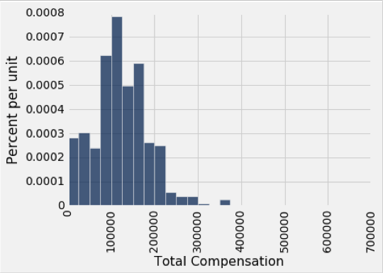
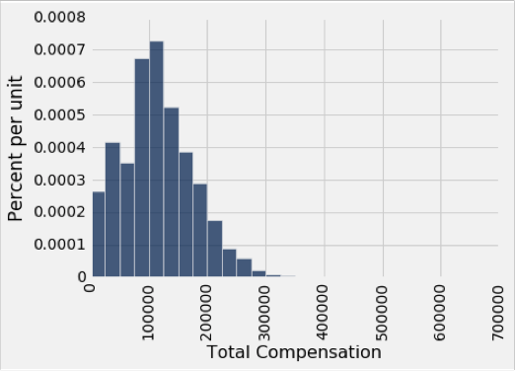
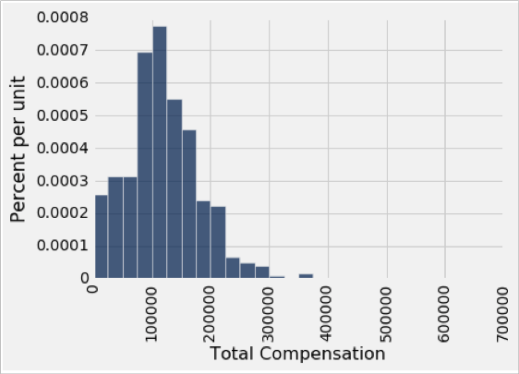
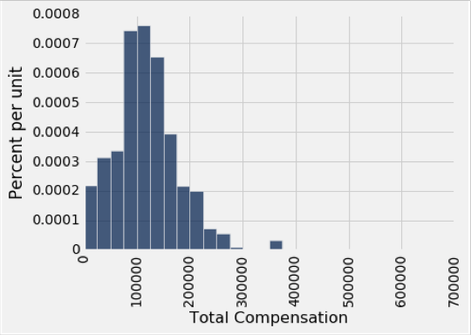
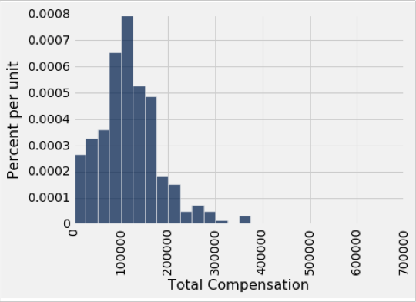
Why the Bootstrap Works
population
sample
All of these look pretty similar, most likely.
resamples

Slide 13
Key to Resampling
From the original sample,
draw at random
with replacement
as many values as the original sample contained
The size of the new sample has to be the same as the original one, so that the two estimates are comparable
(Demo)

Slide 14
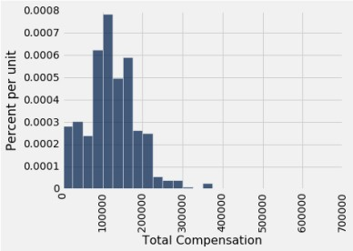
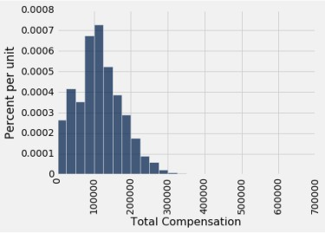
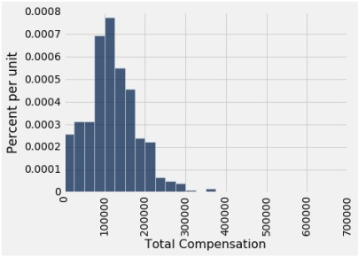
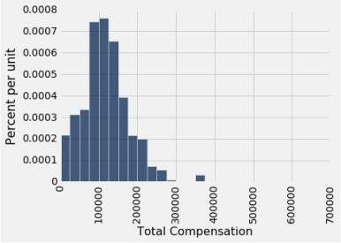
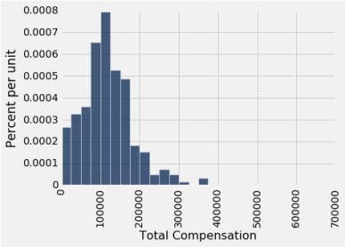
Why the Bootstrap Works
population
sample
All of these look pretty similar, most likely.
resamples

Slide 15

Inference Using the Bootstrap
population
sample
All of these look pretty similar, most likely.
resamples

Slide 16
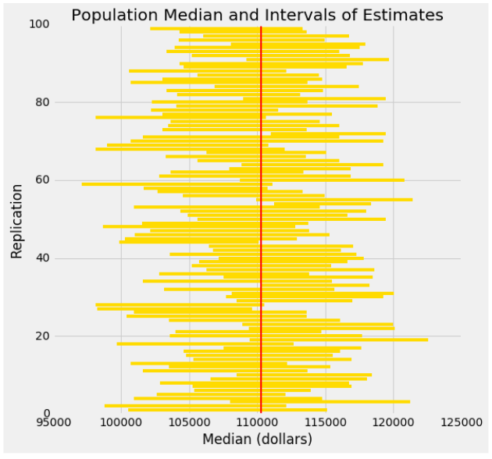
Each line here is a confidence interval from a fresh sample from the population

Slide 17
95% Confidence Interval
Interval of estimates of a parameter
Based on random sampling
95% is called the confidence level
Could be any percent between 0 and 100
Bigger means wider intervals
The confidence is in the process that generated the interval:
It generates a “good” interval about 95% of the time.
(Demo)

Slide 18
Use Methods Appropriately

Slide 19
Can You Use a CI Like This?
By our calculation, an approximate 95% confidence interval for the average age of the mothers in the population is (26.9, 27.6) years.
True or False:
About 95% of the mothers in the population were between 26.9 years and 27.6 years old.
Answer: False. We’re estimating that their average age is in this interval 95% of the time.

Slide 20
Is This What a CI Means?
By our calculation, an approximate 95% confidence interval for the average age of the mothers in the population is (26.9, 27.6) years.
True or False:
There is a 0.95 probability that the average age of mothers in the population is in the range (26.9,27.6) years.
Answer: False. It's not a probability. It's either true or false that the average age of mothers is in the range (26.9, 27.6)

Slide 21
When Not to Use The Bootstrap
If you’re trying to estimate very high or very low percentiles, or min and max
If you’re trying to estimate any parameter that’s greatly affected by rare elements of the population
If the probability distribution of your statistic is not roughly bell shaped (the shape of the empirical distribution will be a clue)
If the original sample is very small
(Demo)

Slide 22
Confidence Interval Tests

Slide 23
95% Confidence Interval
Interval of estimates of a parameter
Based on random sampling
95% is called the confidence level
Could be any percent between 0 and 100
Bigger means wider intervals
The confidence is in the process that generated the interval:
It generates a “good” interval about 95% of the time.
(Demo)

Slide 24
Using a CI for Testing
Null hypothesis: Population mean = x
Alternative hypothesis: Population mean ≠ x
Cutoff for P-value: p%
Method:
Construct a (100-p)% confidence interval for the population average
If x is not in the interval, reject the null
If x is in the interval, can’t reject the null

