Slide 1
Lecture 8
Chance and Sampling

Slide 2
Announcements

Slide 3
Probability

Slide 4
Probability
Lowest value: 0
Chance of event that is impossible
Highest value: 1 (or 100%)
Chance of event that is certain
If an event has chance 70%, then the chance that it doesn’t happen is
100% - 70% = 30%
1 - 0.7 = 0.3
(Demo)

Slide 5
Equally Likely Outcomes
Assuming all outcomes are equally likely, the chance of an event A is:
number of outcomes that make A happen
P(A) = ---------------------------------------------------------------
total number of outcomes

Slide 6
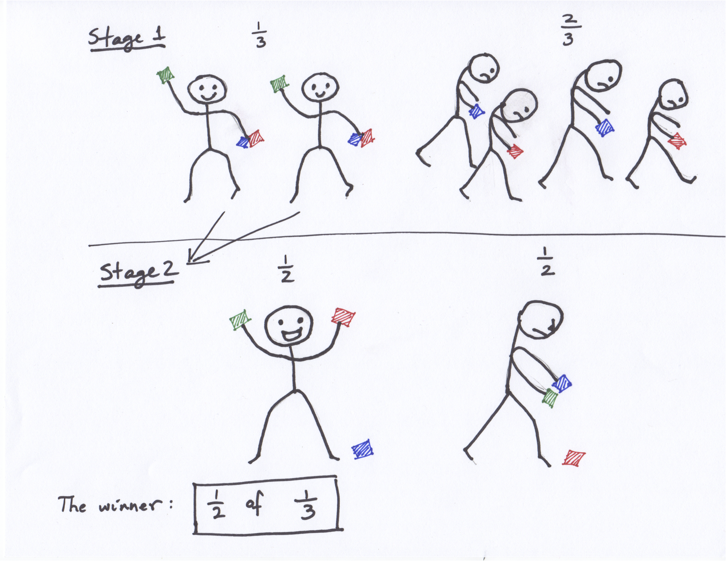
Fraction of a Fraction
(Demo)

Slide 7
Multiplication Rule
Chance that two events A and B both happen
= P(A happens) x P(B happens given that A has happened)
The answer is less than or equal to each of the two chances being multiplied
The more conditions you have to satisfy, the less likely you are to satisfy them all
(Demo)

Slide 8
Addition Rule
If event A can happen in exactly one of two ways, then
P(A) = P(first way) + P(second way)
The answer is greater than or equal to the chance of each individual way

Slide 9
Example: At Least One Head
In 3 tosses:
Any outcome except TTT
P(TTT) = (½) x (½) x (½) = ⅛
P(at least one head) = 1 - P(TTT) = ⅞ = 87.5%
In 10 tosses:
1 - (½)**10
99.9%
(Demo)

Slide 10
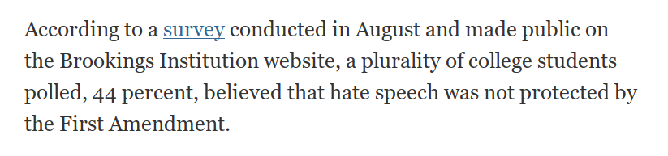

Slide 11
Sampling

Slide 12
Sampling
Deterministic sample:
Sampling scheme doesn’t involve chance
Probability sample:
Before the sample is drawn, you have to know the selection probability of every group of people in the population
Not all individuals have to have equal chance of being selected
(Demo)

Slide 13
Sample of Convenience
Example: sample consists of whoever walks by
Just because you think you’re sampling “at random”, doesn’t mean you are.
If you can’t figure out ahead of time
what’s the population
what’s the chance of selection, for each group in the population
then you don’t have a random sample

Slide 14
Distributions

Slide 15
Probability Distribution
Random quantity with various possible values
“Probability distribution”:
All the possible values of the quantity
The probability of each of those values
In some cases, the probability distribution can be worked out mathematically without ever generating (or simulating) the random quantity
(Demo)

Slide 16
Empirical Distribution
Based on observations
Observations can be from repetitions of an experiment
“Empirical Distribution”
All observed values
The proportion of counts of each value
(Demo)

Slide 17
Large Random Samples

Slide 18
Law of Averages
If a chance experiment is repeated many times,
independently and under the same conditions,
then the proportion of times that an event occurs
gets closer to the theoretical probability of the event
As you increase the number of rolls of a die, the proportion of times you see the face with five spots gets closer to 1/6
(Demo)

Slide 19
Large Random Samples
If the sample size is large,
then the empirical distribution of a uniform random sample
resembles the distribution of the population,
with high probability

Slide 20
Probability & Simulation

Slide 21
Calculation
Roll a fair die 4 times.
What is P(get at least one 6)?
(Demo)

Slide 22
Calculation
Roll a fair die 20 times. What is P(get at least one 6)?
Three ways to compute it:
Calculation: Use math.
Enumeration: Count all outcomes.
Estimation: Randomly sample outcomes. Estimate.

