Slide 1
Lecture 15
The Normal Curve

Slide 2
Standard Units (review)

Slide 3
Standard Units
How many SDs above average?
z = (value - average)/SD
Negative z: value below average
Positive z: value above average
z = 0: value equal to average
When values are in standard units: average = 0, SD = 1
Chebyshev: At least 96% of the values of z are between -5 and 5
(Demo)

Slide 4
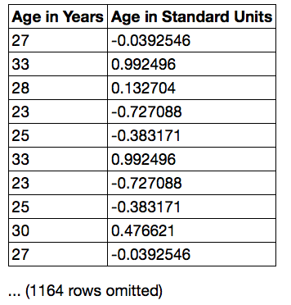
Discussion Question
Find whole numbers that are close to:
the average age
the SD of the ages
(Demo)

Slide 5
The SD and the Histogram
Usually, it's not easy to estimate the SD by looking at a histogram.
But if the histogram has a bell shape, then you can.

Slide 6
The SD and Bell-Shaped Curves
If a histogram is bell-shaped, then
the average is at the center
the SD is the distance between the average and the points of inflection on either side
(Demo)

Slide 7
The Normal Distribution

Slide 8
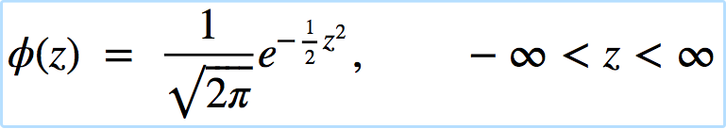
The Standard Normal Curve
A beautiful formula that we won’t use at all:

Slide 9
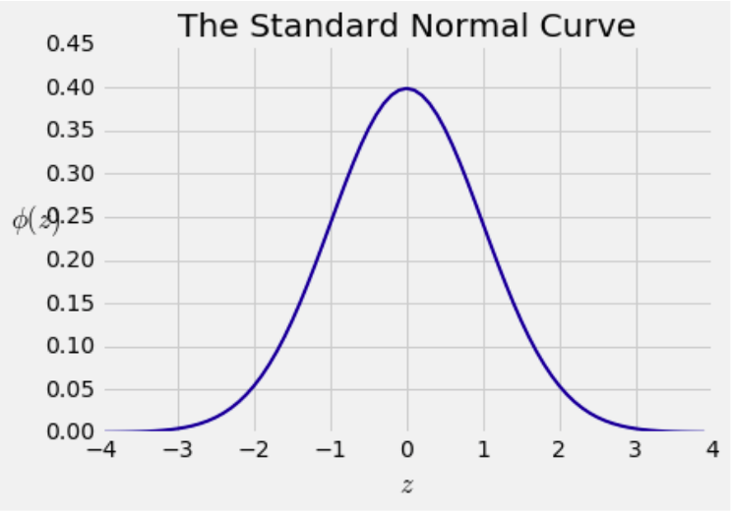
Bell Curve

Slide 10
Normal Proportions

Slide 11
How Big are Most of the Values?
No matter what the shape of the distribution,
the bulk of the data are in the range “average ± a few SDs”
If a histogram is bell-shaped, then
Almost all of the data are in the range
“average ± 3 SDs”

Slide 12
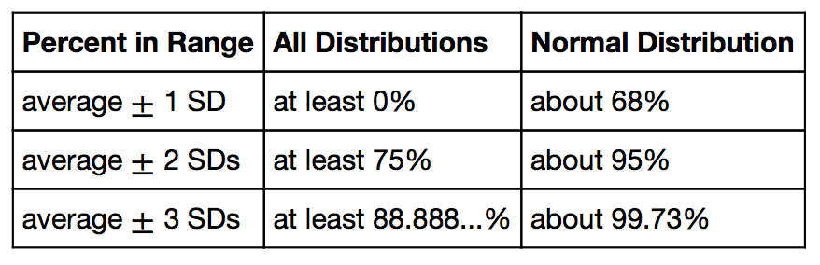
Bounds and Normal Approximations

Slide 13
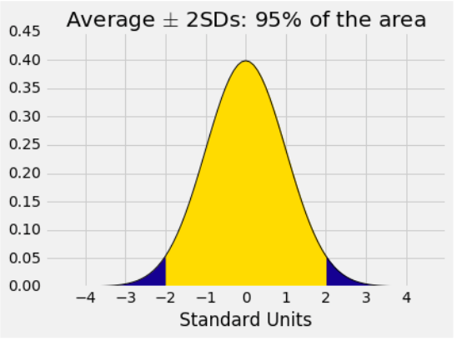
A “Central” Area

Slide 14
Normal Curve in Practice

Slide 15
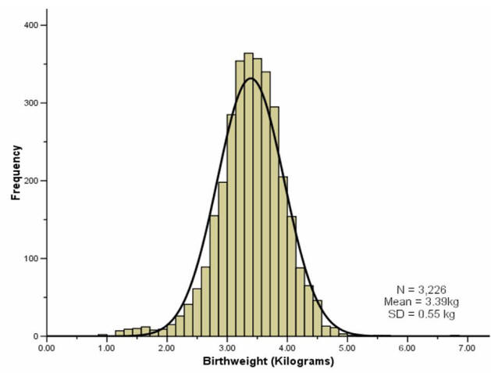
Birth weights of babies

Slide 16
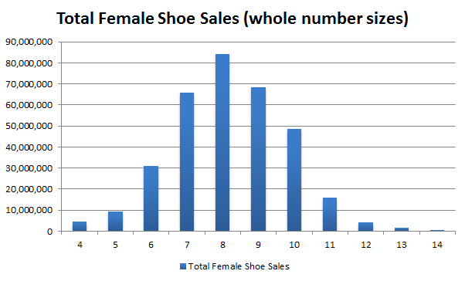
Sales of shoes for women

Slide 17
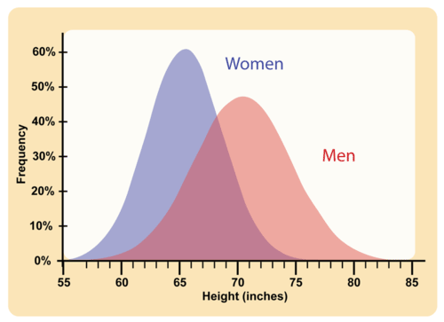
Heights of men and women

Slide 18
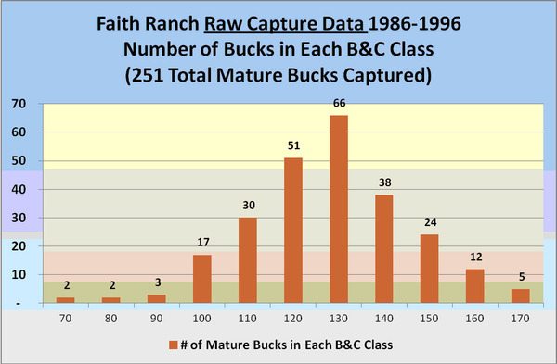
Lengths of Deer Antlers

Slide 19
The Mystery
Why is the normal distribution so common?

Slide 20
Central Limit Theorem

Slide 21
Second Reason for Using the SD
If the sample is
large, and
drawn at random with replacement,
Then, regardless of the distribution of the population,
the probability distribution of the sample sum
(or of the sample average) is roughly normal
(Demo)

