Slide 1
Lecture 16
Designing Experiments

Slide 2
Questions we are studying
How can we quantify natural concepts like “center” and “variability”?
Why do many of the empirical distributions that we generate come out bell shaped?
How is sample size related to the accuracy of an estimate?

Slide 3

How do they know?

Slide 4
Variability of the Sample Average
The distribution of all possible sample averages of a given size is called the distribution of the sample average.
We approximate it by an empirical distribution.
By the CLT, it’s roughly normal:
Center = the population average
SD = (population SD) / √sample size

Slide 5
Discussion Question
A city has 500,000 households. The annual incomes of these households have an average of $65,000 and an SD of $45,000. The distribution of the incomes [pick one and explain]:
is roughly normal because the number of households is large.
is not close to normal.
may be close to normal, or not; we can’t tell from the information given.

Slide 6
Discussion Question
A city has 500,000 households. The annual incomes of these households have an average of $65,000 and an SD of $45,000. A random sample of 900 households is taken.
Fill in the blanks and explain:
There is about a 68% chance that the average annual income of the sampled households is in the range
$__________ plus or minus $__________

Slide 7
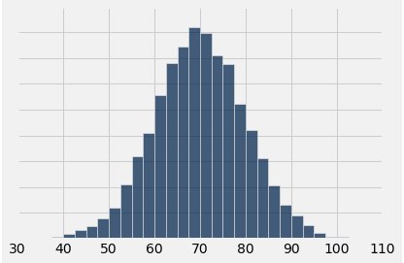
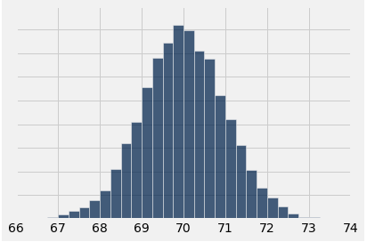
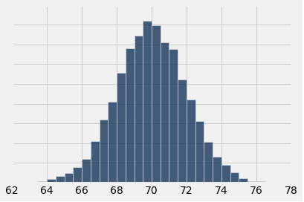
Discussion Question
A population has average 70 and SD 10. One of the histograms below is the empirical distribution of the averages of 10,000 random samples of size 100 drawn from the population. Which one?
(A)
(B)
(C)

Slide 8
Confidence Intervals

Slide 9
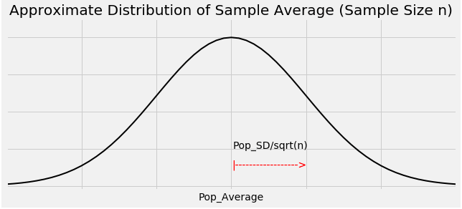
Graph of the Distribution

Slide 10
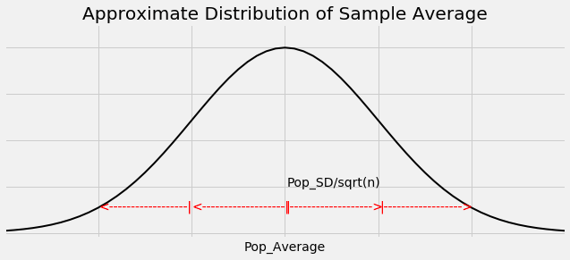
The Key to 95% Confidence
For about 95% of all samples, the sample average and population average are within 2 SDs of each other.
SD = SD of sample average
= (population SD) / √sample size

Slide 11
Constructing the Interval
For 95% of all samples,
If you stand at the population average and look two SDs on both sides, you will find the sample average.
Distance is symmetric.
So if you stand at the sample average and look two SDs on both sides, you will capture the population average.

Slide 12
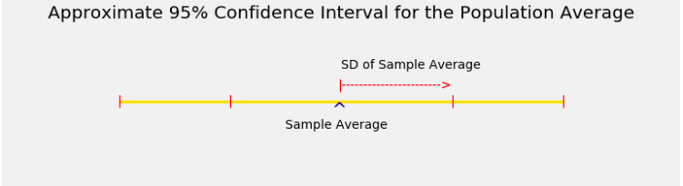
The Interval

Slide 13
Width of the Interval
Total width of a 95% confidence interval for the population average
= 4 * SD of the sample average
= 4 * (population SD) / √sample size

Slide 14
Sample Proportions

Slide 15
Proportions are Averages
Data: 0 1 0 0 1 0 1 1 0 0 (10 entries)
Sum = 4 = number of 1’s
Average = 4/10 = 0.4 = proportion of 1’s
If the population consists of 1’s and 0’s (yes/no answers to a question), then:
the population average is the proportion of 1’s in the population
the sample average is the proportion of 1’s in the sample

Slide 16
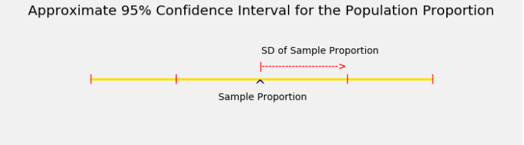
Confidence Interval

Slide 17
Controlling the Width
Total width of an approximate 95% confidence interval for a population proportion
= 4 * (SD of 0/1 population) / √sample size
The narrower the interval, the more accurate your estimate.
Suppose you want the total width of the interval to be no more than 3%. How should you choose the sample size?

Slide 18
The Sample Size for a Given Width
0.03 = 4 * (SD of 0/1 population) / √sample size
Left hand side is 3%, the maximum total width that you will accept
Right hand side is the formula for the total width
√sample size = 4 * (SD of 0/1 population) / 0.03
(Demo)

Slide 19
“Worst Case” Population SD
√sample size = 4 * (SD of 0/1 population) / 0.03
SD of 0/1 population is at most 0.5
√sample size ≥ 4 * 0.5 / 0.03
sample size ≥ (4 * 0.5 / 0.03) ** 2 = 4444.44
The sample size should be 4445 or more

Slide 20
Discussion Question
A researcher is estimating a population proportion based on a random sample of size 10,000.
Fill in the blank with a decimal:
With chance at least 95%, the estimate will be correct to within ________________.

Slide 21
Discussion Question
I am going to use a 68% confidence interval to estimate a population proportion.
I want the total width of my interval to be no more than 2.5%.
How large must my random sample be?
2 * (0.5) / sqrt(sample size) = 0.025

