Slide 1
Lecture 17
Correlation & Linear Regression

Slide 2
Prediction

Slide 3
Guessing the Future
Based on incomplete information
One way of making predictions:
To predict an outcome for an individual,
find others who are like that individual
and whose outcomes you know.
Use those outcomes as the basis of your prediction.

Slide 4
Association

Slide 5
Two Numerical Variables
Trend
Positive association
Negative association
Pattern
Any discernible “shape” in the scatter
Linear
Non-linear
Visualize, then quantify
(Demo)

Slide 6
Correlation Coefficient

Slide 7
Definition of r
Correlation Coefficient (r) =
average of
product of
x in standard units
and
y in standard units
Measures how clustered the scatter is around a straight line

Slide 8
The Correlation Coefficient r
Measures linear association
Based on standard units
-1 ≤ r ≤ 1
r = 1: scatter is perfect straight line sloping up
r = -1: scatter is perfect straight line sloping down
r = 0: No linear association; uncorrelated
(Demo)

Slide 9
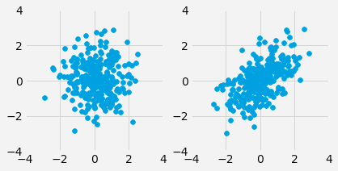
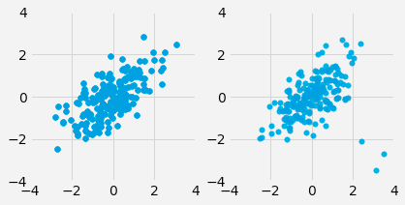
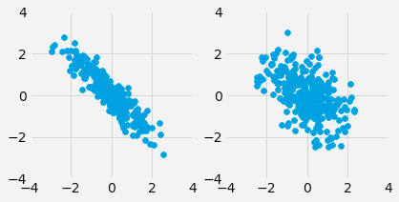
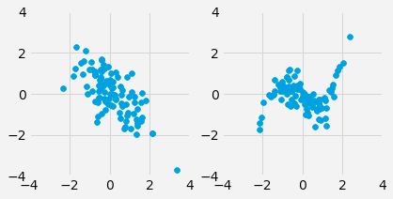
Discussion Question
For each pair, which one will have a higher value of r?
a)
c)
b)
d)

Slide 10
Properties of Correlation

Slide 11
Properties of r
r is a pure number, with no units
r is not affected by changing units of measurement
r is not affected by switching the horizontal and vertical axes

Slide 12
Interpreting r
Watch out for:
Jumping to conclusions about causality
Non-linearity
Outliers
Ecological correlations, based on aggregates or averaged data

Slide 13
Interpreting r
Don't jump to conclusions about causality

Slide 14
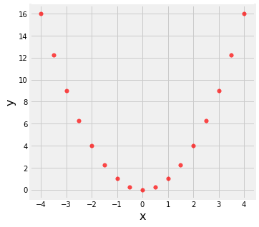
Interpreting r
Watch out for non-linearity.
r = 0.0

Slide 15
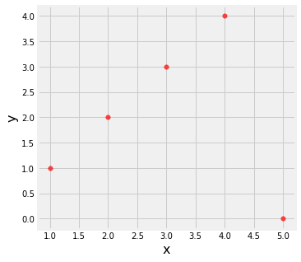
Interpreting r
Watch out for outliers.
r = 0.0

Slide 16
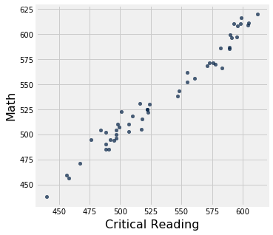
Interpreting r
Watch out for ecological correlations, based on aggregates or averaged data.
r = 0.98

Slide 17
Prediction

Slide 18
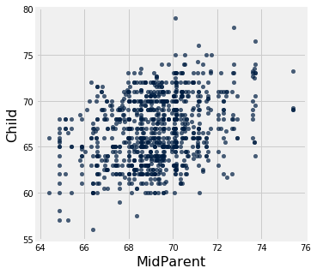
Galton's Heights

Slide 19
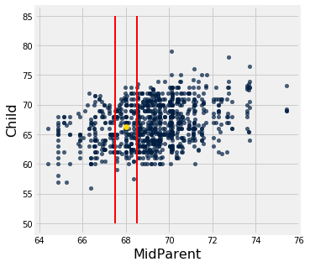
Galton's Heights

Slide 20
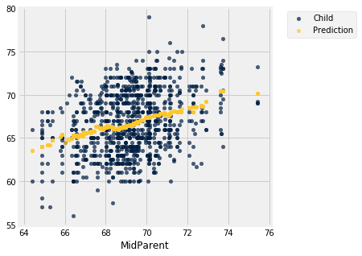
Galton's Heights

Slide 21
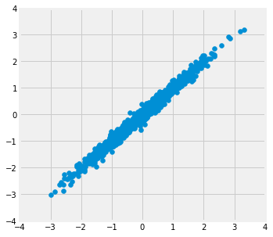
Where is the prediction line?
r = 0.99

Slide 22
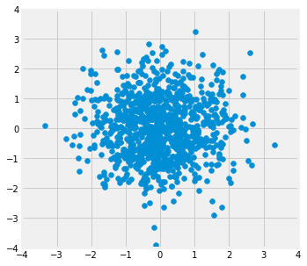
Where is the prediction line?
r = 0.0

Slide 23
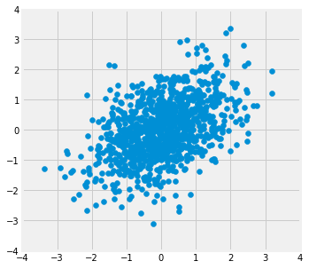
Where is the prediction line?
r = 0.5

Slide 24
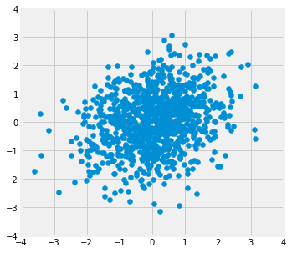
Where is the prediction line?
r = 0.2

Slide 25
Nearest Neighbor Regression
A method for prediction:
Group each x with a representative x value (rounding)
Average the corresponding y values for each group
For each representative x value, the corresponding prediction is the average of the y values in the group.
Graph these predictions.
If the association between x and y is linear, then points in the graph of averages tend to fall on the regression line.

Slide 26
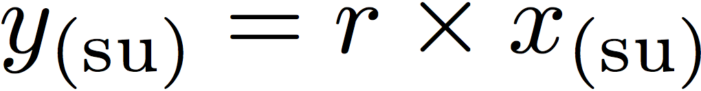
Regression to the Mean
A statement about x and y pairs
Measured in standard units
Describing the deviation of x from 0 (the average of x's)
And the deviation of y from 0 (the average of y's)
On average, y deviates from 0 less than x deviates from 0
Regression Line
Correlation
Not true for all points — a statement about averages

Slide 27
Linear Regression
(Demo)

Slide 28
Slope & Intercept

Slide 29
Regression Line Equation
In original units, the regression line has this equation:
y in standard units
x in standard units
Lines can be expressed by slope & intercept

Slide 30
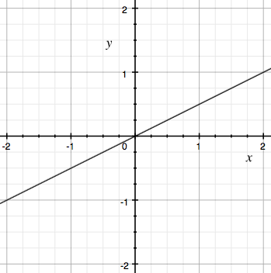
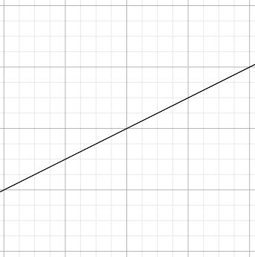
Regression Line
Standard Units
Original Units
(Average x, Average y)
(0, 0)
r
r * SD y
1
SD x

Slide 31
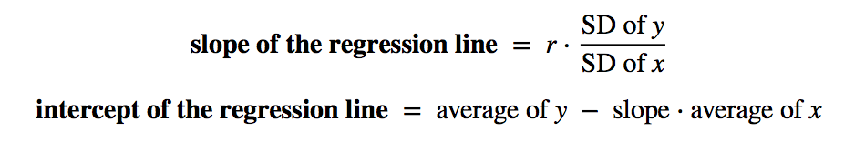
Slope and Intercept
estimate of y = slope * x + intercept
(Demo)

