Slide 1
Lecture 18
Least Squares

Slide 2
Announcements

Slide 3
Algebra Review

Slide 4
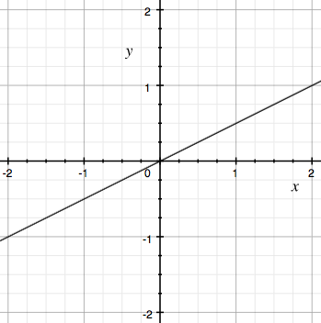
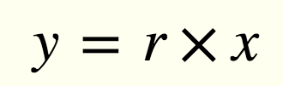
Equation of a Line
(0, 0)
r
1

Slide 5
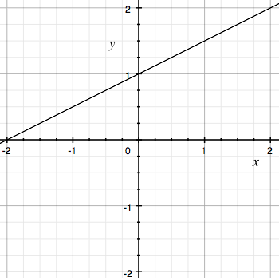
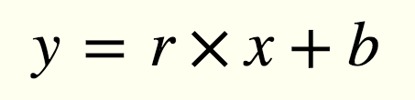
Equation of a Line
(0, b)
r
1
b

Slide 6
Linear Regression

Slide 7
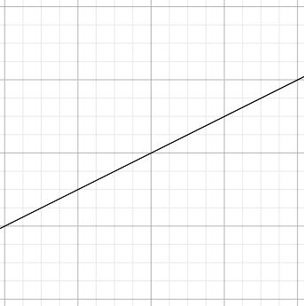
Regression Line
Standard Units
Original Units
(Average x, Average y)
(0, 0)
r
r * SD y
1
SD x

Slide 8
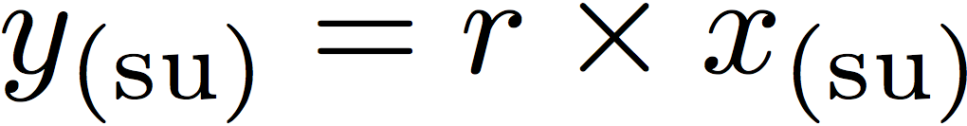
Regression Line Equation
In standard units, the equation of the regression line is:
Fitted value
Observed value
(0, 0)
r
1
Correlation coefficient

Slide 9
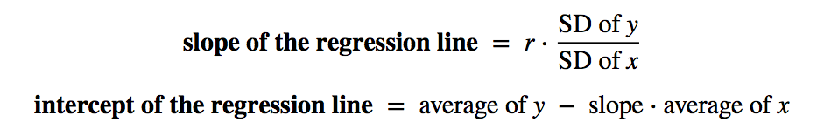
Regression Line Equation
In original units, the regression line has this equation:
y in standard units
x in standard units

Slide 10
Discussion Question
A course has a midterm (average 70; standard deviation 10) and a really hard final (average 50; standard deviation 12)
If the scatter diagram comparing midterm & final scores for students has a typical oval shape with correlation 0.75, then...
What do you expect the average final score would be for students who scored 90 on the midterm?
How about 60 on the midterm?
y = 0.75 * 2 = 1.5
(Demo)

Slide 11
Least Squares

Slide 12
Error in Estimation
error = actual value − estimate
Typically, some errors are positive and some negative
To measure the rough size of the errors
square the errors to eliminate cancellation
take the mean of the squared errors
take the square root to fix the units
root mean square error (rmse)
(Demo)

Slide 13
Least Squares Line
Minimizes the root mean squared error (rmse) among all lines
Equivalently, minimizes the mean squared error (mse) among all lines
Names:
“Best fit” line
Least squares line
Regression line
(Demo)

Slide 14
Numerical Optimization
Numerical minimization is approximate but effective
Lots of machine learning uses numerical minimization
If the function mse(a, b)returns the mse of estimation using the line “estimate = ax + b”,
then minimize(mse)returns array [a₀, b₀]
a₀ is the slope and b₀ the intercept of the line that minimizes the mse among lines with arbitrary slope a and arbitrary intercept b (that is, among all lines)
(Demo)

