Slide 1
Lecture 21
Classification

Slide 2
Announcements

Slide 3
Classification

Slide 4
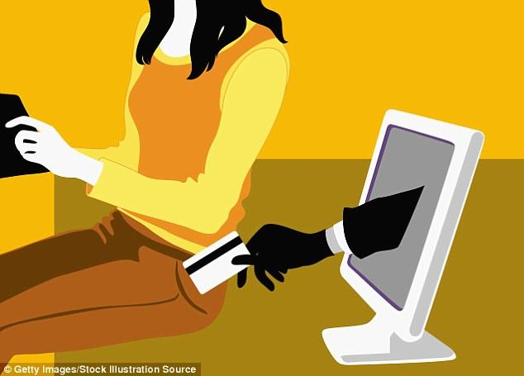
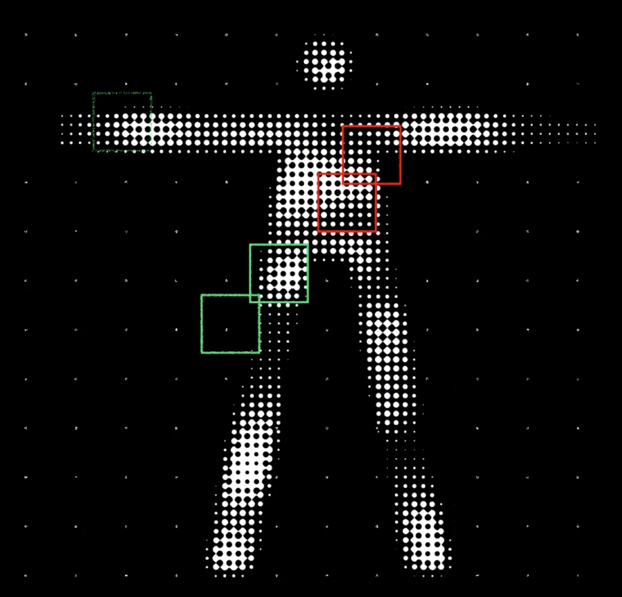
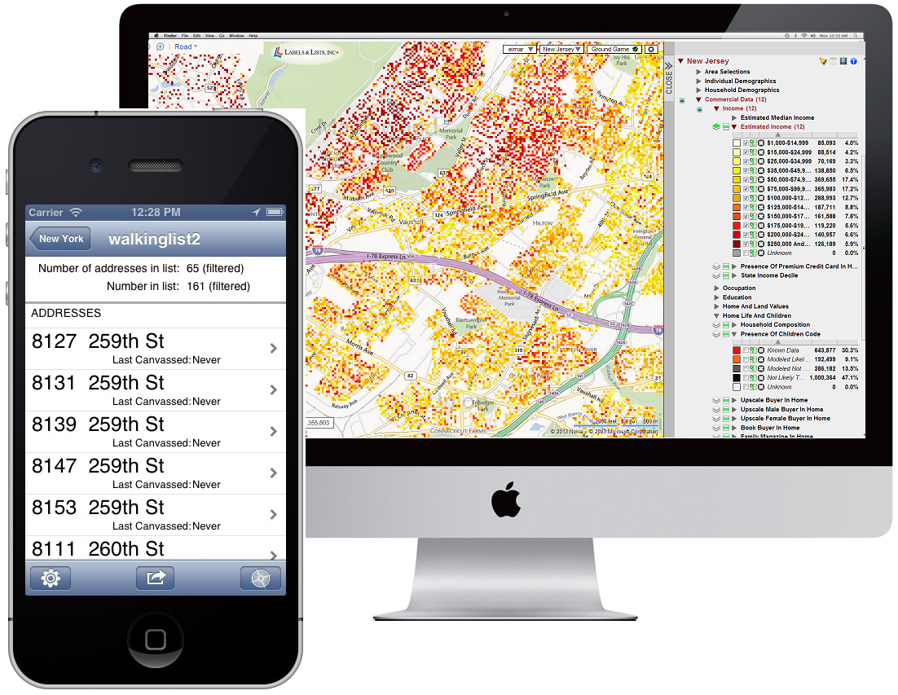
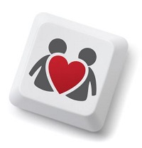
Classification Examples
(Demo)
Notes:
Fraud: order fraud (Amazon, PayPal, etc.), account fraud (LinkedIn)
Dating: https://www.wired.com/2014/01/how-to-hack-okcupid/
If, through statistical sampling, McKinlay could ascertain which questions mattered to the kind of women he liked, he could construct a new profile that honestly answered those questions and ignored the rest. He could match every woman in LA who might be right for him, and none that weren’t.
Diagnosis: http://www.newyorker.com/magazine/2017/04/03/ai-versus-md
In June, 2015, Thrun’s team began to test what the machine had learned from the master set of images by presenting it with a “validation set”: some fourteen thousand images that had been diagnosed by dermatologists (although not necessarily by biopsy). Could the system correctly classify the images into three diagnostic categories—benign lesions, malignant lesions, and non-cancerous growths? The system got the answer right seventy-two per cent of the time. (The actual output of the algorithm is not “yes” or “no” but a probability that a given lesion belongs to a category of interest.) Two board-certified dermatologists who were tested alongside did worse: they got the answer correct sixty-six per cent of the time.
Personality: https://motherboard.vice.com/en_us/article/how-our-likes-helped-trump-win (Cambridge Analytica—Board member Steve Bannon)
Link personality tests to Facebook profiles
"Followers of Lady Gaga were most probably extroverts, while those who "liked" philosophy tended to be introverts. While each piece of such information is too weak to produce a reliable prediction, when tens, hundreds, or thousands of individual data points are combined, the resulting predictions become really accurate."
"Up to now, explains Nix, election campaigns have been organized based on demographic concepts. "A really ridiculous idea. The idea that all women should receive the same message because of their gender—or all African Americans because of their race." What Nix meant is that while other campaigners so far have relied on demographics, Cambridge Analytica was using psychometrics."
Machine learning to predict recidivism (for parole), to predict whether the bank shoud give you a loan, to predict whether immigrants should be admitted to US. Racism, fairness.

Slide 5
Classifiers

Slide 6
Training a Classifier
Classifier
Attributes of an example
Predicted label of the example
Model the association between attributes & labels
Population
Sample
Labels
Training
Set
Estimate the accuracy of the classifier
Test
Set

