Slide 1
Lecture 22
Classifiers

Slide 2
Announcements

Slide 3
Classifiers

Slide 4
Training a Classifier
Classifier
Attributes of an example
Predicted label of the example
Model the association between attributes & labels
Population
Sample
Labels
Training
Set
Estimate the accuracy of the classifier
Test
Set

Slide 5
Nearest Neighbor Classifier
NN Classifier
Use the label of the most similar training example
Attributes of an example
Predicted label of the example
Population
Sample
Labels
Training
Set
Test
Set

Slide 6
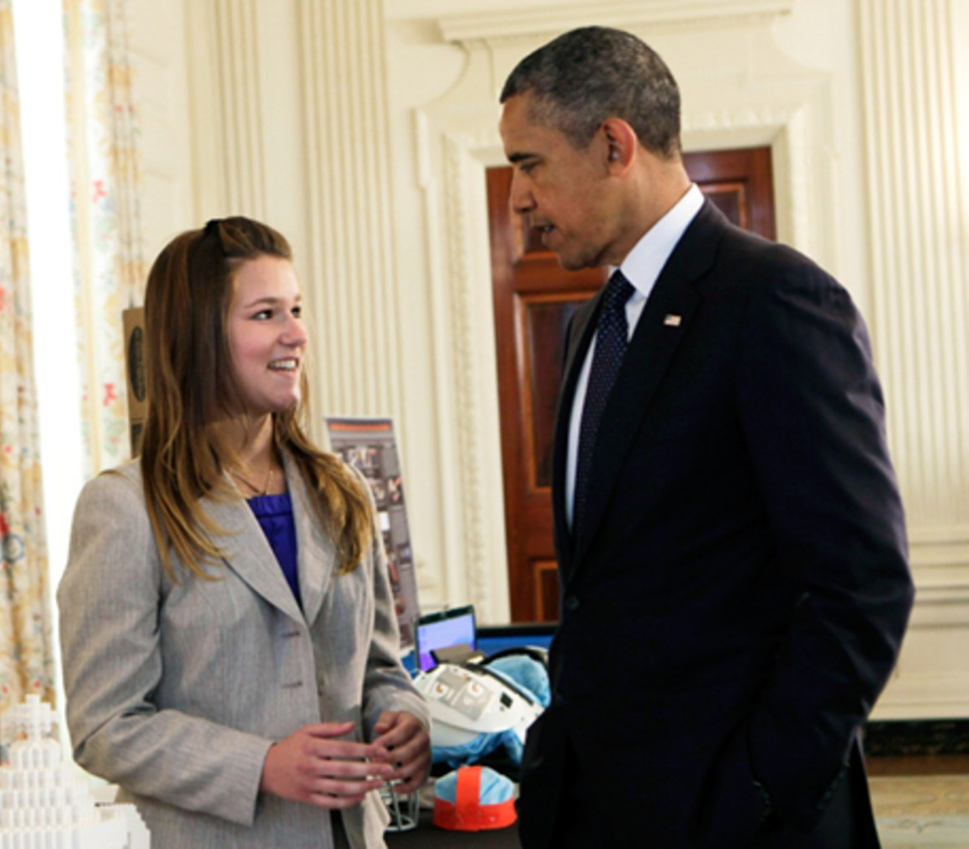
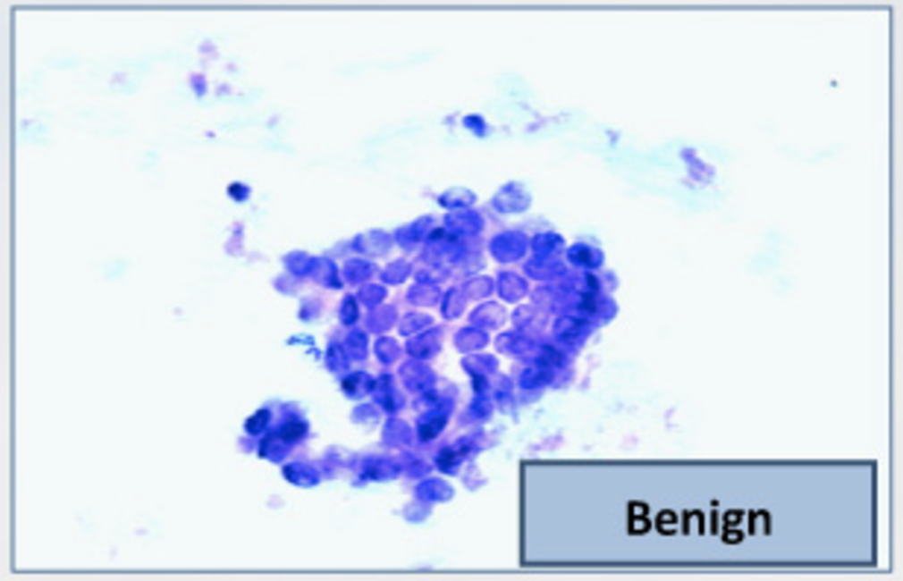
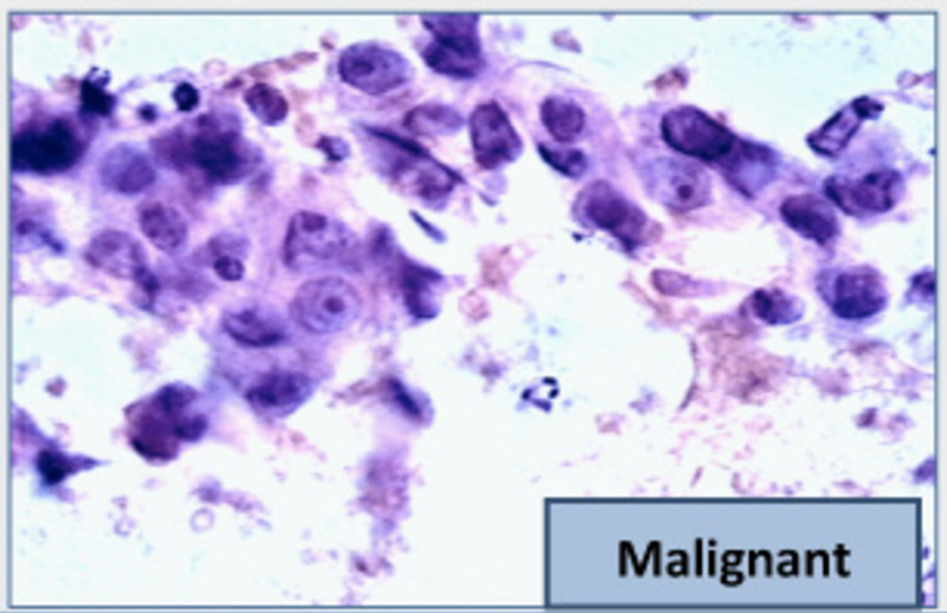
The Google Science Fair
Brittany Wenger, a 17-year-old high school student in 2012
Won by building a breast cancer classifier with 99% accuracy
(Demo)

Slide 7
Distance

Slide 8
Rows of Tables
Each row contains all the data for one individual
t.row(i) evaluates to ith row of table t
t.row(i).item(j)is the value of column j in row i
If all values are numbers, then np.array(t.row(i)) evaluates to an array of all the numbers in the row.
To consider each row individually, use for row in t.rows: ... row.item(j) ...

Slide 9


Distance Between Two Points
Two attributes x and y:
Three attributes x, y, and z:
(Demo)
and so on ...

Slide 10
Nearest Neighbors

Slide 11
Finding the k Nearest Neighbors
To find the k nearest neighbors of an example:
Find the distance between the example and each example in the training set
Augment the training data table with a column containing all the distances
Sort the augmented table in increasing order of the distances
Take the top k rows of the sorted table
(Demo)

Slide 12
The Classifier
To classify a point:
Find its k nearest neighbors
Take a majority vote of the k nearest neighbors to see which of the two classes appears more often
Assign the point the class that wins the majority vote
(Demo)

Slide 13
Evaluation

Slide 14
Accuracy of a Classifier
The accuracy of a classifier on a labeled data set is the proportion of examples that are labeled correctly
Need to compare classifier predictions to true labels
If the labeled data set is sampled at random from a population, then we can infer accuracy on that population
Sample
Labels
Training
Set
Test
Set
(Demo)

Slide 15
Decision Boundaries
A change in input attributes might change the prediction
Inputs that are very close but result in different predicted labels are on either side of a decision boundary
To visualize, plot predictions of a regular set of inputs
(Demo)

