Slide 1
Lecture 24
Case Studies

Slide 2
Announcements

Slide 3
Case study: Health
(Excerpt 2:45)

Slide 4
Malcolm Gladwell
Author (Blink, The Tipping Point) & journalist (New Yorker)
"Revisionist History will go back and reinterpret something from the past: an event, a person, an idea. Something overlooked. Something misunderstood."
You should listen to the whole episode: Season 2, Episode 10
http://revisionisthistory.com/episodes/20-the-basement-tapes

Slide 5
The Diet-Heart Hypothesis

Slide 6
Cardiovascular Disease
Atherosclerosis narrows arteries due to plaque buildup.
#1 cause of death and disability in the developed world.
Cardiovascular disease (CVD) is the leading global cause of death: 17.3 million deaths per year.
The causes are not known, but there are associations with high blood pressure, diabetes, smoking, obesity, family history, age, inactivity, and an unhealthy diet.
https://www.nhlbi.nih.gov/health/health-topics/topics/atherosclerosis/atrisk

Slide 7
Diet & Cardiovascular Disease
1.7M deaths worldwide are attributed to low fruit and vegetable consumption by the WHO (2011).
High intake of salt is linked to high blood pressure.
High intake of processed foods is linked to obesity.
Eliminating trans fats is widely recommended.
Added sugar is linked to high blood pressure & obesity.
High intake of alcohol is associated with CVD risk.
http://www.who.int/cardiovascular_diseases/publications/atlas_cvd/en/

Slide 8
The Diet-Heart Hypothesis
Hypothesis:
Replacing saturated fat (e.g. dairy) with polyunsaturated fat (e.g. plant-based oil) reduces risk of heart disease.
Justification:
This replacement reduces serum cholesterol.
Serum cholesterol is associated with heart disease.
"Clinical trials that used polyunsaturated fat to replace saturated fat reduced the incidence of CVD." (AHA, 2017)
http://circ.ahajournals.org/content/early/2017/06/15/CIR.0000000000000510

Slide 9
Hypothesis Testing

Slide 10
Designing an Experiment
Hypothesis:
Replacing saturated fat (e.g. dairy) with polyunsaturated fat (e.g. plant-based oil) reduces risk of heart disease.
What evidence would support this hypothesis?

Slide 11
Minnesota Coronary Experiment (1968-1973)
(Excerpt 11:10)

Slide 12
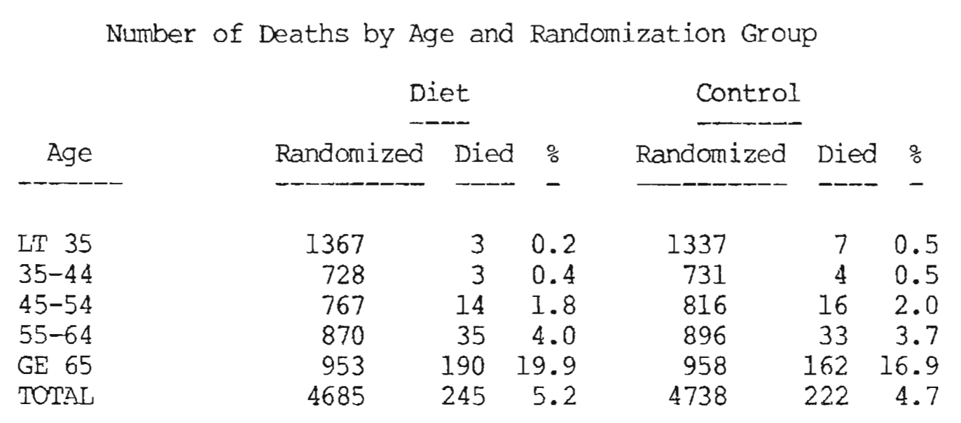
Broste Thesis Figure 6
(Demo)
(Excerpt 3:35)
http://www.psych.uic.edu/download/Broste_thesis_1981.pdf

Slide 13
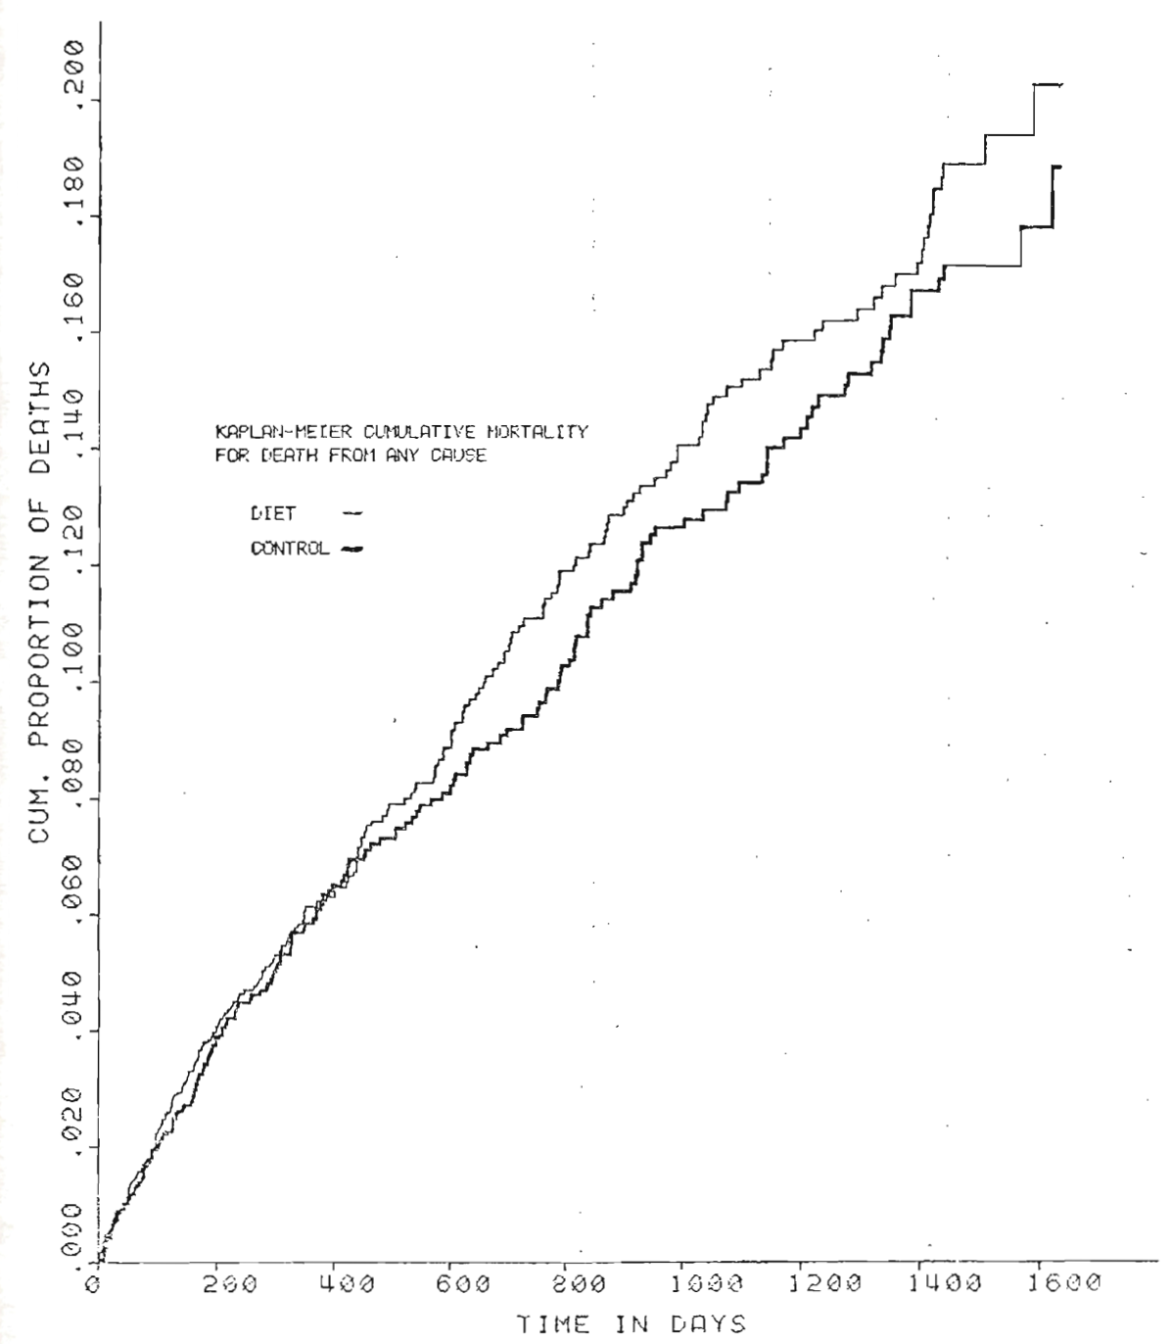
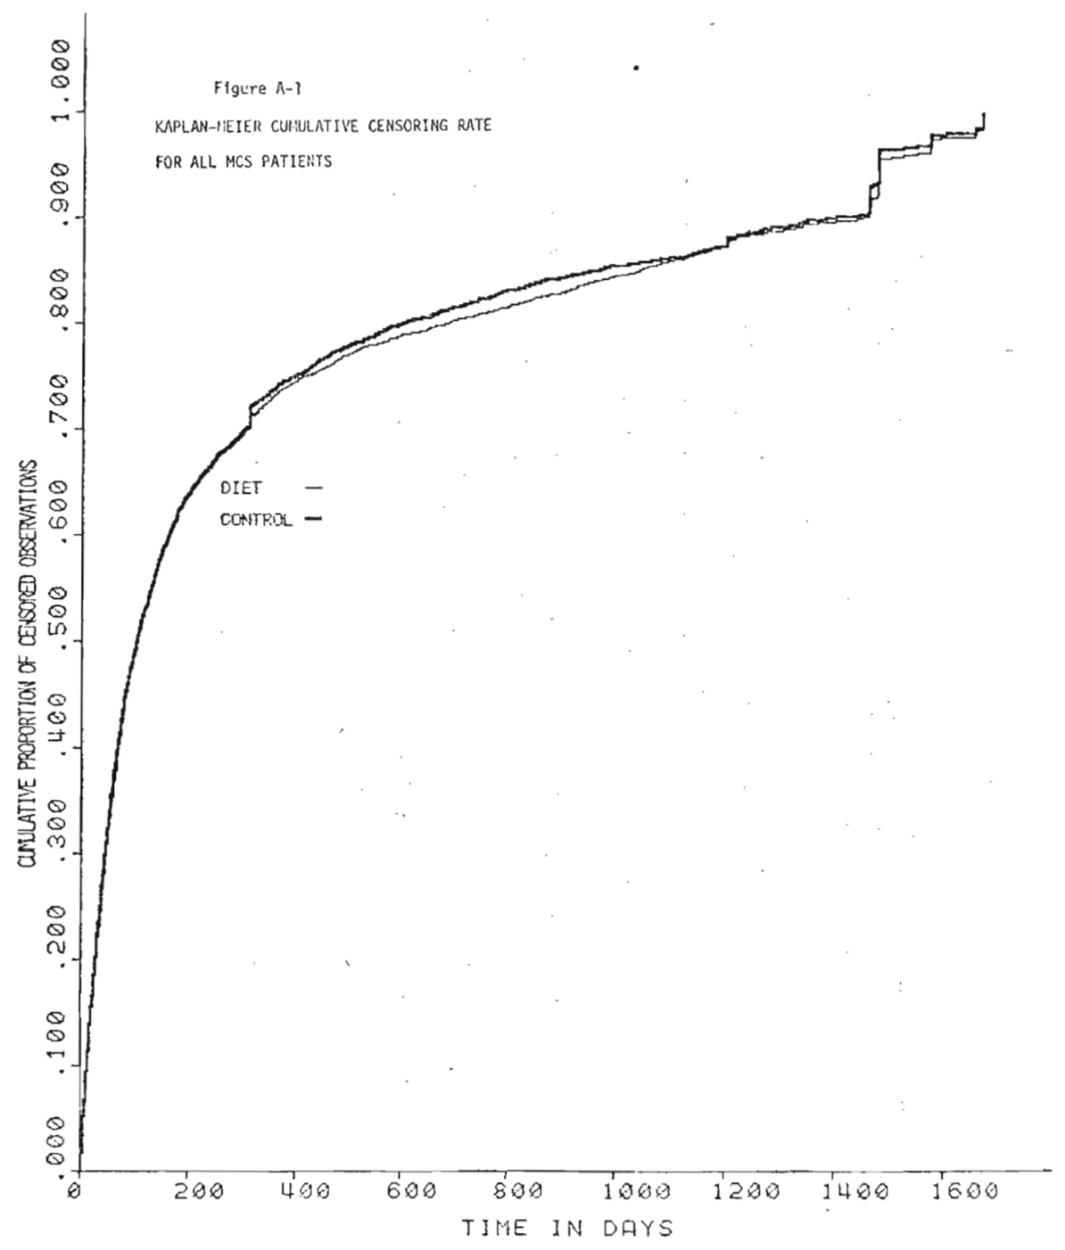
Broste Thesis Figures

Slide 14
Other Clinical Trials

Slide 15
Controlled Experiments
Wadsworth Hospital and Veterans Administration Center in Los Angeles evaluated a diet [using] corn, soybean, safflower, and cottonseed oils, all high in polyunsaturated linoleic acid, to replace saturated fat in the control diet (846 men; mean age of 65 years; 30% had CVD; 8 year duration).
Oslo Diet-Heart Study evaluated changing to a low saturated, high polyunsaturated fat diet (412 men with prior MI).
British Medical Research Council compared a diet containing soybean oil, 86 g/d, with a diet with saturated fat from animal products (393 men with prior MI).
http://circ.ahajournals.org/content/early/2017/06/15/CIR.0000000000000510

Slide 16
Finnish Mental Hospital Study
"The Finnish Mental Hospital Study compared a diet high in polyunsaturated fat, mainly from soybean oil, with a diet high in saturated fat in 1222 patients at 2 psychiatric hospitals. In 1 hospital, the high polyunsaturated fat diet was given first, followed by the saturated fat diet; in the other hospital, the diets were given in the reverse order (1222 patients; 6 years)."
Non-blind & conditions evaluated at different times.
"The amount of sugar in the diet varied by almost 50%."
"The use of psychiatric drugs with known cardiovascular side effects differed substantially between groups."
http://circ.ahajournals.org/content/early/2017/06/15/CIR.0000000000000510 http://wholehealthsource.blogspot.com/2009/07/finnish-mental-hospital-trial.html

Slide 17
Case study: Education

Slide 18
Tutoring in Computer Science

Slide 19
Small-Group Tutoring at Scale
Fall 2017 small-group mentoring/tutoring (CS Mentors & course tutors)
Course | CS 61A | Data 8 | CS 61B | CS 70 | EE 16A
Topic | Program structures | Foundations of data science | Data structures | Discrete math & probability | Linear algebra & circuits
Mentors | 84 | 31 | 51 | 25 | 9
Sections | 140 | 60 | 52 | 27 | 9
Students | 587 | 261 | 160 | 156 | 45

Slide 20
Mentoring Schedule in CS 61A
September 14, 2017 — CS 61A Midterm 1
September 15, 2017 — Sign-ups for adjunct sections open
September 17, 2017 — CS 61A Midterm 1 scores returned
September 18, 2017 — Weekly adjunct sections start
October 19, 2017 — CS 61A Midterm 2
(Demo)

Slide 21
What's Next?

Slide 22
Data Science

Slide 23
Why Data Science
Unprecedented access to data means that we can make new discoveries and more informed decisions.
Computation is a powerful ally in data processing, visualization, prediction, and statistical inference.
People can agree on evidence and measurement.

Slide 24
How to Analyze Data
Begin with a question from some domain, reasonable assumptions about the data, & a choice of methods.
Visualize, then quantify!
Perhaps the most important part: Interpretation of the results in the language of the domain, without statistical jargon.

Slide 25
How Not to Analyze Data
Begin with a question from some domain, reasonable assumptions about the data, & a choice of methods.
Visualize, then quantify!
Perhaps the most important part: Interpretation of the results in the language of the domain, without statistical jargon.

Slide 26
How to Analyze Data in 2020
Begin with a question from some domain, reasonable assumptions about the data, & a choice of methods.
Visualize, then quantify! (Both using computation.)
Perhaps the most important part: Interpretation of the results in the language of the domain, without statistical jargon.

