Slide 1
Lecture 3
Expressions
& Building Tables

Slide 2
Announcements

Slide 3
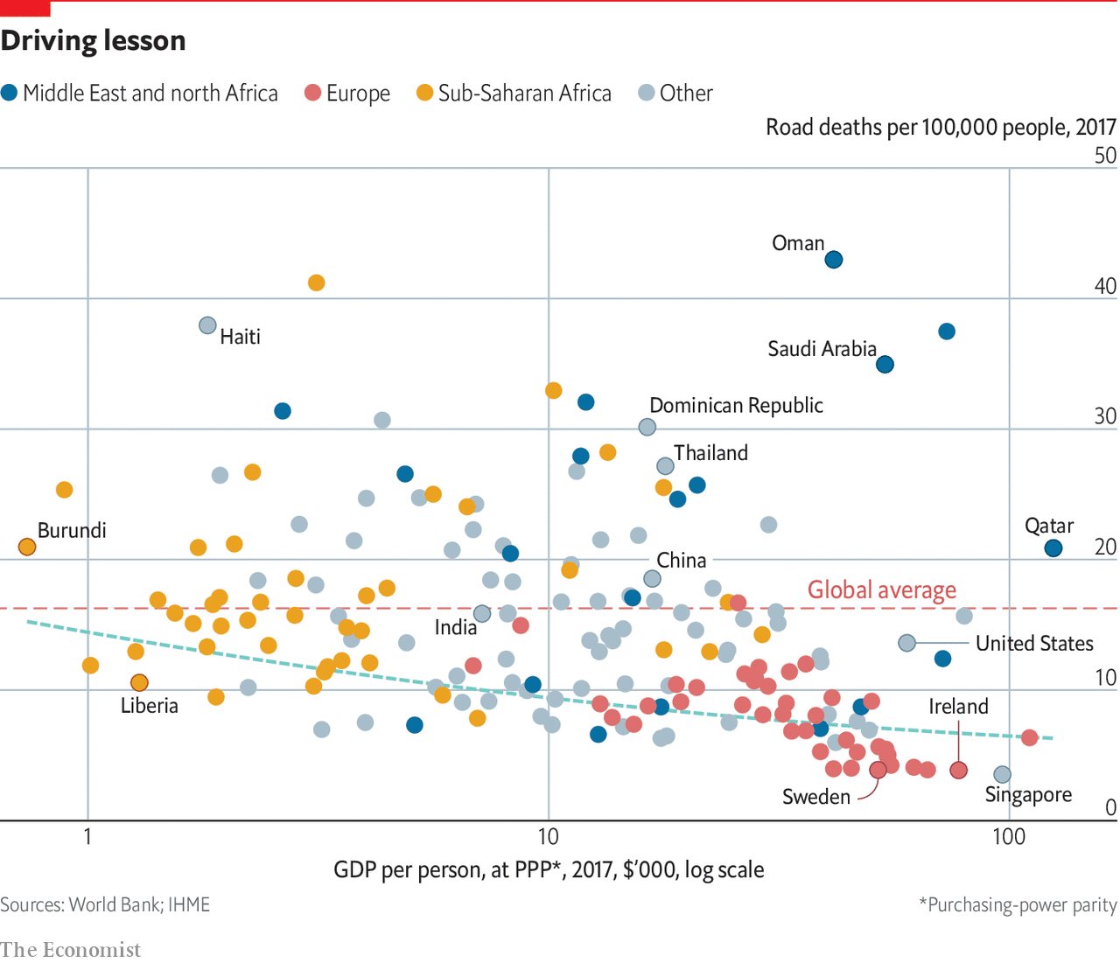

Slide 4
Arithmetic

Slide 5
Arithmetic Operators
Operation | Operator | Example | Value
Addition | + | 2 + 3 | 5
Subtraction | - | 2 - 3 | -1
Multiplication | * | 2 * 3 | 6
Division | / | 7 / 3 | 2.66667
Remainder | % | 7 % 3 | 1
Exponentiation | ** | 2 ** 0.5 | 1.41421
(Demo)

Slide 6
Ints and Floats
Python has two real number types
int: an integer of any size
float: a number with an optional fractional part
An int never has a decimal point; a float always does
A float might be printed using scientific notation
Three limitations of float values:
They have limited size (but the limit is huge)
They have limited precision of 15-16 decimal places
After arithmetic, the final few decimal places can be wrong

Slide 7
Arithmetic Question
Rank the results of the following expressions in order from least to greatest
3 * 10 ** 10
10 * 3 ** 10
(10 * 3) ** 10
10 / 3 / 10
10 / (3 / 10)
30000000000
590490
590490000000000
0.33333333333333337
33.333333333333336

Slide 8
Strings

Slide 9
Text and Strings
A string value is a snippet of text of any length
'a'
'word'
"there can be 2 sentences. Here's the second!"
Strings that contain numbers can be converted to numbers
int('12')
float('1.2')
Any value can be converted to a string
str(5)
(Demo)

Slide 10
Discussion Question
Assume you have run the following statements
x = 3
y = '4'
z = '5.6'
What's the source of the error in each example?
x + y
x + int(y + z)
str(x) + int(y)
str(x, y) + z

Slide 11
Exponential Growth

Slide 12
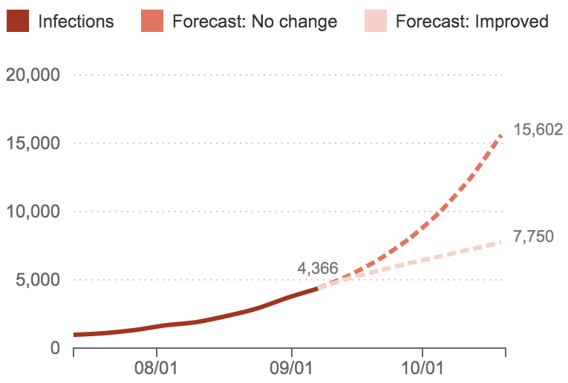
Ebola Epidemic, Sept. 2014
A Frightening Curve: How Fast Is The Ebola Outbreak Growing?
"It's spreading and growing exponentially," President Obama said.
"This is a disease outbreak that is advancing in an exponential fashion," said Dr. David Nabarro, who is heading the U.N.'s effort against Ebola.
http://www.npr.org/sections/goatsandsoda/2014/09/18/349341606/why-the-math-of-the-ebola-epidemic-is-so-scary
Source: Columbia Prediction of Infectious Diseases, World Health Organization

Slide 13
Growth Rate
The rate of increase per unit time
After one time unit, a quantity x growing at rate g will be
x * (1 + g)
After t time units, a quantity x growing at rate g will be
x * (1 + g) ** t
If after and before are measurements of the same quantity taken t time units apart, then the growth rate is
(after/before) ** (1/t) - 1
(Demo)

Slide 14
Arrays

Slide 15
Arrays
An array contains a sequence of values
All elements of an array should have the same type
Arithmetic is applied to each element individually
When two arrays are added, they must have the same size; corresponding elements are added in the result
A column of a table is an array
(Demo)

Slide 16
Ranges

Slide 17
Ranges
A range is an array of consecutive numbers
np.arange(end): An array of increasing integers from 0 up to end
np.arange(start, end): An array of increasing integers from start up to end
np.arange(start, end, step): A range with step between consecutive values
The range always includes start but excludes end

