Slide 1
Lecture 4
Building Tables
& Census

Slide 2
Announcements

Slide 3
Tables Review

Slide 4
Table Structure
A Table is a sequence of labeled columns
Labels are strings
Columns are arrays, all with the same length
Label
Name | Code | Area (m2)
California | CA | 163696
Nevada | NV | 110567
Row
Column

Slide 5
Ways to create a table
Table.read_table(filename) - reads a table from a spreadsheet
Table() - an empty table
and...

Slide 6
Arrays → Tables
Table().with_column(label, data) - creates a table with a single column; data is an array
Table().with_columns(label1, data1, ...) - creates a table, with an array of data for each column

Slide 7
Table Methods
Creating and extending tables:
Table().with_columns and Table.read_table
Finding the size: num_rows and num_columns
Referring to columns: labels, relabeling, and indices
labels and relabeled; column indices start at 0
Accessing data in a column
column takes a label or index and returns an array
Using array methods to work with data in columns
item, sum, min, max, and so on
Creating new tables containing some of the original columns:
select, drop

Slide 8
Examples
The table students has columns Name, ID, and Score.
Write one line of code that evaluates to:
A table consisting of only the column labeled Name
students.select('Name')
b) The largest score
students.column('Score').max()
max(students.column('Score'))

Slide 9
Minard's Map

Slide 10
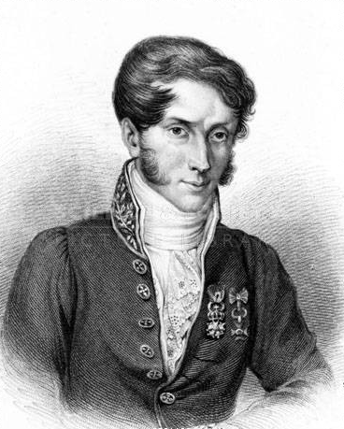
Charles Joseph Minard, 1781-1870
French civil engineer who created one of the greatest graphs of all time
Visualized Napoleon's 1812 invasion of Russia, including
the number of soldiers
the direction of the march
the latitude and longitude of each city
the temperature on the return journey
Dates in November and December

Slide 11
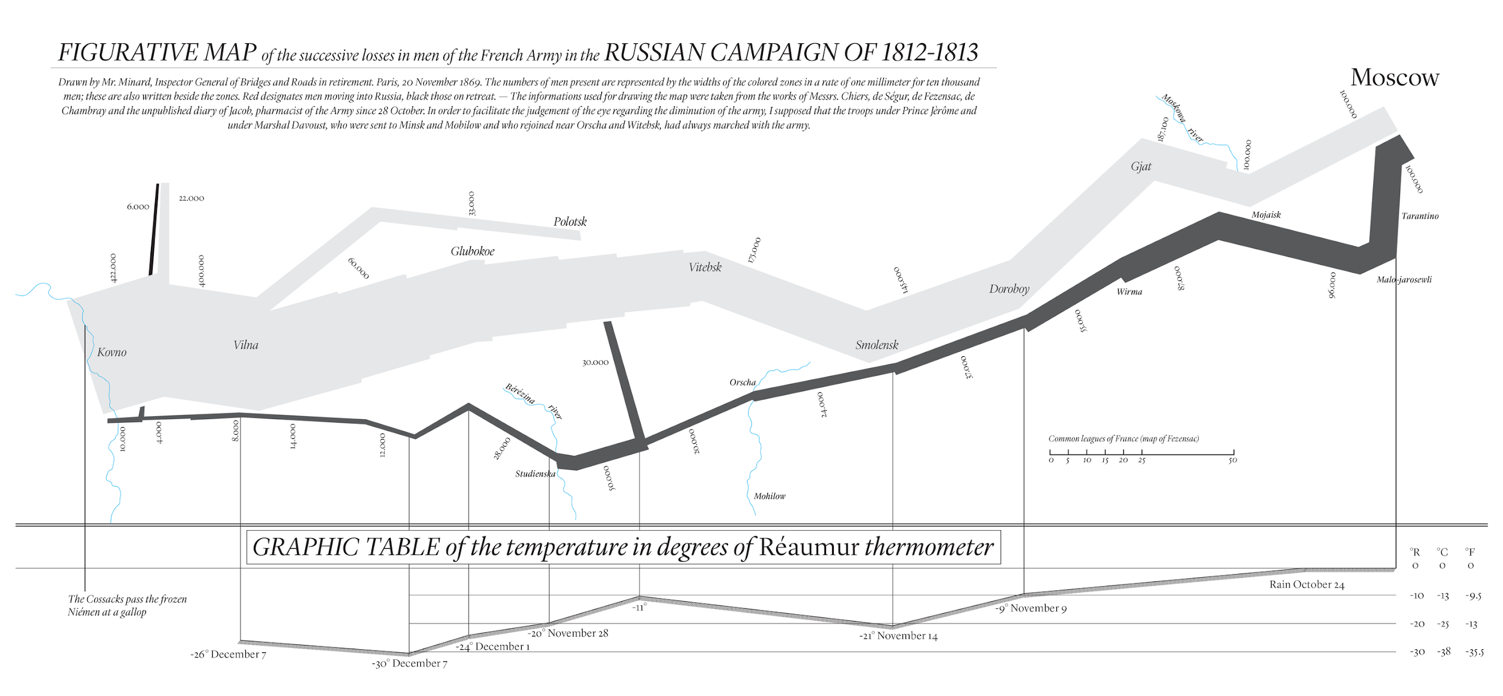
Visualization of 1812 March

Slide 12
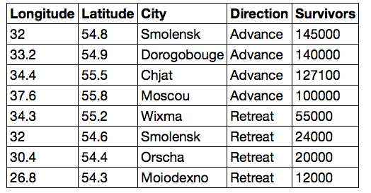
Different types of data
float:
decimal number
string:
text
int: integer

Slide 13
Lists

Slide 14
Lists are Generic Sequences
A list is a sequence of values (just like an array), but the values can all have different types
[2+3, 'four', Table().with_column('K', [3, 4])]
If you create a table column from a list, it will be converted to an array automatically
(Demo)

Slide 15
Take

Slide 16
Take Rows, Select Columns
The select method returns a table with only some columns
The take method returns a table with only some rows
Rows are numbered, starting at 0
Taking a single number returns a one-row table
Taking a list of numbers returns a table as well
(Demo)

Slide 17
The where method
t.where(label, condition) - constructs a new table with just the rows that match the condition
(Demo)

Slide 18
Manipulating Rows
t.sort(column) sorts the rows in increasing order
t.take(row_numbers) keeps the numbered rows
Each row has an index, starting at 0
t.where(column, are.condition) keeps all rows for which a column's value satisfies a condition
t.where(column, value) keeps all rows containing a certain value in a column
t.with_row makes a new table that has another row

Slide 19
Discussion Questions
The table nba has columns NAME, POSITION, and SALARY.
Create an array containing the names of all point guards (PG) who make more than $15M/year
nba.where(1, 'PG').where(2, are.above(15)).column(0)
b) After evaluating these two expressions in order, what's the result of the second one?
nba.with_row(['Samosa', 'Mascot', 100])
nba.where('NAME', are.containing('Samo'))

Slide 20
Census Data

Slide 21
The Decennial Census
Every ten years, the Census Bureau counts how many people there are in the U.S.
In between censuses, the Bureau estimates how many people there are each year.
Article 1, Section 2 of the Constitution:
“Representatives and direct Taxes shall be apportioned among the several States … according to their respective Numbers …”

Slide 22
Analyzing Census Data
Leads to the discovery of interesting features and trends in the population
(Demo)

Slide 23
Census Table Description
Values have column-dependent interpretations
The SEX column: 1 is Male, 2 is Female
The POPESTIMATE2010 column: 7/1/2010 estimate
In this table, some rows are sums of other rows
The SEX column: 0 is Total (of Male + Female)
The AGE column: 999 is Total of all ages
Numeric codes are often used for storage efficiency
Values in a column have the same type, but are not necessarily comparable (AGE 12 vs AGE 999)
http://www2.census.gov/programs-surveys/popest/datasets/2010-2015/national/asrh/nc-est2015-agesex-res.pdf

