Slide 1
Lecture 5
Charts and Histograms

Slide 2
Announcements

Slide 3
Data Visualization

Slide 4
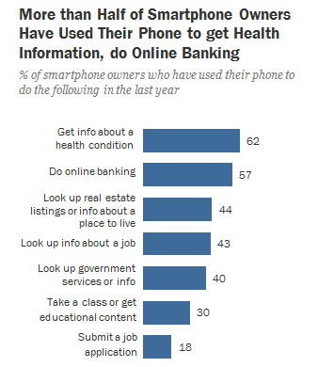
Discussion Question
Which of the following questions can be answered by this chart?
Among survey responders...
What proportion did not use their phone for online banking?
What proportion either used their phone for online banking or to look up real estate listings?
Did everyone use their phone for at least one of these activities?
Did anyone use their phone for both online banking and real estate?
Pew research center, 2014

Slide 5
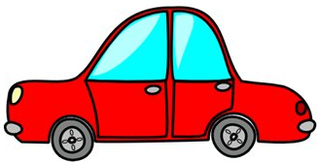
Area Principle
Areas should be proportional to the values they represent
In 2013,
30% of accidental deaths of males were due to automobile accidents
20% of accidental deaths of females were due to automobile accidents
0%
10%
20%
30%
Example from Tian Zheng

Slide 6
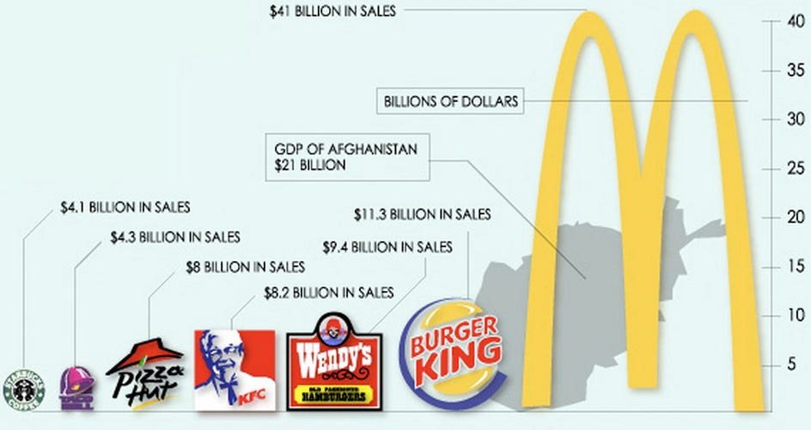

Slide 7
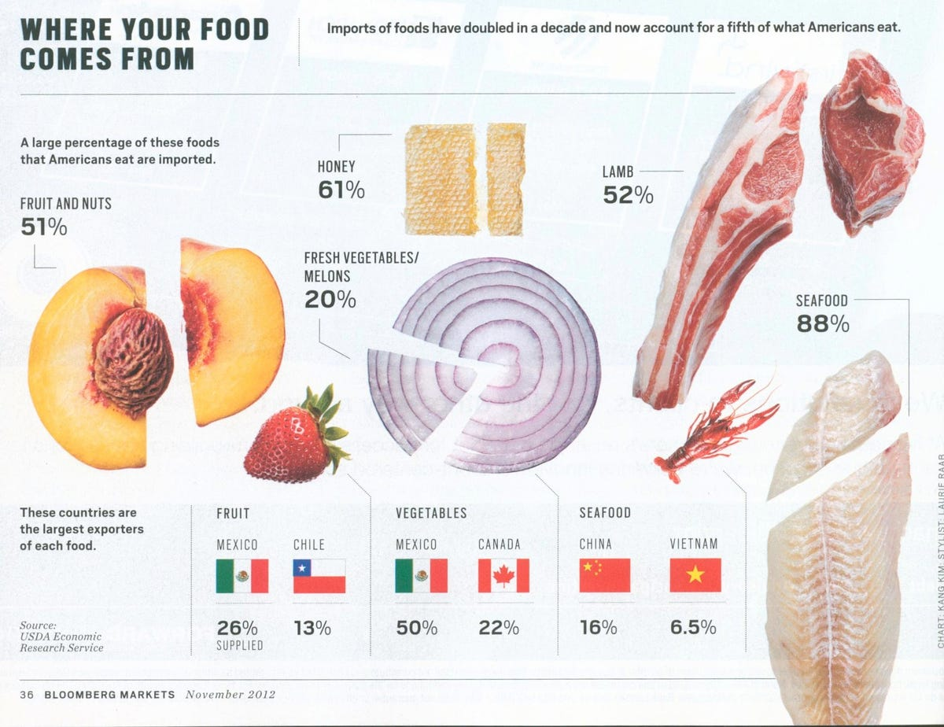

Slide 8
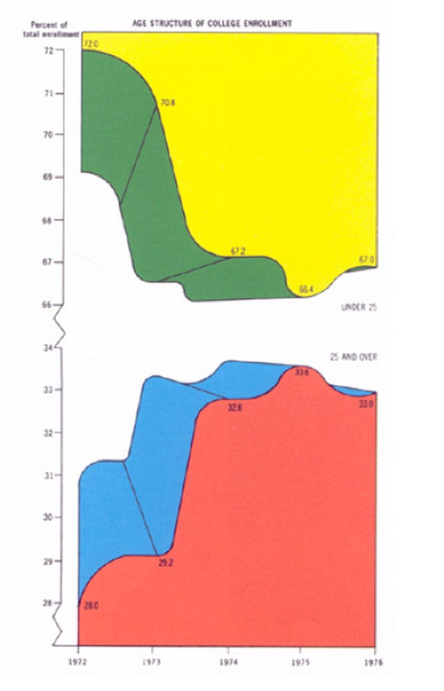

Slide 9
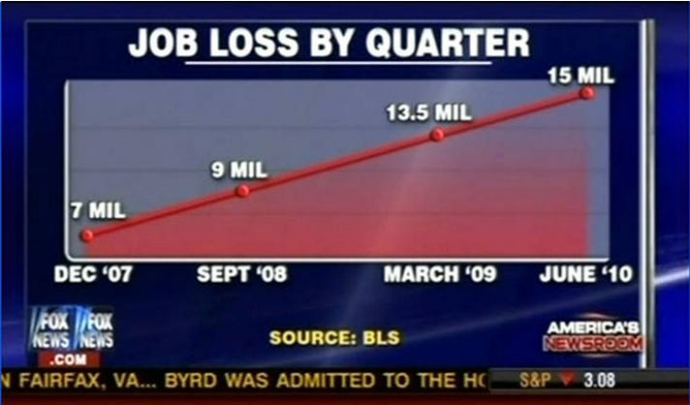

Slide 10
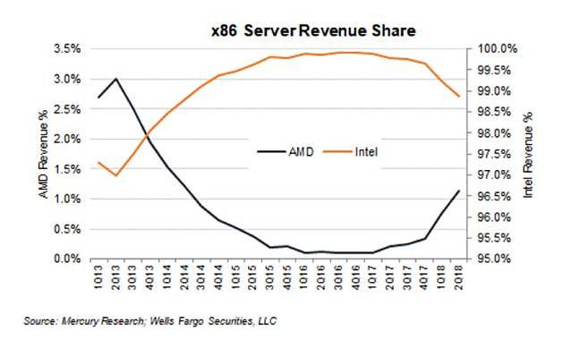

Slide 11
Numerical Data
(Demo)

Slide 12
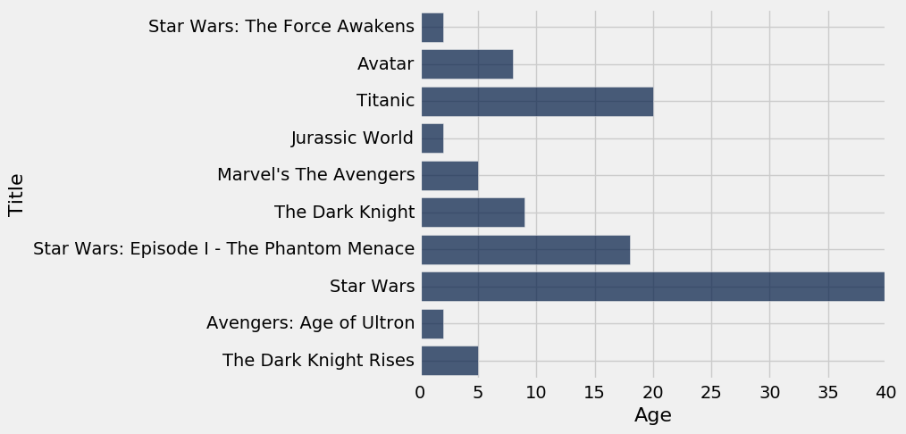
How Do You Generate This Chart?
Top 10 highest grossing movies
How long ago each one was released

Slide 13
Types of Data
All values in a column should be both the same type and be comparable to each other in some way
Numerical — Each value is from a numerical scale
Numerical measurements are ordered
Differences are meaningful
Categorical — Each value is from a fixed inventory
May or may not have an ordering
Categories are the same or different

Slide 14
“Numerical” Data
Just because the values are numbers, doesn’t mean the variable is numerical
Census example had numerical SEX code (0, 1, and 2)
It doesn’t make sense to perform arithmetic on these “numbers”, e.g. 1 - 0 or (0+1+2)/3 are nonsense here
The variable SEX is still categorical, even though numbers were used for the categories

Slide 15
Terminology
Individuals: those whose features are recorded
Variables: features; these vary across individuals
Variables have different values
Values can be numerical, or categorical, or of many other types
Distribution: For each different value of the variable, the frequency of individuals that have that value
Frequency is measured in counts. Later we will use proportions or percents.

Slide 16
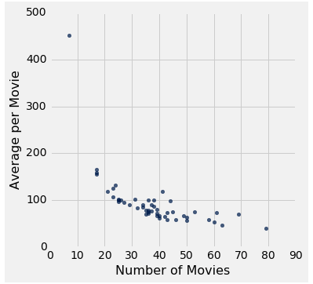
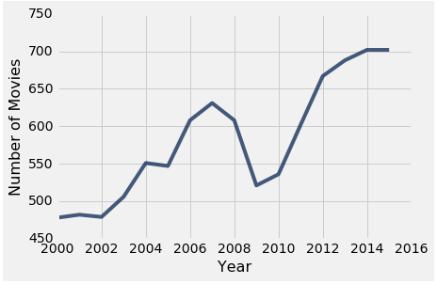
Plotting Two Numerical Variables
Scatter plot: scatter
Line graph: plot

Slide 17
Categorical Data
(Demo)

Slide 18
Bar Charts of Counts
Distributions:
The distribution of a variable (a column) describes the frequency of its different values
The group method counts the number of rows for each value in a column
Bar charts can display the distribution of categorical values
Proportion of how many US residents are male or female
Count of how many top movies were released by each studio
(Demo)

Slide 19
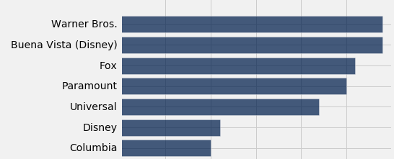
Categorical Distributions
bar chart: barh
Displays a categorical distribution
(But when the values of the variable have a rank ordering, or fixed sizes relative to each other, more care might be needed.)

Slide 20
Binning

Slide 21
Binning Numerical Values
Binning is counting the number of numerical values that lie within ranges, called bins.
Bins are defined by their lower bounds (inclusive)
The upper bound is the lower bound of the next bin
188, 170, 189, 163, 183, 171, 185, 168, 173, ...
The [185,190) bin
160
165
170
175
180
185
190

Slide 22
Histogram
Chart to display the distribution of numerical values using bins
(Demo)

Slide 23
The Density Scale

Slide 24
Histogram Axes
By default, hist uses a scale (normed=True) that ensures the area of the chart sums to 100%
The horizontal axis is a number line (e.g., years)
The vertical axis is a rate (e.g., percent per year)
The area of a bar is a percentage of the whole
(Demo)

Slide 25
How to Calculate Height
The [20, 40) bin contains 59 out of 200 movies
“59 out of 200” is 29.5%
The bin is 40 - 20 = 20 years wide
29.5 percent
Height of bar = --------------------------
20 years
= 1.475 percent per year

Slide 26
Height Measures Density
% in bin
Height = ---------------------
width of bin
The height measures the percent of data in the bin relative to the amount of space in the bin.
So height measures crowdedness, or density.
(Demo)

Slide 27
Area Measures Percent
Area = % in bin = Height x width of bin
“How many individuals in the bin?” Use area.
“How crowded is the bin?” Use height.

Slide 28
Discussion Question
Name | 2016 Income (millions)
Jennifer Lawrence | 61.7
Scarlett Johansson | 57.5
Angelina Jolie | 40
Jennifer Aniston | 24.75
Anne Hathaway | 24
Melissa McCarthy | 24
Bingbing Fan | 20
Sandra Bullock | 20
Cara Delevingne | 15
Reese Witherspoon | 15
Amy Adams | 15
Kristen Stewart | 12
Amanda Seyfried | 10.5
Tina Fey | 10.5
Julia Roberts | 10
Emma Stone | 10
Natalie Portman | 8.5
Margot Robbie | 8
Meryl Streep | 6
Mila Kunis | 4.5
What's the height of each bar in these two histograms?
actress.hist(1, bins=[0,15,25,85])
actress.hist(1, bins=[0,15,35,85])
What are the vertical axis units?

Slide 29
Chart Types

Slide 30
Bar Chart Versus Histogram
Bar Chart
1 categorical axis & 1 numerical axis
Bars have arbitrary (but equal) widths and spacings
For distributions: height (or length) of bars are proportional to the percent of individuals
Histogram
Horizontal axis is numerical, hence to scale with no gaps
Height measures density; areas are proportional to the percent of individuals

