Slide 1
Lecture 6
Functions

Slide 2
Announcements

Slide 3
Overlaid Graphs
For visually comparing two populations
(Demo)

Slide 4
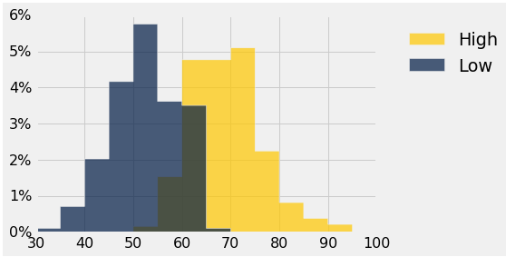
Discussion Question
This histogram describes a year of daily temperatures
Try to answer these questions:
What proportion of days had a high temp in the range 60-69?
What proportion had a low of 45 or more?
How many days had a difference of more than 20 degrees between their high & low temperatures?

Slide 5
Defining Functions

Slide 6
Def Statements
User-defined functions give names to blocks of code
Name
Argument names (parameters)
def spread(values):
return max(values) - min(values)
Return expression
Body
(Demo)

Slide 7
Discussion Question
What does this function do? What kind of input does it take? What output will it give? What's a reasonable name?
def f(s):
return np.round(s / sum(s) * 100, 2)
(Demo)

Slide 8
Apply

Slide 9
Apply
The apply method creates an array by calling a function on every element in input column(s)
First argument: Function to apply
Other arguments: The input column(s)
table_name.apply(function_name, 'column_label')
(Demo)

Slide 10
Example: Prediction

Slide 11
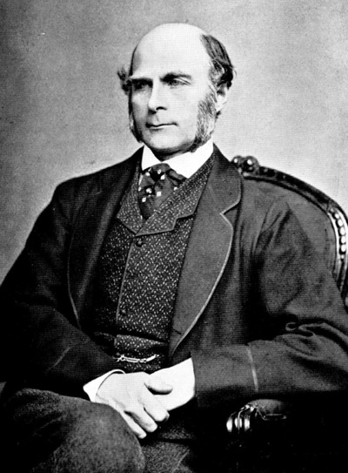
Sir Francis Galton
1822 - 1911 (knighted in 1909)
A pioneer in making predictions
Particular interest in heredity
Charles Darwin's half-cousin
(Demo)

Slide 12
Apply
The apply method creates an array by calling a function on every element in one or more input columns
First argument: Function to apply
Other arguments: The input column(s)
table_name.apply(one_arg_function, 'column_label')
table_name.apply(two_arg_function,
'column_label_for_first_arg',
'column_label_for_second_arg')
apply called with only a function applies it to each row
(Demo)

Slide 13
Grouping Rows

Slide 14
Group
The group method aggregates all rows with the same value for a column into a single row in the result
First argument: Which column to group by
Second argument: (Optional) How to combine values
len — number of grouped values (default)
sum — total of all grouped values
list — list of all grouped values
(Demo)

Slide 15
Pivot Tables

Slide 16
Pivot
Cross-classifies according to two categorical variables
Produces a grid of counts or aggregated values
Two required arguments:
First: variable that forms column labels of grid
Second: variable that forms row labels of grid
Two optional arguments (include both or neither)
values=’column_label_to_aggregate’
collect=function_with_which_to_aggregate
(Demo)

Slide 17
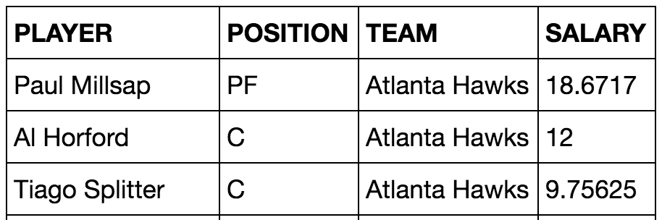
Challenge Question
Which NBA teams spent the most on their starters in 2016?
Each team has one starter per position
Assume the starter for a team & position is the player with the highest salary on that team in that position

