Slide 1
Lecture 10
Hypothesis Testing

Slide 2
Testing a Hypothesis
Step 1: Select Two Hypotheses
A test chooses between two views of how data were generated: Null hypothesis proposes a random process for how the data were generated that can be simulated; Alternative hypothesis proposes some other process
Step 2: Choose a Test Statistic
A value that can be computed from the data
Step 3: Compute What The Null Hypothesis Predicts
Compute the distribution of the test statistic under the null: what the test statistic might be if the null hypothesis were true.
Step 4: Compare the Prediction to the Observed Data

Slide 3
Hypothesis Testing Logic
Define 2 mutually exclusive descriptions: either this or that.
One of them can be evaluated using probability (the null hypothesis)
You can "reject the null," so then you “accept” the alternative.
Otherwise: you're still not sure, but null looks plausible.

Slide 4
Step 1: Select Two Hypotheses

Slide 5
Example: Jury
Swain vs. Alabama: 8 Black jurors out of 100 from a population that was 26% Black.
Jury selection is random from the population. If the observed distribution of jurors is different from the model, the difference is due to random chance.
Jury selection is not Random from the population.
Null
Alternative
(Demo)

Slide 6
Example: The Two Hypotheses
Gregor Mendel (1822-1884) was an Austrian monk and founder of the modern field of genetics. Among many experiments, he tested the hypothesis that pea plants will bear purple or white flowers at random, in the ratio 3:1.
Mendel’s model describes the world. If the distribution of the observed plants is different from the distribution in the model, it's just chance variation.
Mendel’s model doesn’t describe the world.
Null
Alternative
(Demo)

Slide 7
Example: Smoking and Babies
Researchers are interested in whether there is an association between smoking mothers and the health of their babies. For each birth, they record the baby's birth weight and whether the mother smokes or not.
Birth weights aren't affected by maternal smoking. The birthweight distribution for babies of smokers is same as that of babies of non-smokers.
They are affected.
Null
Alternative

Slide 8
Example: Smoking and Babies
Researchers are interested in whether there is an association between smoking mothers and the health of their babies. For each birth, they record the baby's birth weight and whether the mother smokes or not.
Birth weights aren't affected by maternal smoking. The birthweight distribution for babies of smokers is same as that of babies of non-smokers.
They are lower. Birthweight of babies of smokers are lower than birthweights of babies of non-smokers.

Slide 9
Step 2: Choose a Test Statistic

Slide 10
Absolute Values & Alternatives
Choose a test statistic where alternative hypothesis suggests which direction statistic will go.
Alternative: Smoking causes poor health.
Test statistic: Average birth weight for smokers, minus average for non-smokers.
Alternative: Smoking has some relation to health.
Test statistic: Absolute value of that difference.

Slide 11
Step 3: Compute the Distribution of the Test Statistic under the Null Hypothesis

Slide 12
Step 4: Compare the Prediction to the Observed Data

Slide 13
Conclusion of a Test
Resolve choice between null and alternative hypotheses
Compare observed test statistic to its empirical distribution under the null hypothesis
If the observed value is consistent with the distribution, then the test does not reject the null hypothesis
Whether a value is consistent with a distribution:
A visualization may be sufficient
Convention: The observed significance level (P-value)

Slide 14
Definition of P-value
The P-value is the chance,
under the null hypothesis,
that the test statistic
is equal to the value that was observed in the data or is even further in the direction of the alternative.

Slide 15
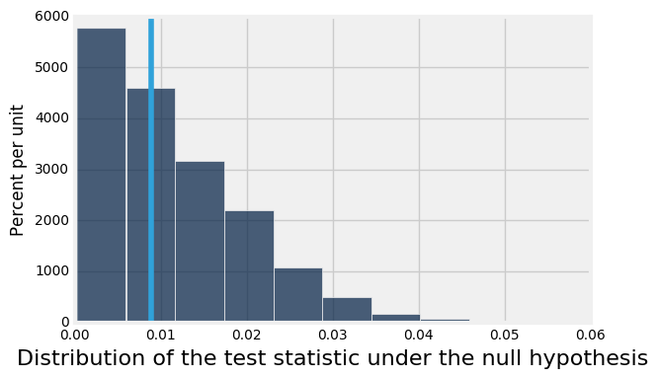
Quantifying Conclusions
P(the test statistic would be equal to or more extreme than the observed test statistic under the null hypothesis)
Evaluating Mendel's pea flower hypothesis
This area is the P-value (approximately)

Slide 16
Conventions of Consistency
“Inconsistent”: The test statistic is in the tail of the null distribution.
“In the tail,” first convention:
The area in the tail is less than 5%.
The result is “statistically significant.”
“In the tail,” second convention:
The area in the tail is less than 1%.
The result is “highly statistically significant.”

