Slide 1
A Dynamic Mixture Model to Detect Student Motivation and Proficiency
  Jeff Johns
  Autonomous
  Learning Laboratory
  Beverly Woolf
  Center for Knowledge
  Communication
  AAAI 7/20/2006

Slide 2
Agenda
Problem Statement
Proposed Model
Results
Conclusions and Future Work

Slide 3
Problem Statement
Background
  Develop a machine learning component for a geometry tutoring system used by high school students (SAT, MCAS)
  Focus on estimating the “state” of a student, which is then used for selecting an appropriate pedagogical action
Problem
  Currently using a model to estimate student ability, but…
  Students appear unmotivated in ~30% of problems
Solution
  Explicitly model motivation (as a dynamic variable) and student proficiency in a single model

Slide 4
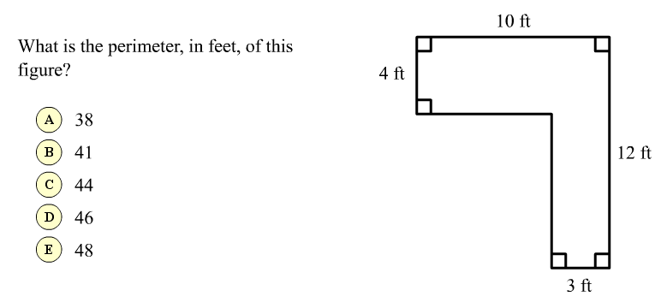

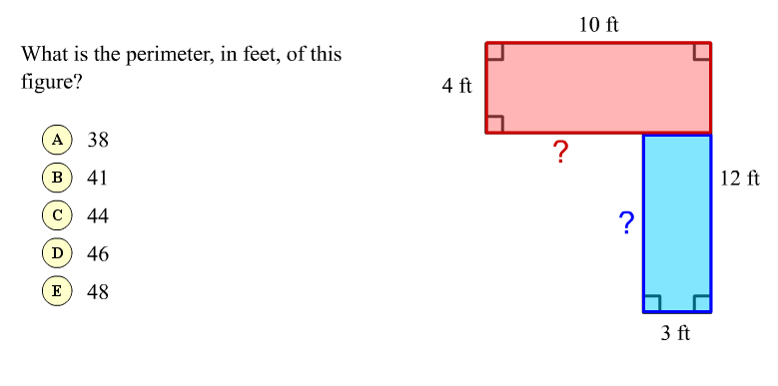
Wayang Outpost, a Geometry Tutor
wayang.cs.umass.edu

Slide 5
Low Student Motivation
Example: Actual data from a student performing 12 problems (green = correct, red = incorrect)
  Problems are of roughly equal difficulty
Student appears to perform well in beginning and worse toward the end
Conclusion: The student’s proficiency is average
…
1
2
3
4
5
6
7
8
9
10
11
12

Slide 6
Low Student Motivation
However, we come to a different conclusion when considering the student’s response time!
50
40
Time (s)
To First
Response
30
20
10
0
…
1
2
3
4
5
6
7
8
9
10
11
12

Slide 7
Low Student Motivation
Conclusion: Poor performance on the last five problems is due to low motivation (not proficiency)
50
40
Time (s)
To First
Response
30
Use observed data to infer motivation!
Student is unmotivated
20
10
0
…
1
2
3
4
5
6
7
8
9
10
11
12

Slide 8
Low Student Motivation
Opportunity for intelligent tutoring systems to improve student learning by addressing motivation
This issue is being dealt with on a larger scale by the educational assessment community
  Wise & Demars 2005. Low Examinee Effort in Low-Stakes Assessment: Potential Problems and Solutions. Educational Assessment.

Slide 9
Agenda
Problem Statement
Proposed Model
Results
Conclusions and Future Work

Slide 10
Combined Model
Jointly estimate proficiency and motivation in a single model
Item Response
Theory Model
+
Hidden Markov
Model
=
Combined
Model
Used to estimate
student proficiency
(continuous and
static variable)
Used to estimate
student motivation
(discrete and
dynamic variable)
More accurately
estimate proficiency
by accounting for
motivation
Design appropriate
interventions based
on motivation
estimate

Slide 11
Item Response Theory (IRT)
Random Variables
  U_{i} ∈ {correct, incorrect} student response to problem i
  θ ∈ ℜ^{k} student ability
    θ ~ MVN(0, I) (assume k=1)
Joint Probability = P(θ) ∏ P(U_{i} | θ)
  Problems are assumed independent
  Ability (θ) is a static variable
P(U_{i} | θ) is modeled using
an item characteristic curve
→
n
i=1
θ
U₁
U₂
U₃
…
U_{n}

Slide 12
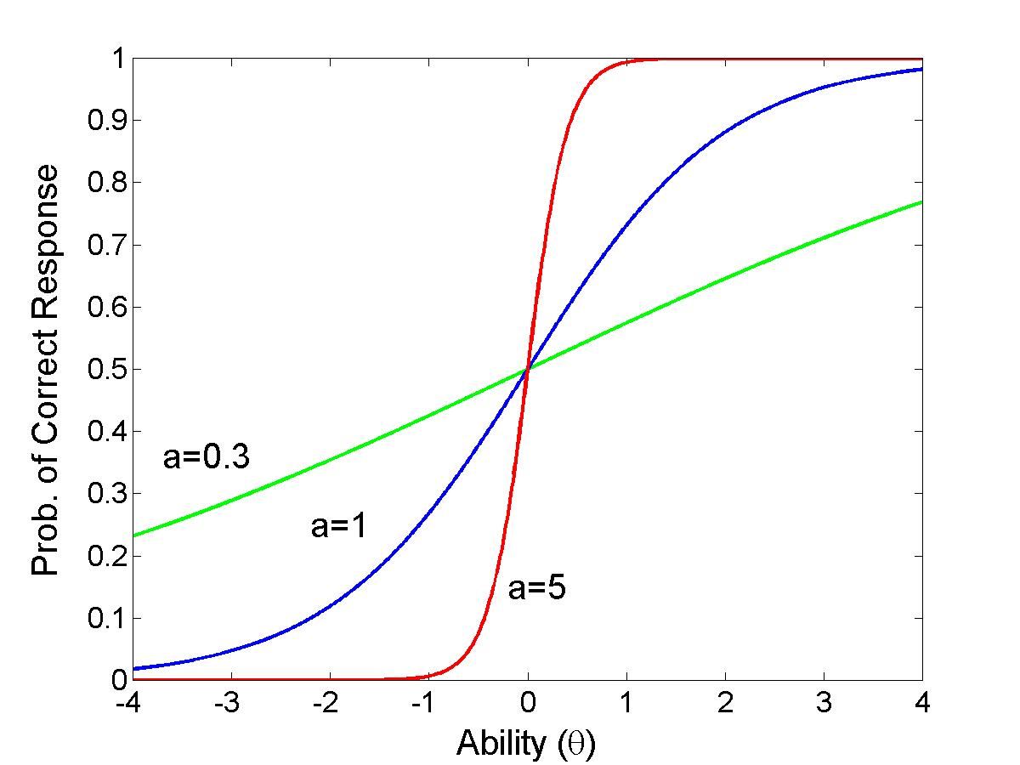
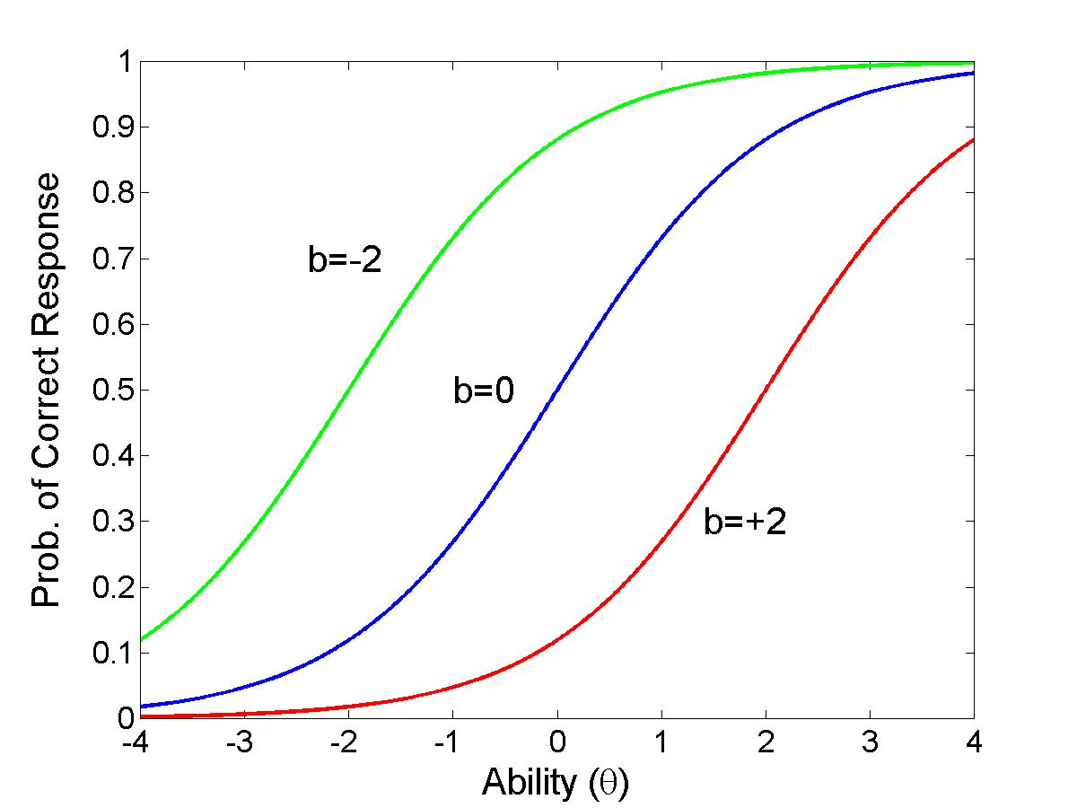
Item Characteristic Curve
Two parameter (a&b) logistic curve relating ability (θ) to the probability of a correct response
Prob. of correct response = [1 + exp(-a(θ–b))]⁻¹
Discrimination Parameter (a)
Difficulty Parameter (b)

Slide 13
Hidden Markov Model (HMM)
A HMM is used to capture a student’s changing behavior (level of motivation)
M₁
M₂
…
M_{n}
H₁
H₂
…
H_{n}
M_{i} (hidden) | H_{i} (observed)
Unmotivated – Hint | Time to first response < t_{min} AND Number of hints before correct response > h_{max}
Unmotivated – Guess | Time to first response < t_{min} AND Number of hints before correct response < h_{min}
Motivated | If other two cases don’t apply

Slide 14
Combined Model
New edges (in red) change the conditional probability of a student’s response: P(U_{i} | θ, M_{i})
M₁
M₂
…
M_{n}
H₁
H₂
…
H_{n}
Motivation (M_{i} ) affects student response (U_{i} )
U₁
U₂
…
U_{n}
θ

Slide 15
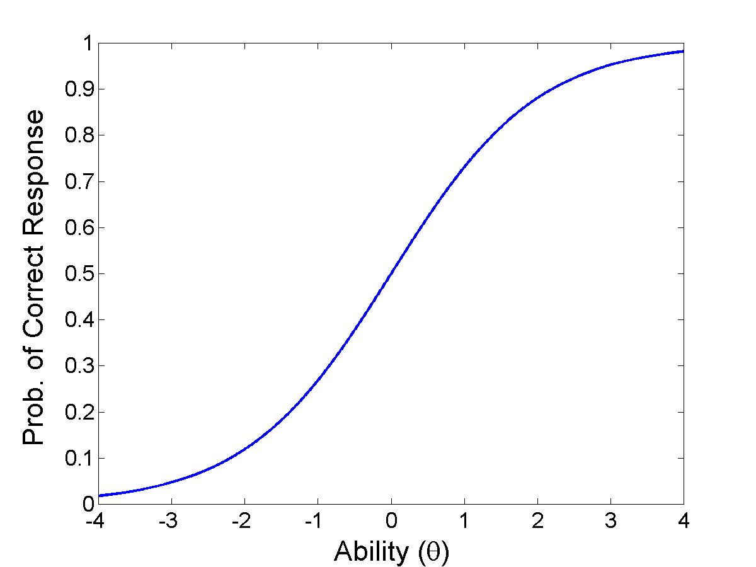
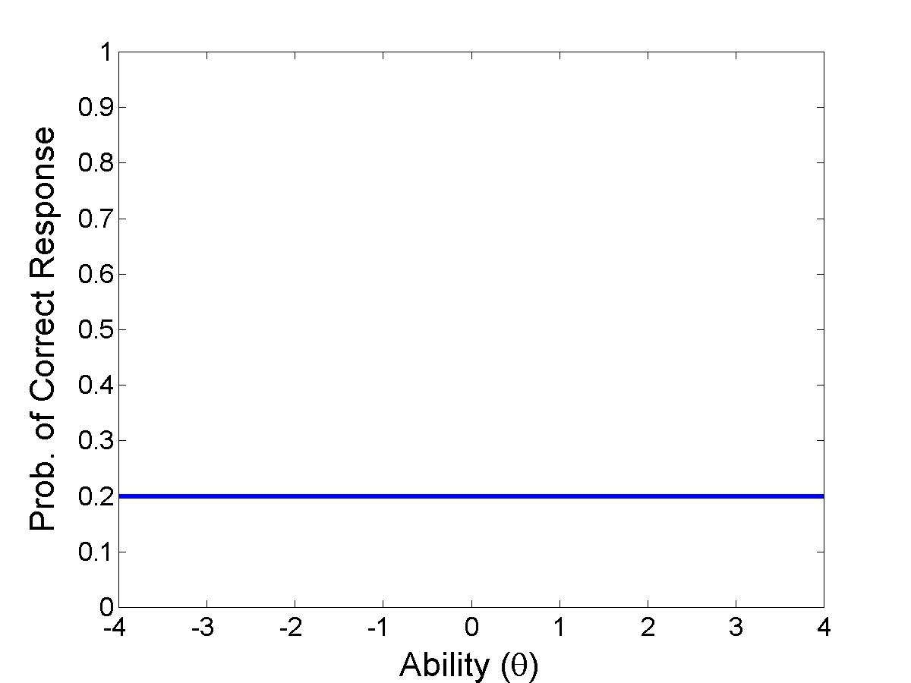
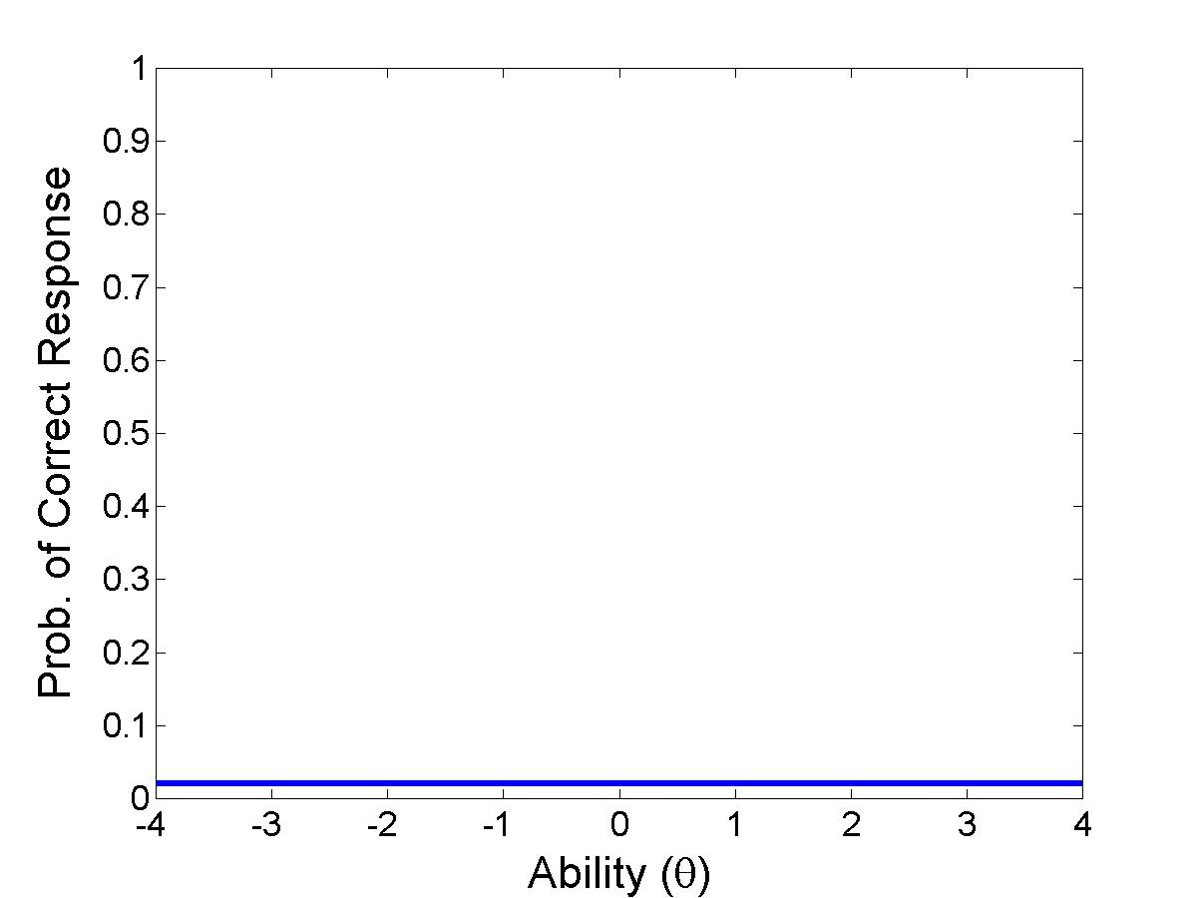
How Motivation Affects Response
P(U_{i} | θ, M_{i}) viewed as a mixture of behaviors (M_{i})
M_{i} = Unmotivated
(quick guess)
M_{i} = Unmotivated
(many hints)
M_{i} = Motivated

Slide 16
How Motivation Affects Response
P(U_{i} | θ, M_{i}) viewed as a mixture of behaviors (M_{i})
M_{i} = Unmotivated
(quick guess)
M_{i} = Unmotivated
(many hints)
M_{i} = Motivated
P(U_{i} | θ, M_{i}=motivated) =
[1 + exp(-a(θ–b))]⁻¹
IRT describes behavior

Slide 17
How Motivation Affects Response
P(U_{i} | θ, M_{i}) viewed as a mixture of behaviors (M_{i})
M_{i} = Unmotivated
(quick guess)
M_{i} = Unmotivated
(many hints)
M_{i} = Motivated
P(U_{i} | θ, M_{i}=motivated) =
[1 + exp(-a(θ–b))]⁻¹
IRT describes behavior
P(U_{i} | θ, M_{i}=unmotivated) = constant
Performance is independent of ability!

Slide 18
Parameter Estimation
Uses an Expectation-Maximization algorithm to estimate parameters
  M-Step is iterative, similar to the Iterative Reweighted Least Squares (IRLS) algorithm
Model consists of discrete and continuous variables
  Integral for the continuous variable is approximated using a quadrature technique
Only parameters not estimated
  P(U_{i} | θ, M_{i}=unmotivated-guess) = 0.2
  P(U_{i} | θ, M_{i}=unmotivated-hint) = 0.02

Slide 19
Agenda
Problem Statement
Proposed Model
Results
Conclusions and Future Work

Slide 20
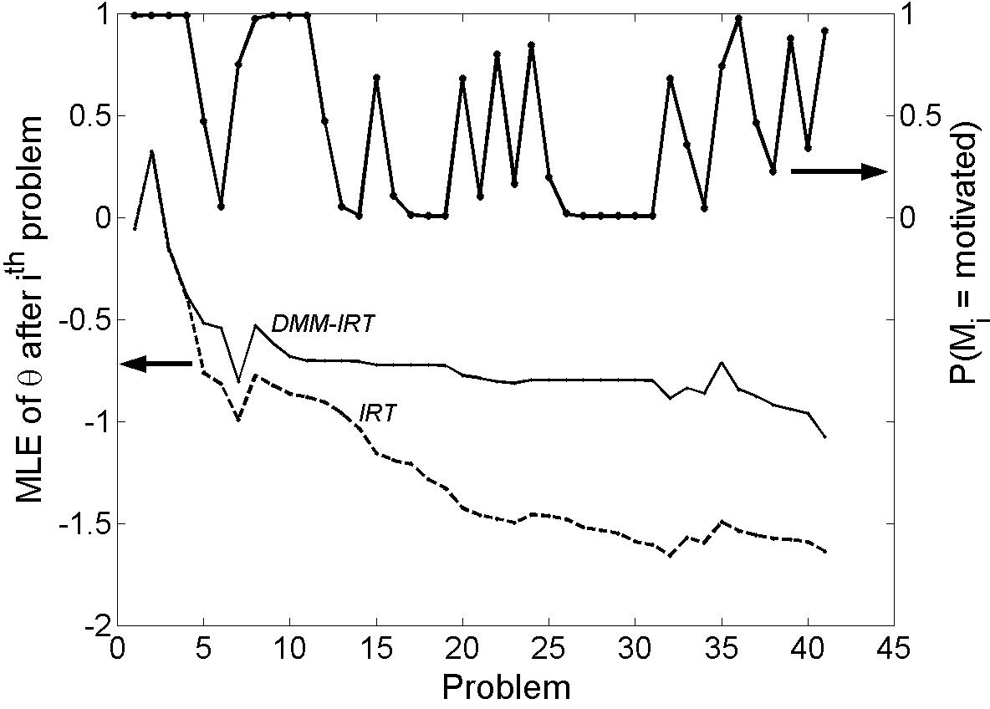
Modeling Ability and Motivation
Combined model does not decrease the ability estimate when the student is unmotivated

Slide 21
Modeling Ability and Motivation
Combined model does not decrease the ability estimate when the student is unmotivated
Combined model separates ability from motivation (IRT model lumps them together)

Slide 22
Experiments: Five-Fold Cross-Validation
Data: 400 high school students, 70 problems, a student finished 32 problems on average
Train the Model
  Estimate parameters
Test the Model
  For each student, for each problem:
    Estimate θ and P(M_{i}) via maximum likelihood
    Predict P(M_{i+1}) given HMM dynamics
    Predict U_{i+1}. Does it match actual U_{i+1}?
Compare combined model vs. just an IRT model

Slide 23
Results
Combined model achieved 72.5% cross-validation accuracy versus 72.0% for the IRT model
  Gap is not statistically significant
Opportunities for improving the accuracy of the combined model
  Longer sequences (per student)
  Better model of the dynamics, P(M_{i+1} | M_{i})

Slide 24
Agenda
Problem Statement
Proposed Model
Results
Conclusions and Future Work

Slide 25
Conclusions
Proposed a new, flexible model to jointly estimate student motivation and ability
  Not separating ability from motivation conflates the two concepts
  Easily adjusted for other tutoring systems
Combined model achieved similar accuracy to IRT model
Online inference in real-time
  Implemented in Java; ran it in one high school in May ’06

Slide 26
Future Work
Improve the combined model’s accuracy
  Tests with simulated students
  Better modeling of the dynamics, P(M_{i+1} | M_{i})
Create interventions to engage unmotivated students
Intervention 1
M_{i}
Intervention 2
M_{i+1}
Unmotivated
???
Intervention 3

