Slide 1
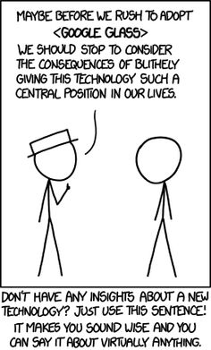
Today:
PA4 questions?
Go over Quiz
Finish talking about array examples
Start talking about sorting

