Slide 1
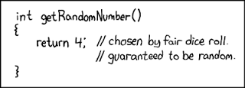

Log in and Sync your Repository!
Turn in Lab8
Static Classes
PA5
Reminder: Homework 8 due Wednesday

