Slide 1
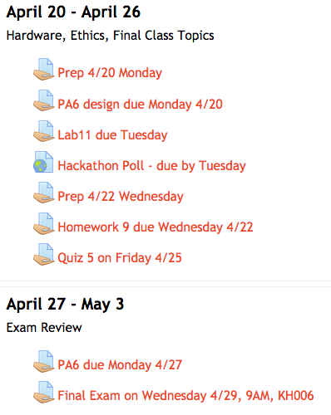

Upcoming Polls:
Hackathon for working on PA6
Extra Exam Review Session

Slide 2
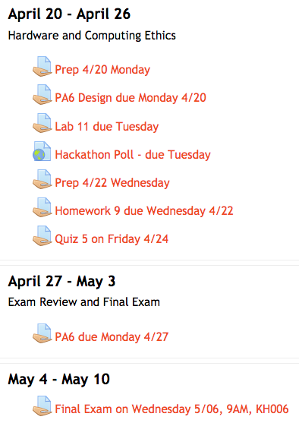
Upcoming Polls:
Hackathon for working on PA6
Extra Exam Review Session

