Slide 1
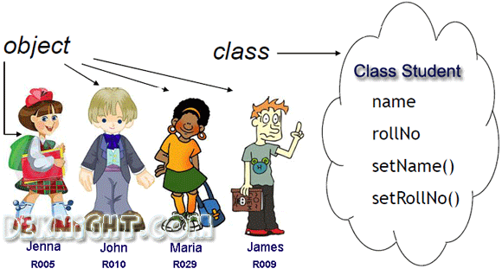
Sync your Class Examples repository
Late PA5s?
Go over Quiz 4

