Slide 1
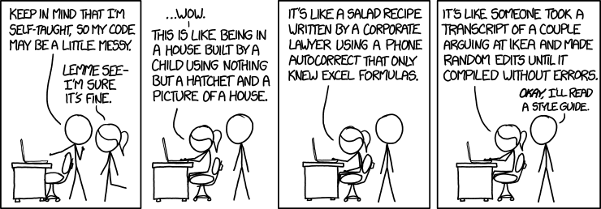
Extra credit quiz at end of class
PA6 due Monday
*** Don’t forget to take partner evaluation poll on Moodle (will be posted over the weekend)
Exam review poll due Monday

