Slide 1
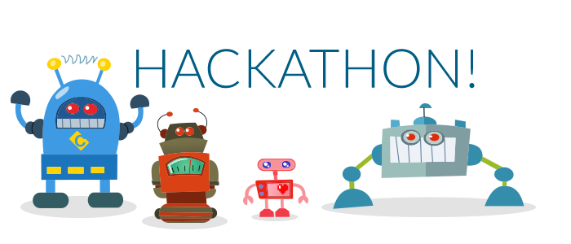
Take the poll for an extra exam review session
Hackathon for PA6 – Thursday 5-8PM,
Pizza!

Slide 2
Understand the basics in the breadth of computer science, such as ethical issues in computing, the hardware of computers, and human computer interaction
Design solutions to problems that can be solved using programming, via algorithms, flowcharts, and object-oriented design
Understand Java syntax well enough to use Java programming to solve problems involving:
Mathematical computation
Decision making
Repetition
Java classes
Arrays
Use an Integrated Development Environment (IDE) to enter, compile, and run simple programs
Use and create program documentation
Understand the meaning of programs and test their correctness appropriately

