Slide 1
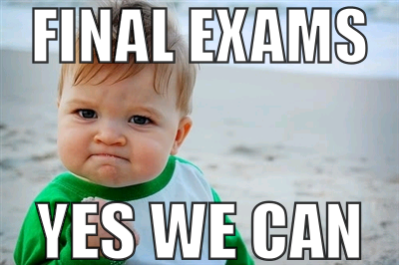
Extra Review Session: Next Tuesday 11-1 in DS121
Notes:
11AM section is next Tuesday 11-1

