Slide 1
CS201: Computer Science I
Spring 2015
Notes:
Welcome, will be a fun semester

Slide 2
Introductions
Name
Freshman, Sophomore, Junior, Senior, Other
Intended major (undecided is fine!)
The country you’d most like to visit
1 more fact about you

Slide 3
Who should take this class?
Notes:
Majors, non-majors, no prior knowledge expected – but it is fast paced and will take some work
Here have discussion of rest of first page of syllabus

Slide 4
Why Study Computer Science?
Notes:
(why are YOU interested in the course?)
Handout on why CS is awesome? And why skills are useful to non-majors?
All of the areas CS touches, both areas to work in as CS and areas in our lives where CS already exists

Slide 5



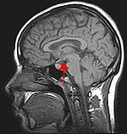
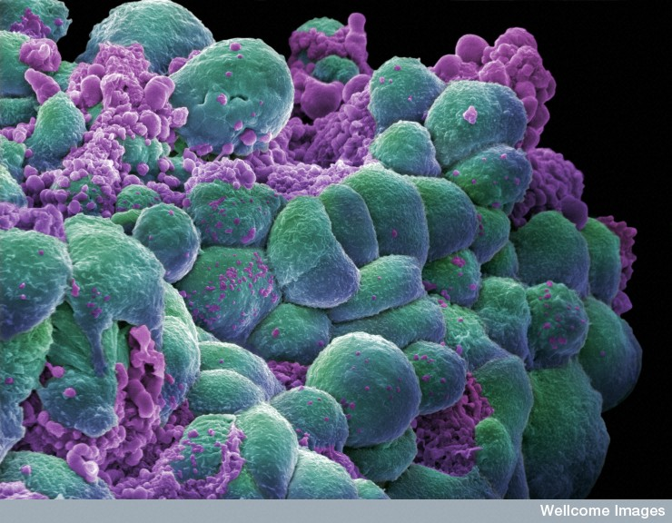
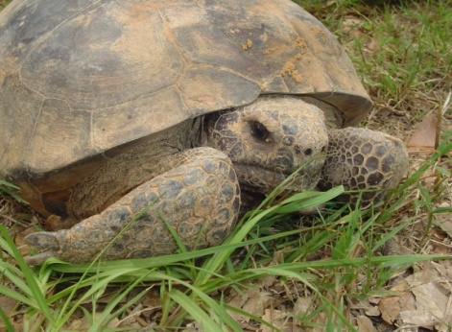



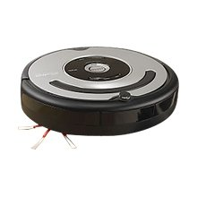
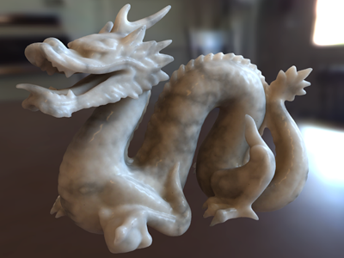

http://prisms.cs.umass.edu/dome/terrapinnet
http://www-cs.stanford.edu/research/
http://www.cs.umass.edu/~ruiwang/

Slide 6
What IS Computer Science?
The fundamental question underlying all of computer science is
“What information processing tasks can be efficiently automated?”

Slide 7
The Nine Subfields
Algorithms and data structures
Programming languages
Computer architecture
Operating systems
Software engineering
Numerical and symbolic computation
Database and information retrieval systems
Artificial Intelligence and robotics
Human Computer Interaction

Slide 8
Quick Writing Exercise

