Slide 1
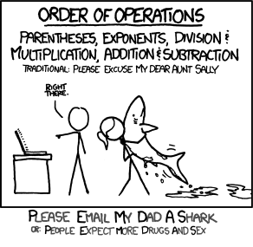
Turn in Lab 1 reflection
Discuss PA1 Design
Reminder: Homework 2 due Wednesday
New Tutor Hours on Moodle

