Slide 1
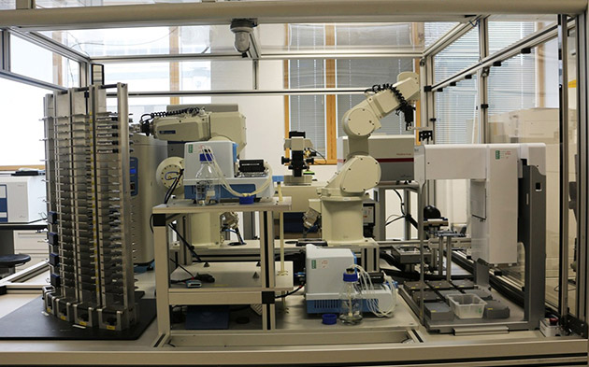
Eve – the robot scientist
“Every industry now benefits from automation and science is no exception. Bringing in machine learning to make this process intelligent…could greatly speed up scientific progress...”
Homework 4 due next Wednesday
PA2 Designs will be graded over the weekend

