Slide 1
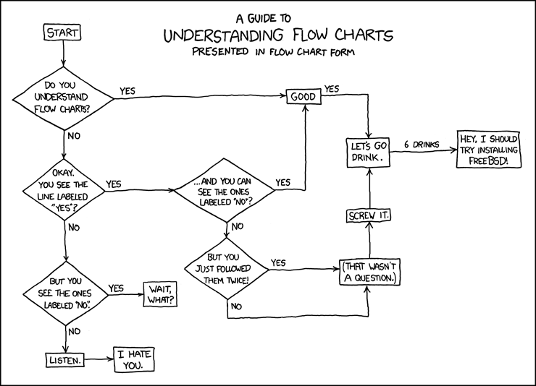
Get ready to turn in Homework 3 & Lab 2
Reminder: Quiz Wed, Pa2 design Fri
We’ll go over BMI first, then end of class we’ll go over PA2
xkcd.com

