Slide 1
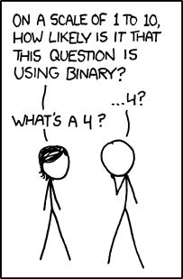
Today:
Collect late PA2
Collect Lab4
Snow announcements
New Homework

