Slide 1
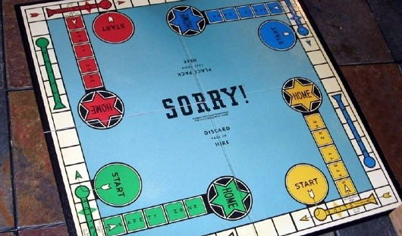
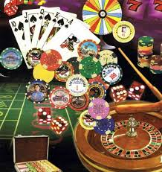

Go over Quiz 2
Randomness – You’ll be programming with a partner
Sync your ClassExamples repository
Discuss Midterm (Tuesday after spring break)

