Slide 1
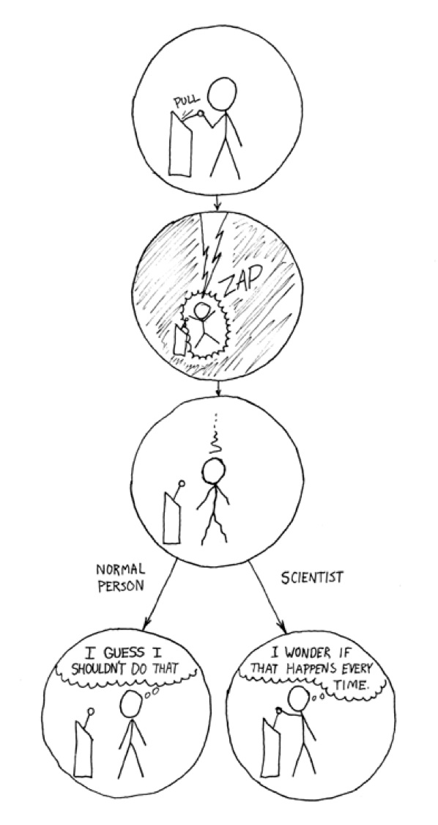
Today
PA3 Questions
Lab6 Questions
File I/O
Quiz 2

