Slide 1
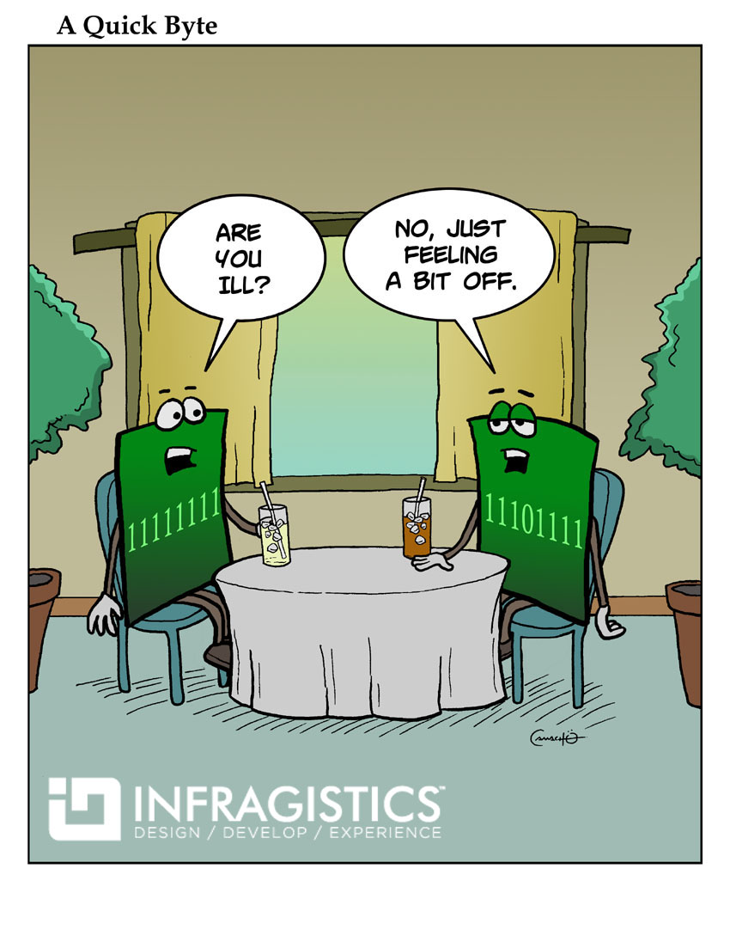
Log in and sync your ClassExamples repository
Get ready to turn in PA3
Homework 6 due Wednesday
We’ll finish loop notes before starting methods

