Slide 1
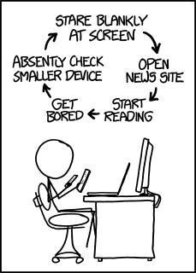
Thursday, 5:30, DS121: Back To School Night
Today’s office hours 1-3, I’ll be around after 5 too
Go over midterm
For Loops & Do While Loops!
Essence of Loops --------→

