Slide 1
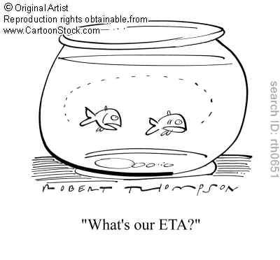
PA4 design due on Github
Questions on PA4?
Homework 6
Lab 6

