Slide 1
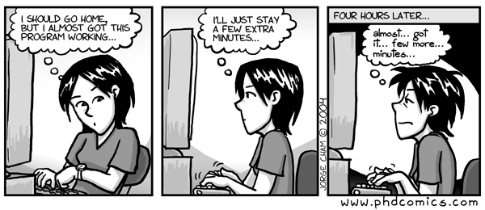
Log in and sync your ClassExamples repository
Turn in late PA3
Homework 6 due Wednesday
Homework 7 – 3/30
PA4 design - Friday

Slide 2
If you tend to sit in the back, I give no guarantee that you will hear me today. You may wish to move forward.

