Slide 1

Amrita Vishwa Vidyapeetham · School of Artificial Intelligence
Pyrolysis Advisor
Using physics + machine learning to get more bio-oil with less oxygen
Team 2: Mohalraj Shivanethran · Pranesh Subramanian · Srinath Balakrishnan · Umasuthan Palaniappan
Mentor: Dr. Akhil Mohan, Assistant Professor, School of Artificial Intelligence
Notes:
Introduce the team. One line: we built a tool that tells you which pyrolysis temperature and heating rate give more bio-oil with less oxygen.

Slide 2
THE PROBLEM
Bio-oil contains too much oxygen
Pyrolysis turns biomass into oil, but that oil is 31–52% oxygen — acidic, unstable and hard to use.
Biomass
Pyrolysis
Bio-oil
→
→
wood, husk, residue
heat to 400–600 °C
without air
plus char and gas
Our question: Which temperature and heating rate give the most oil with the least oxygen, for a given biomass?
Notes:
Bio-oil from pyrolysis carries a lot of oxygen, which makes it acidic and unstable and means it must be cleaned up later. Running the reactor at the right conditions can give more oil that already has less oxygen. That is the question we answer.

Slide 3
OUR APPROACH
Three steps: data → models → advice
1
2
3
Data
Physics + ML
Pyrolysis Advisor
2 published datasets
Predict oil yield and oxygen (O/C)
Recommends conditions
~1,270 pyrolysis experiments from the literature (Zhang 2022, Pascarella 2025)
Reaction-kinetics features feed XGBoost and Gaussian-process models
Suggests temperature and heating rate, and shows the yield vs oxygen trade-off
Notes:
Step 1: we used two public datasets compiled from published experiments. Step 2: we added physics — reaction-rate equations for how wood breaks down into gas, oil and char — as inputs to machine-learning models. Step 3: the Advisor searches many temperature and heating-rate settings and recommends the best balance.

Slide 4
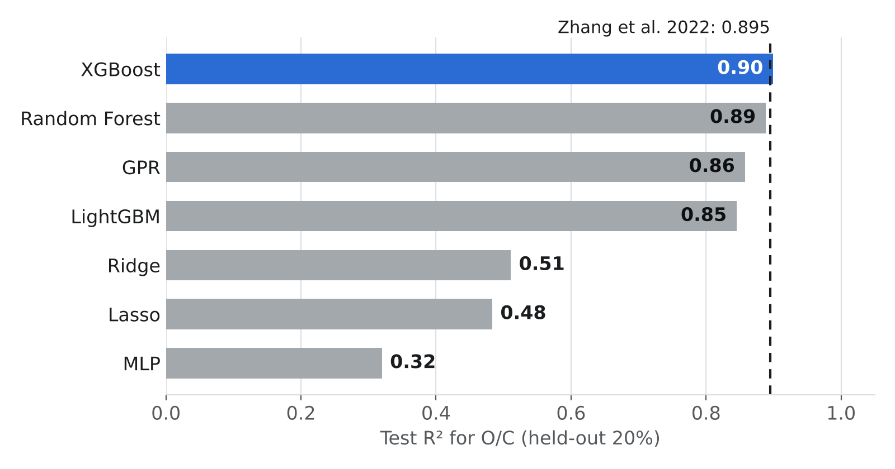
RESULT 1 · ACCURACY
As accurate as the published study
R² 0.90
Our best model (XGBoost) on unseen test data
0.895
Published result (Zhang et al. 2022)
R² = 1 means perfect prediction.
Notes:
We compared seven machine-learning models on the standard test used in the literature: train on 80 percent of the data, test on the other 20 percent. Our best model reaches R² 0.90 for the oxygen-to-carbon ratio, level with the published 0.895. R² of 1 would be perfect. On average over ten different random splits, the final Advisor models score about 0.61.

Slide 5
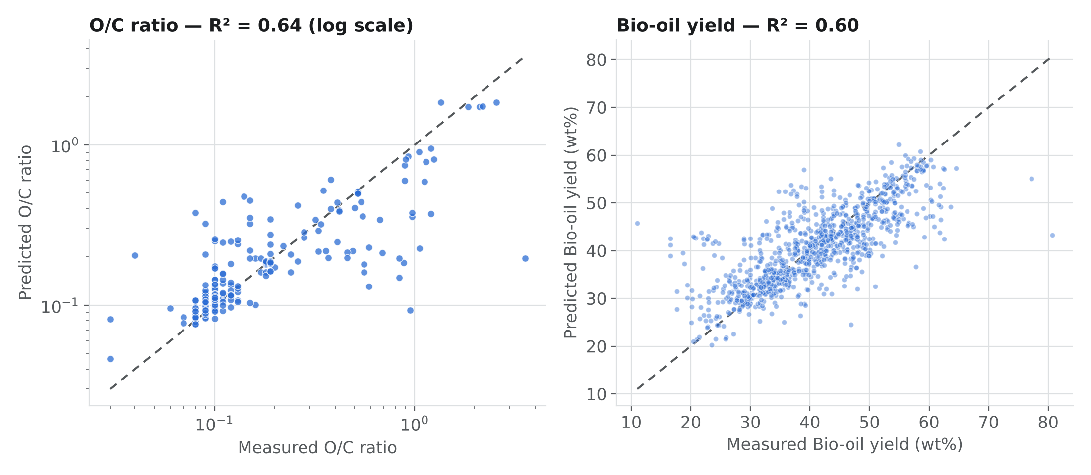
RESULT 2 · PREDICTIONS VS REALITY
Predictions follow the measured values
Each dot is one experiment. Dots on the dashed line = perfect prediction.
± 4 wt%
Typical error in predicted oil yield
18%
Typical error in predicted oxygen (O/C)
Notes:
These are the final models used inside the Advisor. Points close to the dashed line are good predictions. Oil yield is typically within about 4 wt%, and oxygen within about 18 percent.

Slide 6
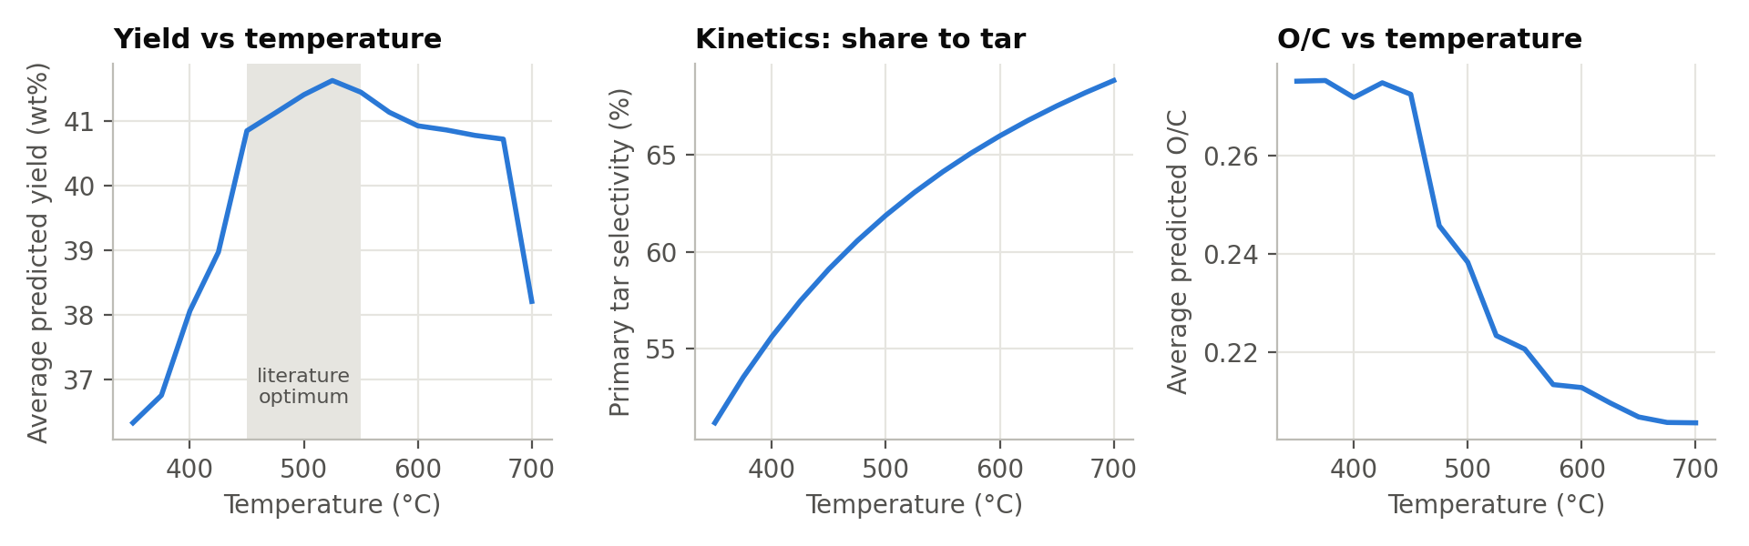
RESULT 3 · PHYSICS CHECK
The model behaves like real pyrolysis chemistry
Oil peaks at ~525 °C
Too hot → less oil
Hotter → less oxygen
matches the known best range (450–550 °C)
oil vapours crack into gas above ~600 °C
oxygen content always falls with temperature
Notes:
A good model should agree with known chemistry. Ours does: predicted oil yield peaks around 525 °C, inside the textbook best range; above about 600 °C yield drops because hot vapours crack into gas; and oxygen content always decreases as temperature rises.

Slide 7
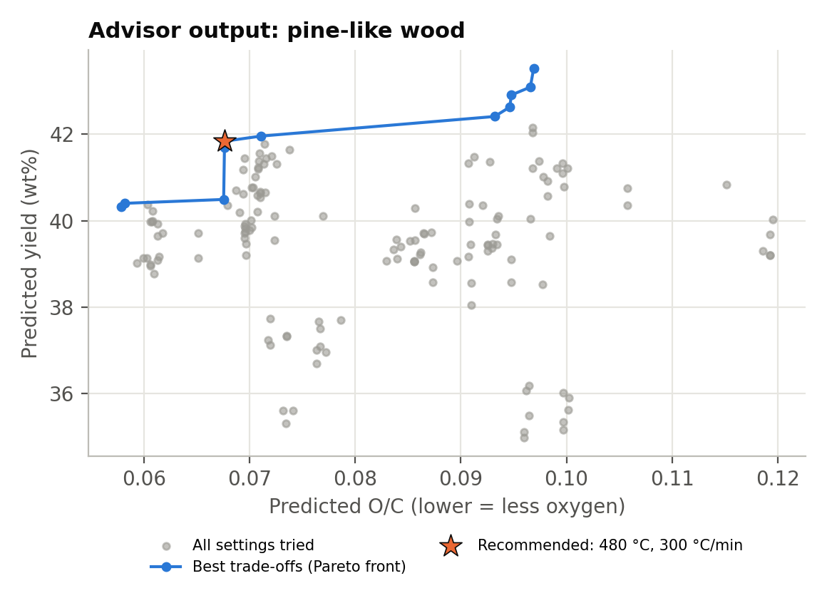
RESULT 4 · THE ADVISOR
It recommends the best reactor settings
Example: pine wood
RECOMMENDED
480 °C · 300 °C/min
41.8 wt% bio-oil
O/C 0.068 (low oxygen)
Max-yield option: 570 °C → 43.5 wt% oil, but O/C 0.097 (≈40% more oxygen)
Each dot is one setting the Advisor tested; the line is the best trade-off.
Notes:
The Advisor tests 156 combinations of temperature and heating rate. For pine it recommends 480 °C at 300 °C per minute: 41.8 wt% oil with low oxygen. Pushing for maximum yield gives only 1.7 wt% more oil but about 40 percent more oxygen, so the recommended setting is the better balance.

Slide 8
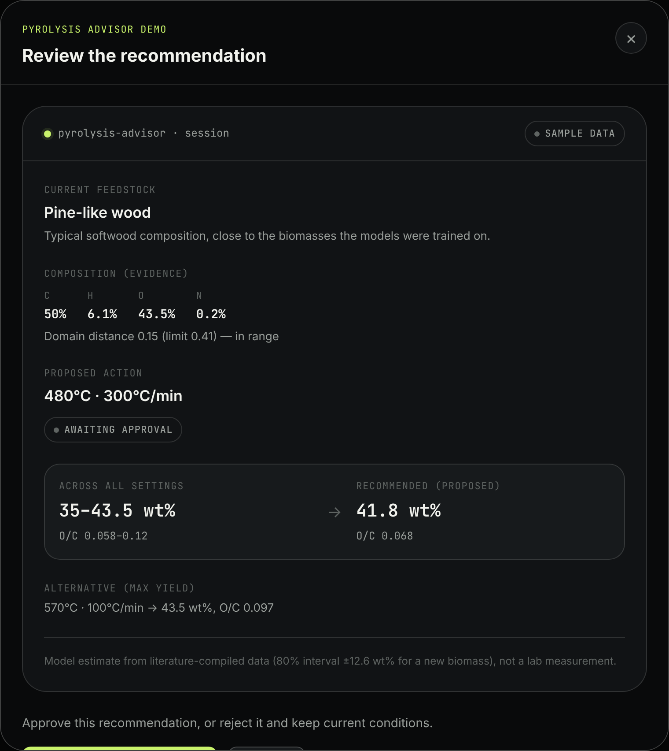
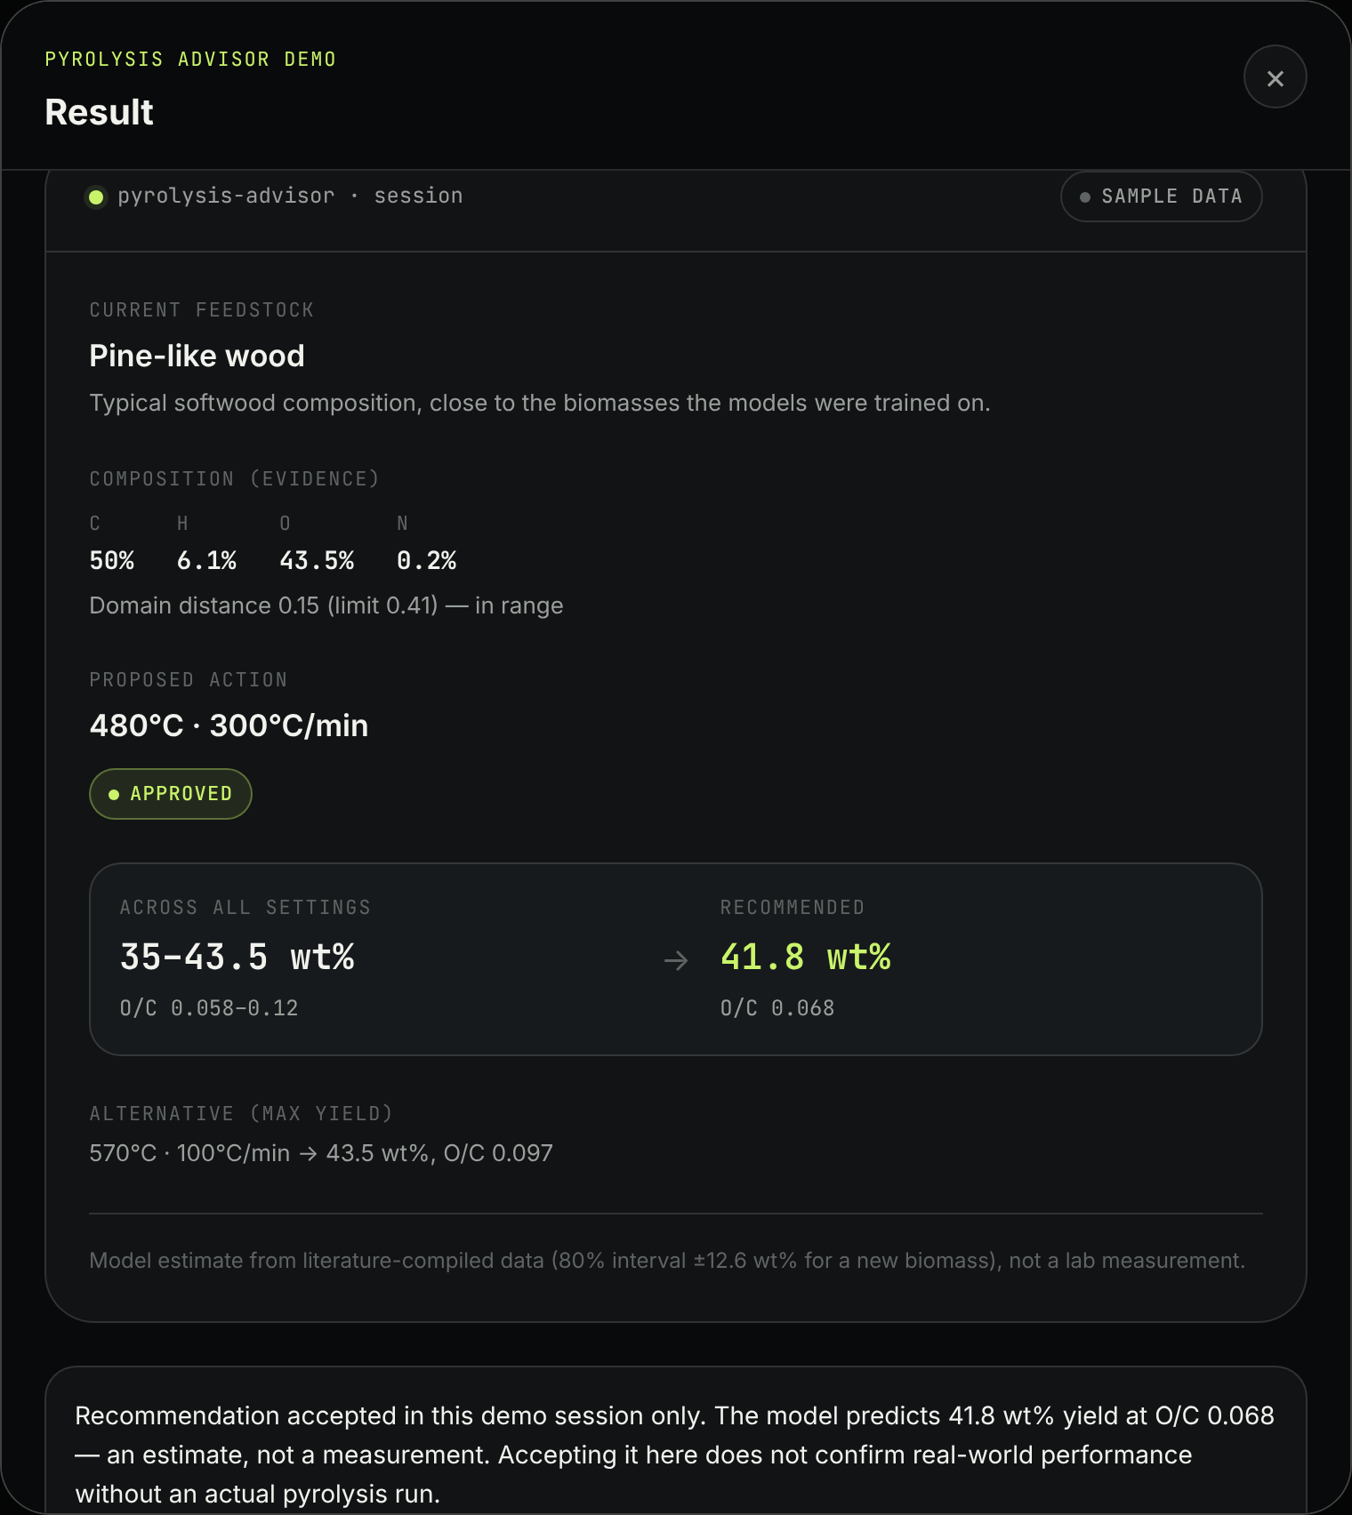
WORKING MODEL
Try it: the Advisor web app
1
Pick a biomass
2
See the recommended temperature and heating rate
3
Accept or reject — the result is shown
Notes:
This is the working web app. Show it live if you can: in the advisor-frontend folder run npm install and npm run dev, then open localhost:5173 and click Run the Advisor. It uses the trained models' pre-computed results for sample biomasses.

Slide 9
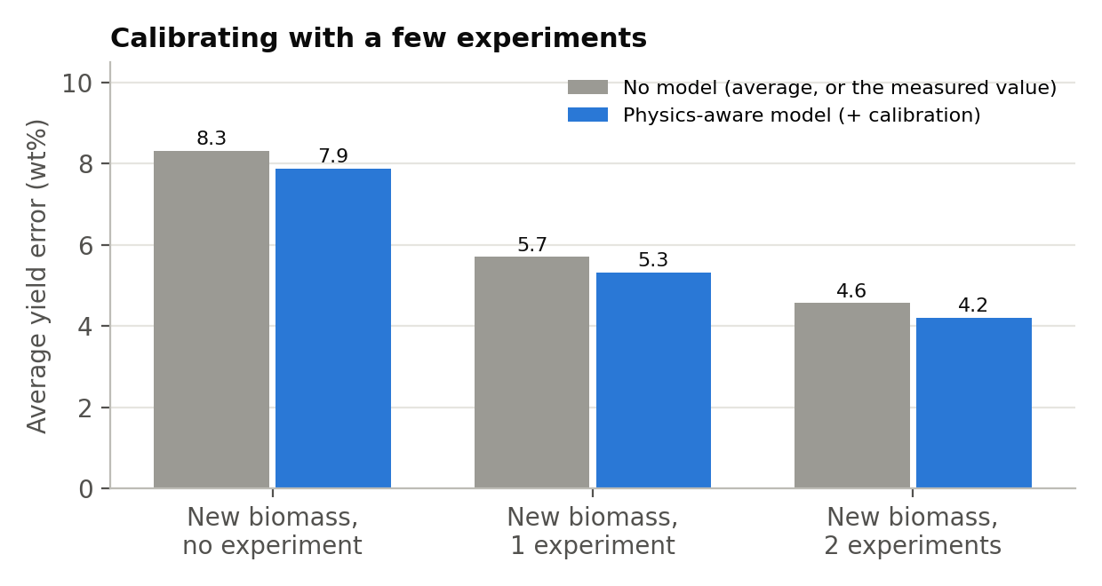
RESULT 5 · NEW BIOMASS
New biomass? One or two experiments improve it
Error in predicted oil yield for a biomass the model has never seen
8 → 5.3 → 4.2
Yield error (wt%) with 0, 1 and 2 real experiments
Brand-new biomass is the hardest case
The Advisor warns when a biomass is unlike its training data
Notes:
As a second, tougher test we hid whole biomasses from the model. Accuracy is lower in that case, so the Advisor lets you add one or two real experiments: average yield error drops from about 8 to 5.3 and then 4.2 wt%. It also warns you when a feedstock is very different from anything it was trained on.

Slide 10
SUMMARY
What we achieved
R² 0.90
Oxygen prediction as good as the published study
± 4 wt%
Typical error in predicted oil yield
✓ Physics
Model agrees with known pyrolysis chemistry
Web app
Advisor recommends temperature and heating rate
Thank you — questions?
github.com/umasuthanpalaniappan/BioOil-Automation
Notes:
Recap the four results. Next steps if asked: collect consistent data from a single reactor, and connect the web app directly to the live models.

