Slide 1

AMRITA VISHWA VIDYAPEETHAM · SCHOOL OF ARTIFICIAL INTELLIGENCE
PROJECT RESULTS
Physics-Aware ML for Bio-Oil Pyrolysis
Accurate, physics-consistent prediction models and a working Pyrolysis Advisor for higher yield and lower oxygen
TEAM 2
MENTOR
Mohalraj Shivanethran (AIM25020)
Pranesh Subramanian (AIM25030)
Srinath Balakrishnan (AIM25040)
Umasuthan Palaniappan (AIM25041)
Dr. Akhil Mohan
Assistant Professor, School of Artificial Intelligence
Notes:
Introduce the team and the project. One-line framing: we built physics-aware machine-learning models that predict bio-oil yield and oxygen content (O/C) from biomass composition and pyrolysis conditions, and turned them into a tool that recommends operating conditions.

Slide 2
OUTCOMES AT A GLANCE
Three things this project delivers
01
02
03
Accurate prediction
Physics-aware models
A working Advisor
O/C model reaches R² 0.90 on the standard literature test, matching Zhang et al. (0.895). Yield models reach R² up to 0.69.
Final yield and O/C models built on kinetics-based features and physical constraints that behave like real pyrolysis.
A web tool that recommends temperature and heating rate and shows the yield/oxygen trade-off.
Data: Zhang et al. 2022 (O/C, 122 biomasses) and Pascarella et al. 2025 (yield, ~160 studies)
Notes:
These are the three outcomes. Everything after this slide is evidence for one of them. Datasets: Zhang 2022 for O/C ratio, Pascarella 2025 compiled dataset for yield.

Slide 3
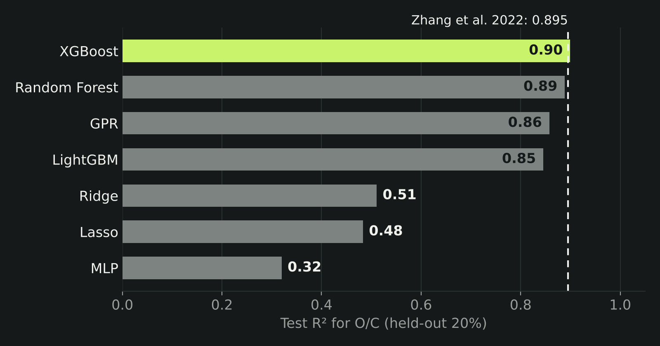
RESULT 1 · PREDICTION ACCURACY · TEST 1 (STANDARD 80/20 SPLIT)
Our O/C model matches the published benchmark
R² 0.90
XGBoost O/C on the held-out 20% test set
0.895
Zhang et al. (2022) published O/C result
7 models compared · 232 samples · physics-informed features
Notes:
Test 1 follows the standard approach in the literature, including Zhang et al. 2022: train on 80 percent of the rows, test on the held-out 20 percent. Our XGBoost model with physics-informed features reaches R² 0.90 for O/C, level with the published 0.895. Seven model types were compared; tree ensembles and GPR all exceed 0.85. Without the physics features XGBoost scored 0.886. Scores vary from split to split, so the next slide also reports averages over ten random splits.

Slide 4
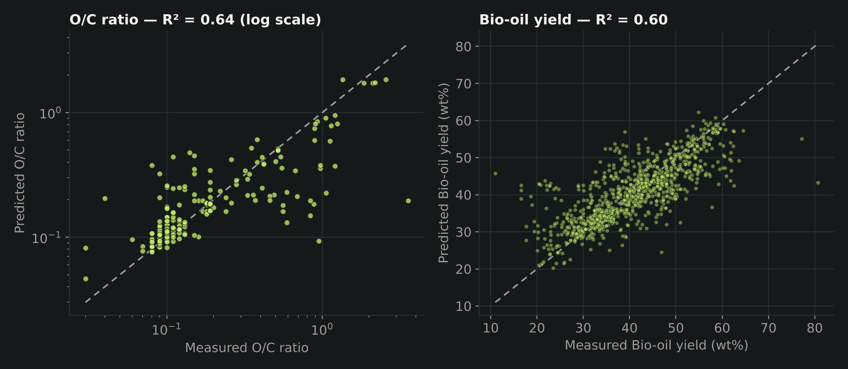
RESULT 2 · FINAL ADVISOR MODELS · TEST 1
Predicted vs measured for the final models
R² 0.61
O/C (log scale), mean of 10 random splits; best split 0.85; typical error 18%
R² 0.61
Yield, mean of 10 random splits; best 0.67; error 4.2 wt%
Yield model (random split) | R² | MAE
Random Forest | 0.69 | 3.8 wt%
XGBoost | 0.66 | 4.2 wt%
GPR | 0.60 | 4.2 wt%
Notes:
These are the final models used inside the Advisor, scored the literature way on random splits. Each dot is a sample predicted while it was held out. O/C averages R² 0.61 on a log scale, with a typical error of 18 percent; yield averages 0.61 with a mean error of 4.2 wt%. The table shows the single-algorithm yield models on the same splits, up to 0.69 for Random Forest. The final models trade a little raw accuracy for physics constraints and better behaviour on new biomass.

Slide 5
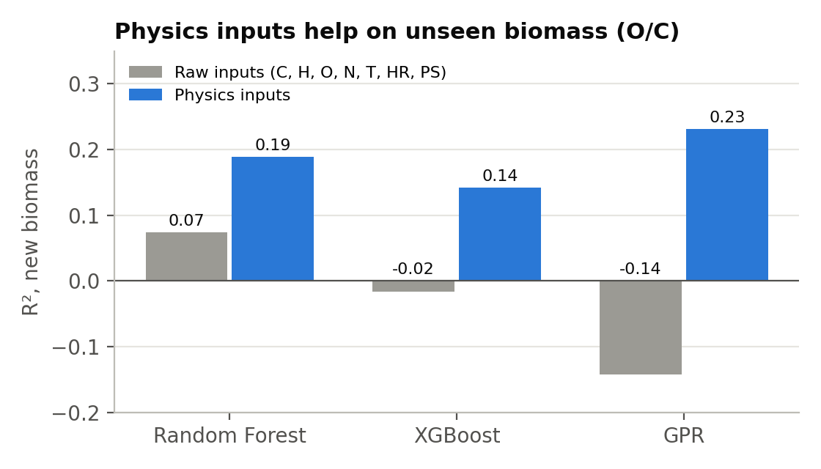
RESULT 3 · PHYSICS FEATURES
Physics-informed features improve every model
0.43 → 0.63
−0.14 → 0.23
GPR O/C R², Test 1: raw → physics inputs
Same model, Test 2 (unseen biomass)
Chan et al. (1985) Arrhenius kinetics: wood → gas / tar / char
Kinetic tar share and pyrolysis number at each temperature
Heating-regime and thermal-severity indices
Molar O/C, H/C and effective H/C of the feedstock
Figure: Test 2 (unseen biomass), raw vs physics inputs
Notes:
Adding physics features improved O/C prediction for every model in both tests: GPR goes from 0.43 to 0.63 on the standard test, and from below zero to 0.23 on unseen biomass. The features encode known reaction chemistry rather than raw numbers only.

Slide 6
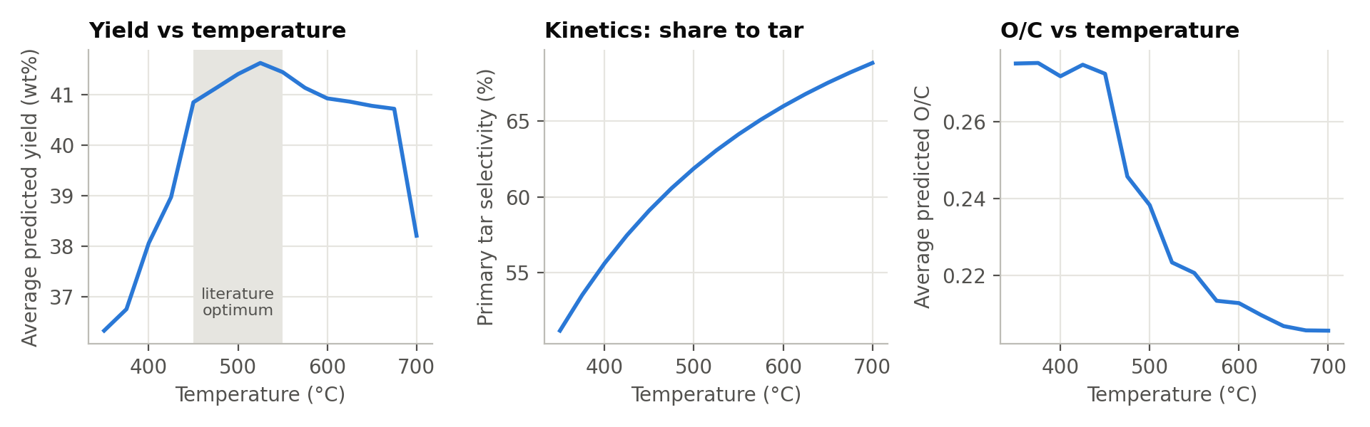
RESULT 4 · PHYSICS CONSISTENCY
The final models behave like real pyrolysis
525°C
51% → 69%
0.28 → 0.21
Yield peak (41.6 wt%) — inside the literature 450–550°C optimum
Tar selectivity rises 350→700°C, explaining the yield drop from vapour cracking
O/C falls with temperature — stronger deoxygenation, never violated
Notes:
Sanity check against chemistry. Average predicted yield peaks at 525 °C, matching the known optimum. Above about 600 °C the yield falls, consistent with secondary cracking of vapours — the model learned this two-step behaviour from data. O/C decreases monotonically with temperature, guaranteed by a constraint.

Slide 7
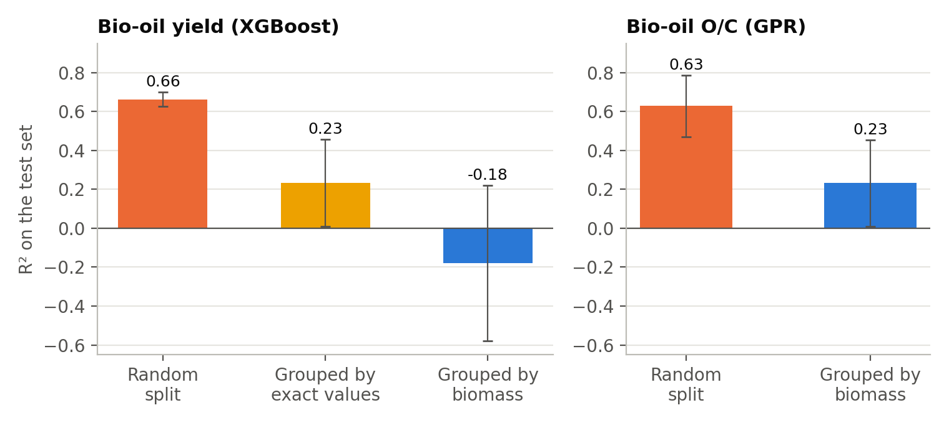
TEST 2 · STRICTER CHECK ON UNSEEN BIOMASS
Second test: a biomass the model has never seen
0.23
O/C R² when whole biomasses are held out (GPR)
0.66 → −0.18
Yield R², Test 1 → Test 2 (XGBoost)
Most published studies stop at Test 1. Holding out whole biomasses is harder, and the drop tells us when to calibrate with real experiments.
Figure: test R² for Test 1 (random split) vs Test 2 (grouped by biomass)
Notes:
As an extra robustness check we also tested the harder case: every sample of a biomass goes to either train or test, never both. This mimics a user bringing a completely new feedstock. Scores drop, as expected, because yield varies a lot between labs and reactors in compiled data. That is why the Advisor reports an uncertainty band and lets the user calibrate with one or two real experiments, shown next.

Slide 8
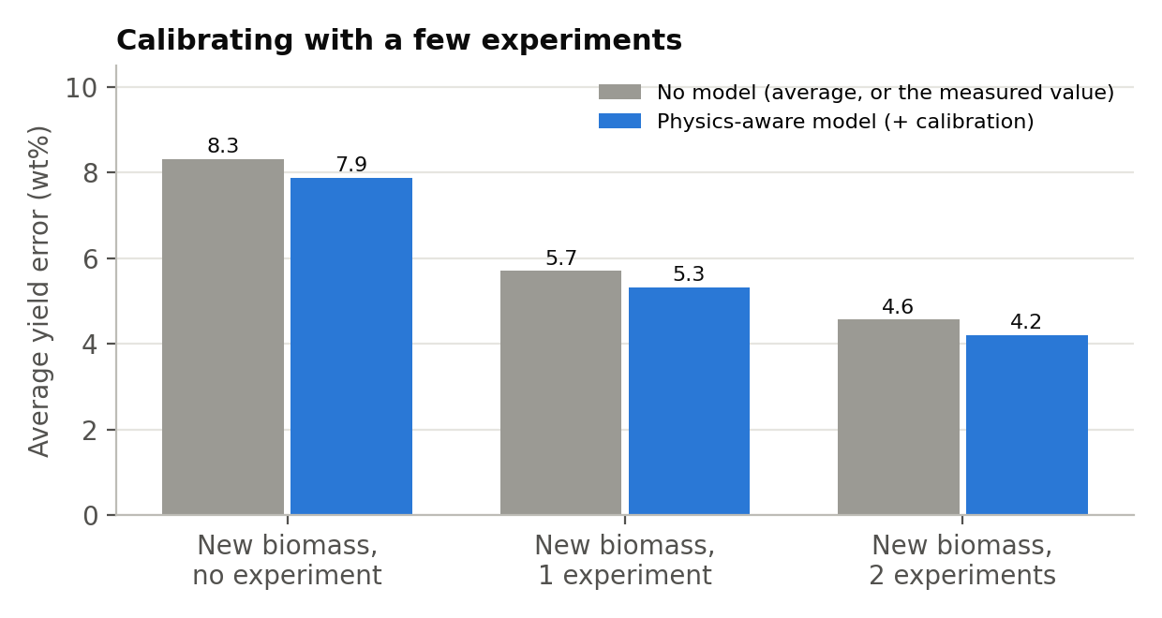
RESULT 5 · UNCERTAINTY AND CALIBRATION
One or two real experiments sharply cut the error
~8 → 5.3 → 4.2
Average yield error (wt%) with 0, 1, 2 calibration experiments
±12.6 wt%
80% interval for a brand-new biomass (Test 2) with no experiments
Calibrated model beats simply reusing the measured value (5.7, 4.6 wt%) because it adds the learned response to conditions.
Notes:
For a completely new biomass (Test 2 setting) the 80 percent interval is about plus or minus 12.6 wt%. After one real experiment, error drops to 5.3 wt%; after two, to 4.2. That is better than just reusing the measured point. For O/C the measured value alone was slightly better, which we state openly.

Slide 9
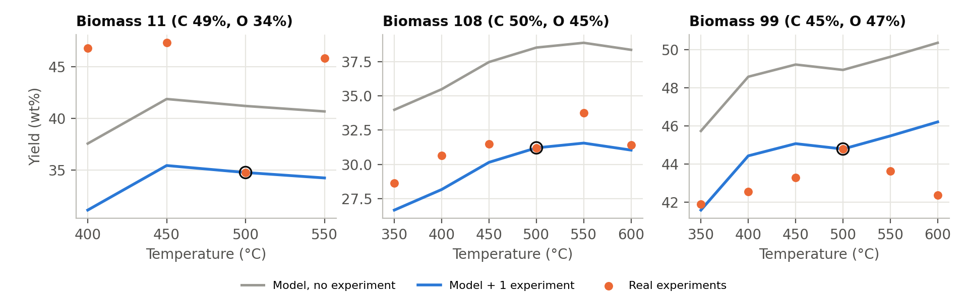
RESULT 6 · CASE STUDIES
Correct optimum temperature for 2 of 3 unseen biomasses
Biomass | Real best T | Model best T | Error, 0 exp. | Error, 1 exp.
11 (C 49%, O 34%) | 450°C | 450°C ✓ | 6.6 wt% | 13.0 wt%
108 (C 50%, O 45%) | 550°C | 550°C ✓ | 5.6 wt% | 1.7 wt%
99 (C 45%, O 47%) | 500°C | 600°C | 6.0 wt% | 1.9 wt%
Notes:
These three biomasses were withheld entirely from training. With zero experiments, the model picked the correct optimum temperature for two of them. One calibration point cut the error under 2 wt% for biomasses 108 and 99. For biomass 11 the calibration point was an outlier, which made things worse — lesson: calibrate with at least two points.

Slide 10
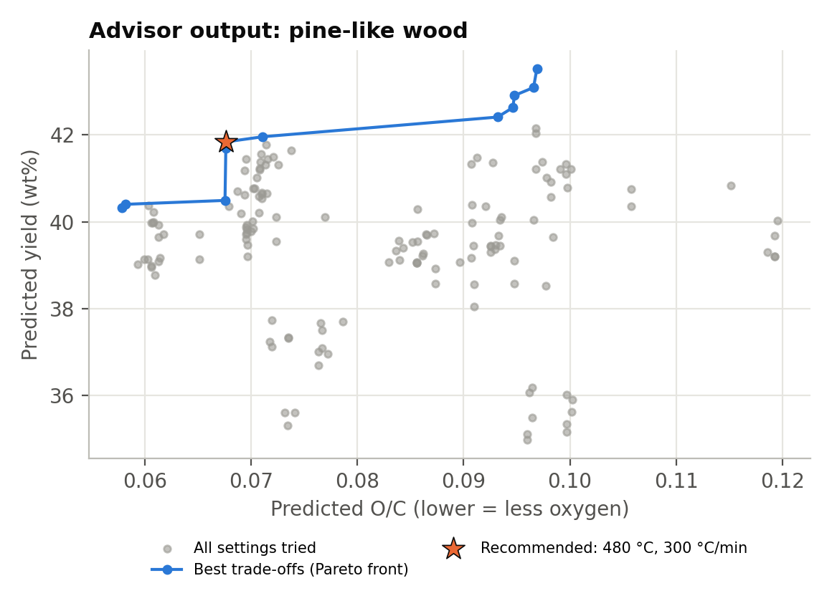
RESULT 7 · THE PYROLYSIS ADVISOR
Recommendations that show the trade-off — and know their limits
Feedstock | Status | Recommended | Max-yield alternative
Pine-like wood | In range | 480°C, 300°C/min → 41.8 wt%, O/C 0.068 | 570°C → 43.5 wt%, O/C 0.097
Rice husk-like | In range | 510°C, 10°C/min → 41.6 wt%, O/C 0.062 | 570°C → 44.7 wt%, O/C 0.113
Microalgae-like (N 8.5%) | Flagged | Withheld — distance 0.52 > 0.41 | Needs 1–2 experiments
Coal-like (C 80%) | Flagged | Withheld — distance 1.20 > 0.41 | Not biomass
For pine, the last 1.7 wt% of yield costs about 40% more oxygen in the oil.
Notes:
The Advisor searches temperature and heating rate, then shows the yield-versus-oxygen Pareto front instead of a single answer. For pine, pushing from 41.8 to 43.5 wt% yield raises O/C by about 40 percent. The applicability check correctly refuses the nitrogen-rich microalgae and the coal-like feedstock.

Slide 11
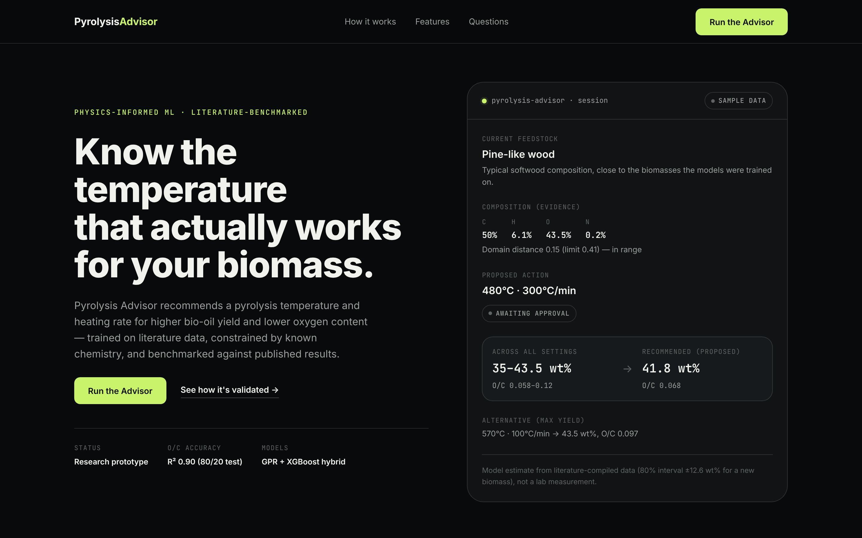
WORKING MODEL · LIVE DEMO
The Advisor as a web app
React + TypeScript web app
Pick a feedstock, review the recommended conditions, then accept or reject
Every screen states it uses sample results from our validation
Run locally: advisor-frontend → npm run dev
Notes:
This is the working model. Show it live if possible: cd advisor-frontend, npm install, npm run dev. The page explains the method, then the Run the Advisor button opens the interactive demo. The demo uses the Advisor's actual pre-computed outputs for four feedstocks; it does not connect to a reactor.

Slide 12
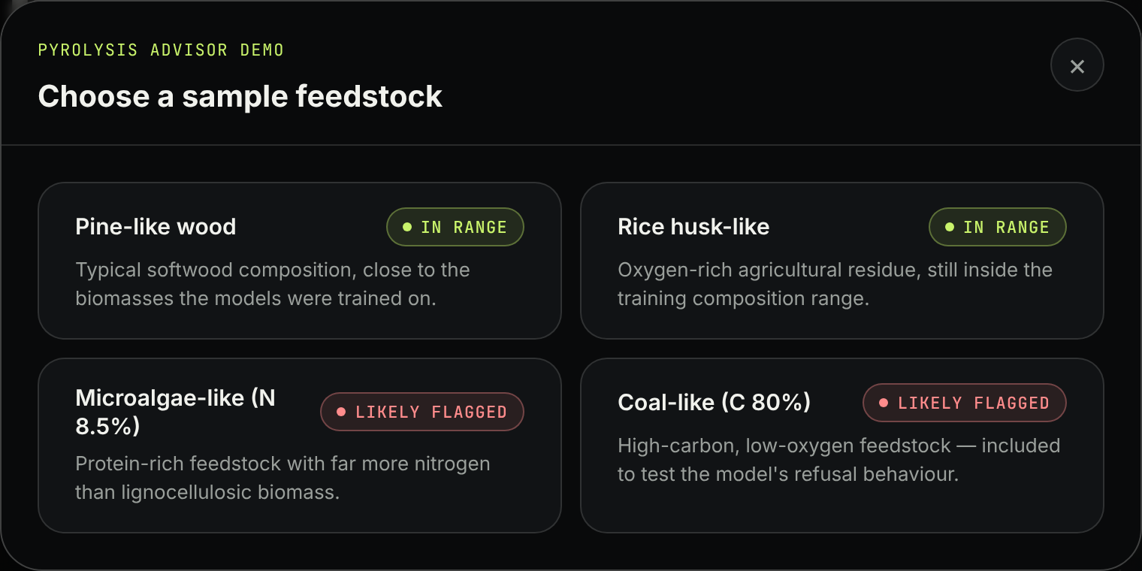
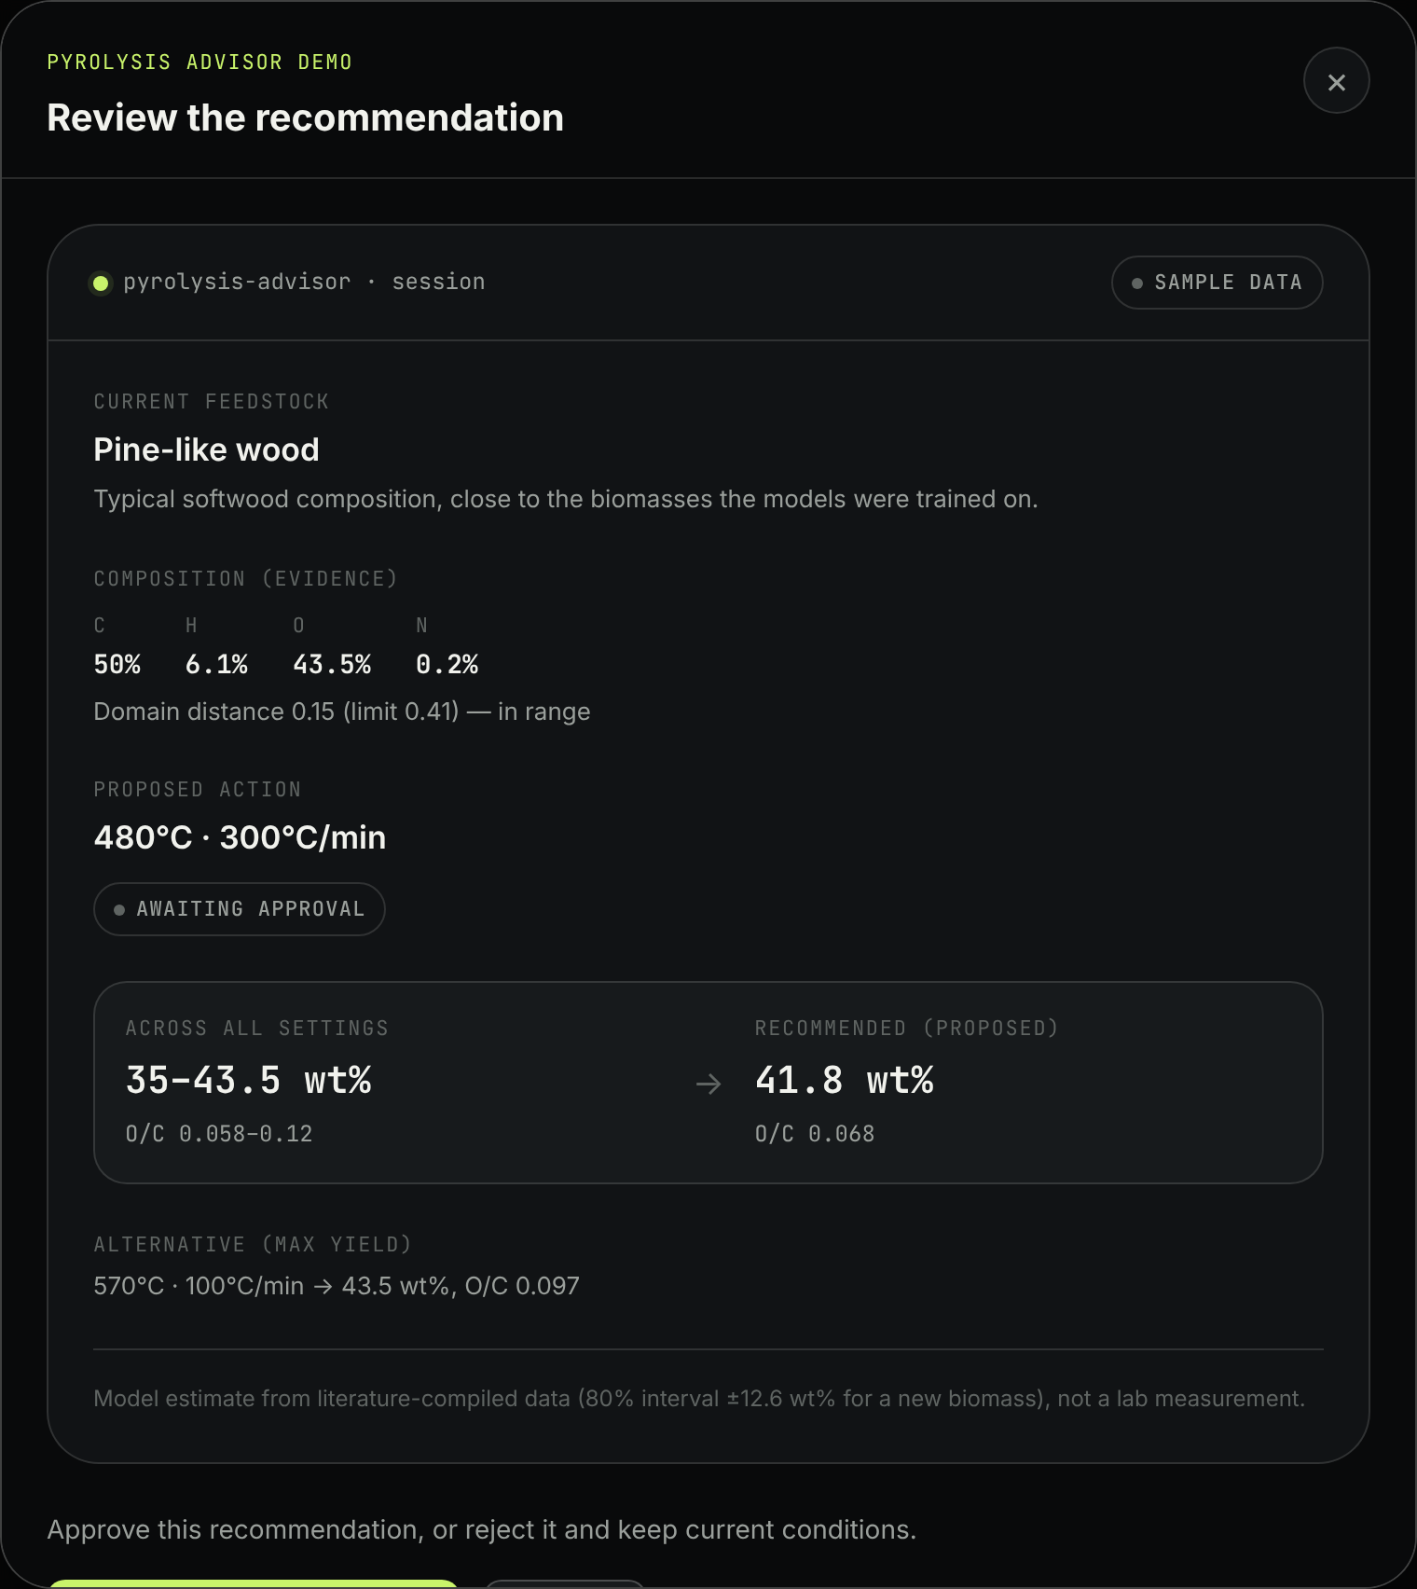
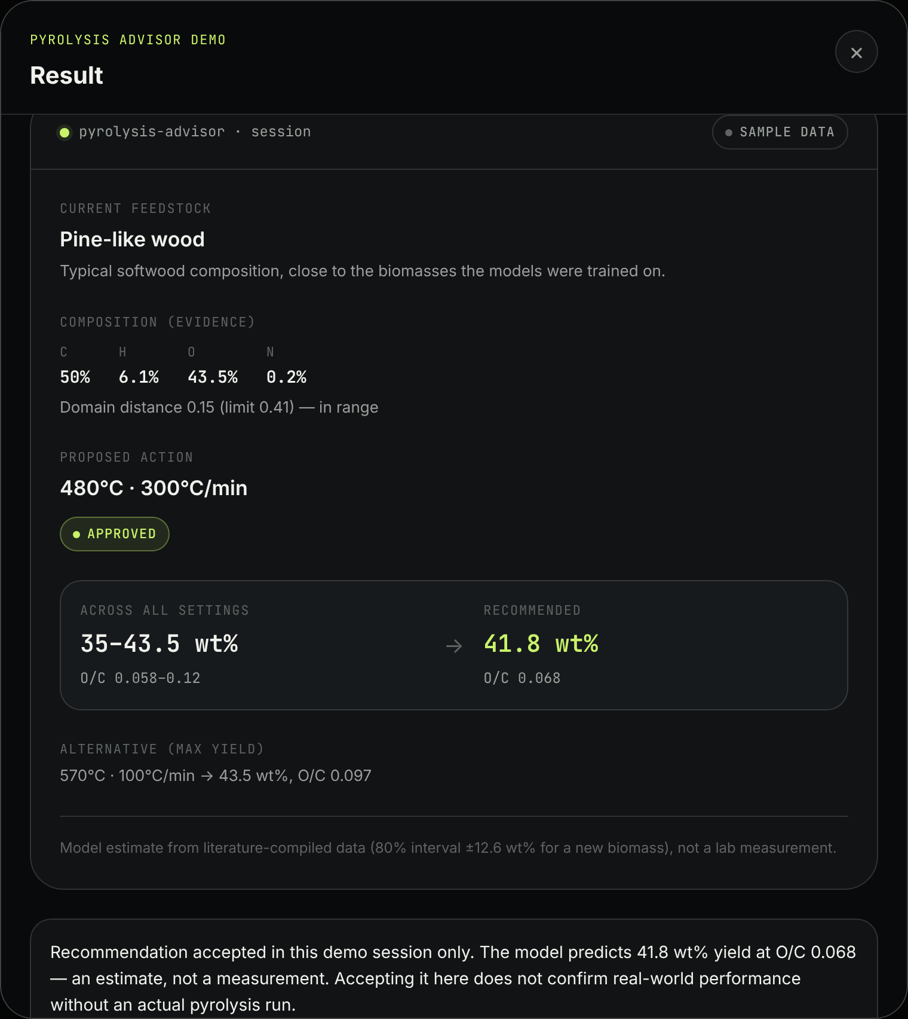
WORKING MODEL · DEMO FLOW
Choose → review → decide
1 Choose a sample feedstock
2 Review recommendation and range
3 Accept — result shown honestly
Two feedstocks are in range; two are flagged before any number is shown.
Notes:
Walk through the demo. Step 1: pick a sample feedstock. Step 2: the Advisor shows the composition, its domain-distance check, the proposed temperature and heating rate, and the yield range across all settings. Step 3: the user decides; the result screen says clearly that this is a model estimate, not a measurement.

Slide 13
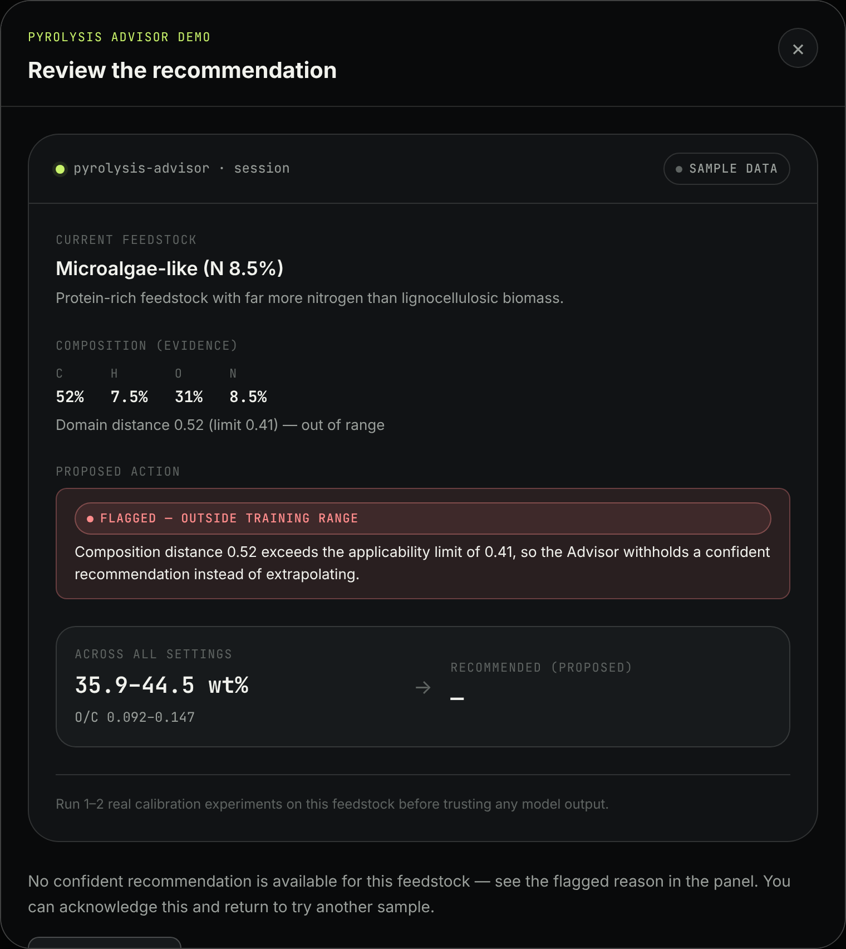
WORKING MODEL · SAFETY CHECK
It refuses to guess on unfamiliar feedstock
0.52 > 0.41
Microalgae-like feedstock: composition distance exceeds the applicability limit
No recommendation is shown, only the reason
User is told to run 1–2 calibration experiments first
Coal-like input (distance 1.20) is refused the same way
Notes:
A model that always answers is dangerous. The Advisor measures how far a feedstock's composition is from anything in training. Above the 0.41 limit it withholds the recommendation, explains why, and asks for calibration experiments.

Slide 14
SUMMARY
Results scorecard
Metric | Test 1: standard 80/20 split | Test 2: unseen biomass
O/C R², best benchmark model (XGBoost) | 0.90 | —
O/C R², final Advisor model (log scale) | 0.61 | 0.27
Yield R², best single model (Random Forest) | 0.69 | −0.25
Yield R², final Advisor model | 0.61 | 0.07
Yield error after 1 / 2 calibration experiments | — | 5.3 / 4.2 wt%
Correct optimum temperature, 3 held-out biomasses | — | 2 of 3
Out-of-range feedstocks flagged | — | 2 of 2
Notes:
Test 1 is the standard protocol used by Zhang et al. and most published studies; on it our O/C model reaches 0.90, level with the literature, and the final Advisor models reach about 0.6 for both targets. Test 2 is our extra, stricter check on brand-new biomasses: scores are lower, which is why the Advisor reports uncertainty, supports calibration with one or two experiments, and flags feedstocks outside its training range.

Slide 15
LIMITATIONS AND NEXT STEPS
What we would do next
LIMITATIONS
NEXT STEPS
Literature data mixes labs; residence time rarely reported
Yield and O/C come from two separate datasets
Wide uncertainty for a brand-new biomass
Lower accuracy on brand-new biomass (Test 2)
Web demo runs on pre-computed sample results
Leave-one-study-out testing to isolate lab effects
Model organic (water-free) yield on 413 rows
Collect consistent single-reactor data and retrain
Connect the web app to the trained models via API
Notes:
Be upfront about limits. Most important next step: consistent single-reactor data, and wiring the web app to the live models through the FastAPI backend already in the repository.

Slide 16
Thank you
Questions and live demo
github.com/umasuthanpalaniappan/BioOil-Automation
Notes:
Offer to run the live demo during Q&A.

