Slide 1
RBAC Authorization on an yii2-framework based system
2020/03/13 (Fri)
By Umbalaconmeogia

Slide 2
Table of Contents
Overview
Sample project: Company blog system
Access Control Filter
RBAC
RBAC data design
Permission and Role
Rule
user->can()
Implementation
Access control on actions (Backend, in general)
Access control applied on UI
Behavior based on access permission

Slide 3
Table of Contents
Overview
Sample project: Company blog system
Access Control Filter
RBAC
RBAC data design
Permission and Role
Rule
user->can()
Implementation
Access control on actions (Backend, in general)
Access control applied on UI
Behavior based on access permission

Slide 4
Overview
Purpose of this document: Introduce about RBAC on yii2 framework, with some usage example.
Prerequisite:
Audience should have basic experience of using yii2 framework.
Read about Authorization on yii2

Slide 5
Table of Contents
Overview
Sample project: Company blog system
Access Control Filter
RBAC
RBAC data design
Permission and Role
Rule
user->can()
Implementation
Access control on actions (Backend, in general)
Access control applied on UI
Behavior based on access permission

Slide 6
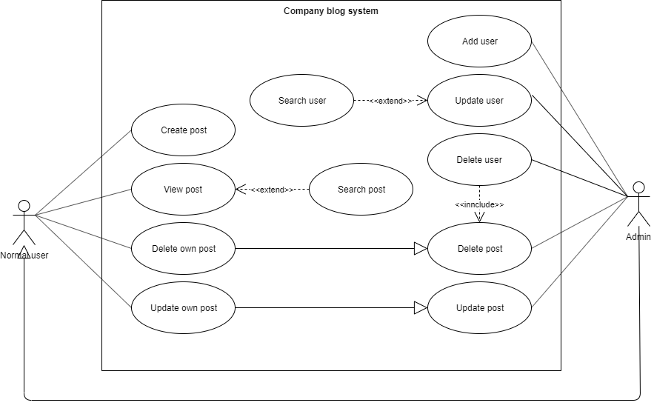
Sample project: Company blog system
A simple system to post and view content.

Slide 7
Database design
TBD

Slide 8
Table of Contents
Overview
Sample project: Company blog system
Access Control Filter
RBAC
RBAC data design
Permission and Role
Rule
user->can()
Implementation
Access control on actions (Backend, in general)
Access control applied on UI
Behavior based on access permission

Slide 9
Table of Contents
Overview
Sample project: Company blog system
Access Control Filter
RBAC
RBAC data design
Permission and Role
Rule
user->can()
Implementation
Access control on actions (Backend, in general)
Access control applied on UI
Behavior based on access permission

Slide 10
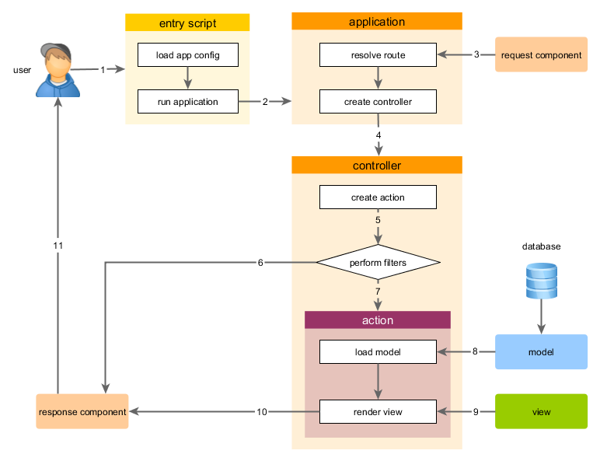
Access Control Filter
Decide if current web user can access to a controller’s action.
Filter defined in controller’s behaviors()
Reference:
Access Control Filter
Request handling overview
behaviors()

Slide 11
Table of Contents
Overview
Sample project: Company blog system
Access Control Filter
RBAC
RBAC data design
Permission and Role
Rule
user->can()
Implementation
Access control on actions (Backend, in general)
Access control applied on UI
Behavior based on access permission

Slide 12
RBAC
RBAC is a method to build access control.
It builds a way to check if current user have permission to do something.
RBAC can be used as filter in ACF.
RBAC can be used in any part of code.
2 steps to use RBAC:
Build RBAC data (define permission/role/rule and assign permission).
Use RBAC in code.
Reference: Role Based Access Control

Slide 13
RBAC used in ACF
Simple roles defined in ACF
public function behaviors()
{
return [
'access' => [
'class' => AccessControl::className(),
'only' => ['login', 'logout', 'signup'],
'rules' => [
[
'allow' => true,
'actions' => ['login', 'signup'],
'roles' => ['?'],
],
[
'allow' => true,
'actions' => ['logout'],
'roles' => ['@'],
],
],
],
];
}
ACF using roles defined by RBAC
public function behaviors()
{
return [
'access' => [
'class' => AccessControl::className(),
'rules' => [
[
'allow' => true,
'actions' => ['index'],
'roles' => ['managePost'],
],
[
'allow' => true,
'actions' => ['view'],
'roles' => ['viewPost'],
],
[
'allow' => true,
'actions' => ['create'],
'roles' => ['createPost'],
],
[
'allow' => true,
'actions' => ['update'],
'roles' => ['updatePost'],
],
[
'allow' => true,
'actions' => ['delete'],
'roles' => ['deletePost'],
],
],
],
];
}

Slide 14
RBAC used in code
if (\Yii::$app->user->can('createPost')) {
// create post
}
if (\Yii::$app->user->can('updatePost', ['post' => $post])) {
// update post
}

Slide 15
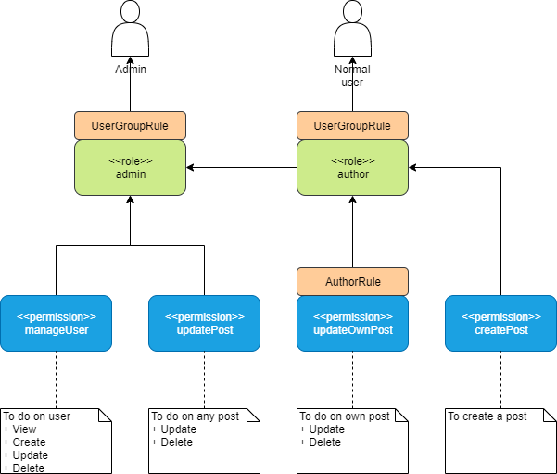
RBAC data design
RBAC data doesn’t need relate to system function (it may be common mistake of access control design to create access permission same as user function)
Any logged in user can view post, so it is unnecessary to define permission for viewing post (we have AFC definition for viewing post).

Slide 16
RBAC permission and role

Slide 17
Table of Contents
Overview
Sample project: Company blog system
Access Control Filter
RBAC
RBAC data design
Permission and Role
Rule
user->can()
Implementation
Access control on actions (Backend, in general)
Access control applied on UI
Behavior based on access permission

