Slide 1
RBAC Authorization on an yii2-framework based system
2020/03/13 (Fri)
By Umbalaconmeogia

Slide 2
Table of Contents
Overview
Sample project: Company blog system
Access Control Filter
RBAC
RBAC data design
Permission and Role
Rule
user->can()
Implementation
Access control on actions (Backend, in general)
Access control applied on UI
Behavior based on access permission

Slide 3
Table of Contents
Overview
Sample project: Company blog system
Access Control Filter
RBAC
RBAC data design
Permission and Role
Rule
user->can()
Implementation
Access control on actions (Backend, in general)
Access control applied on UI
Behavior based on access permission

Slide 4
Overview
Purpose of this document: Introduce about RBAC on yii2 framework, with some usage example.
Prerequisite:
Audience should have basic experience of using yii2 framework.
Read about Authorization on yii2
References:
Sample code on github.

Slide 5
Table of Contents
Overview
Sample project: Company blog system
Access Control Filter
RBAC
RBAC data design
Permission and Role
Rule
user->can()
Implementation
Access control on actions (Backend, in general)
Access control applied on UI
Behavior based on access permission

Slide 6
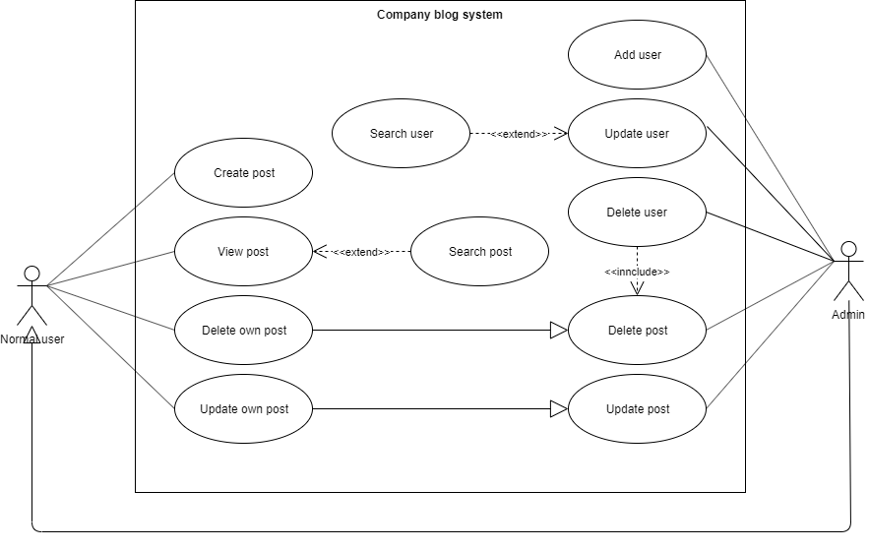
Sample project: Company blog system
A simple system to post and view content.

Slide 7
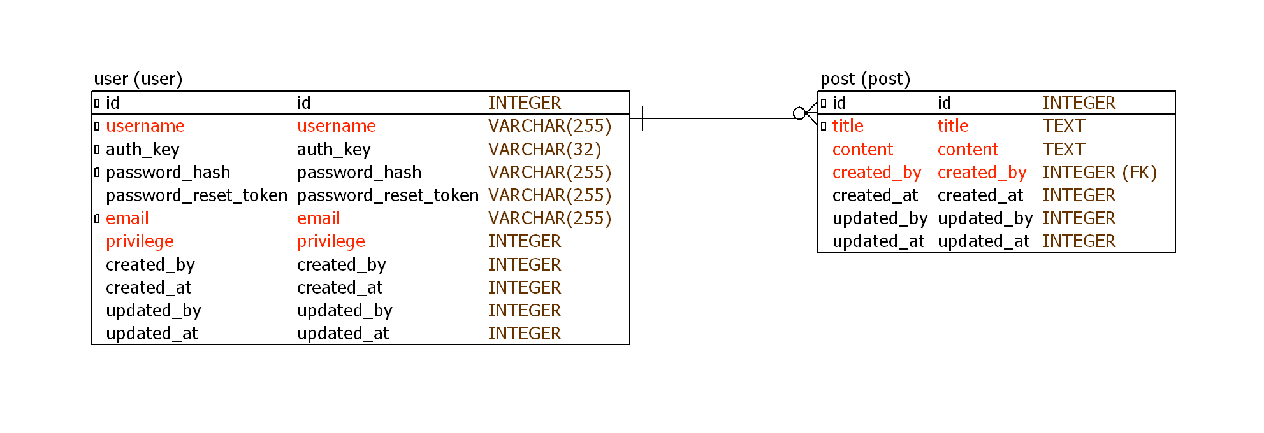
Database design

Slide 8
Table of Contents
Overview
Sample project: Company blog system
Access Control Filter
RBAC
RBAC data design
Permission and Role
Rule
user->can()
Implementation
Access control on actions (Backend, in general)
Access control applied on UI
Behavior based on access permission

Slide 9
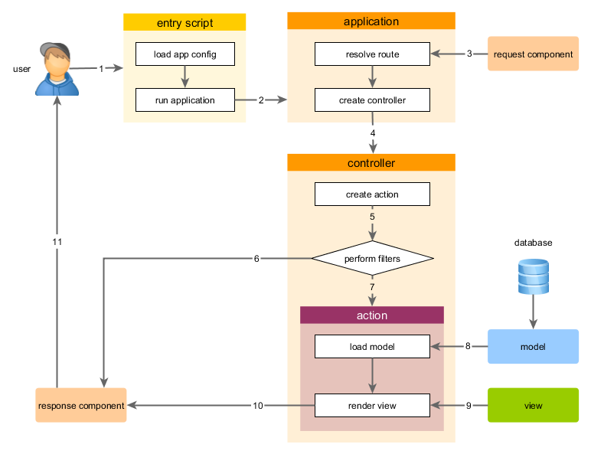
Access Control Filter
Decide if current web user can access to a controller’s action.
Filter defined in controller’s behaviors()
Reference:
Access Control Filter
Request handling overview
behaviors()

Slide 10
Table of Contents
Overview
Sample project: Company blog system
Access Control Filter
RBAC
RBAC data design
Permission and Role
Rule
user->can()
Implementation
Access control on actions (Backend, in general)
Access control applied on UI
Behavior based on access permission

Slide 11
Why we want to use a framework like RBAC
Default function of ACF is for simple case only.
Some easy thinking code like this ☺
if ($post->created_by == Yii::$app->user->id || Yii::$app->user->privilege = User::PRIVILEGE_ADMIN) {
// Do update post
}
And we need to write code like this many times in the code to check privilege
By using a good framework, it become short and clear.
if (Yii::$app->user->can(‘updatePost’)) {
// Do update post
}
We concentrate into writing business code (do update post), leave privilege checking to the framework.
By using RBAC combining with ACF, we even move privilege checking out of the business logic code.
It’s easier to maintain (adding more privileges, role…).

Slide 12
RBAC
RBAC is a method to build access control.
It builds a way to check if current user have permission to do something.
RBAC can be used as filter in ACF.
RBAC can be used in any place of code.
2 steps to use RBAC:
Build RBAC data (define permission/role/rule and assign permission).
Use RBAC in code.
Reference: Role Based Access Control

Slide 13
RBAC used in ACF
Simple roles defined in ACF
public function behaviors()
{
return [
'access' => [
'class' => AccessControl::className(),
'only' => ['login', 'logout', 'signup'],
'rules' => [
[
'allow' => true,
'actions' => ['login', 'signup'],
'roles' => ['?'],
],
[
'allow' => true,
'actions' => ['logout'],
'roles' => ['@'],
],
],
],
];
}
ACF using roles defined by RBAC
public function behaviors()
{
return [
'access' => [
'class' => AccessControl::className(),
'rules' => [
[
'allow' => true,
'actions' => ['index'],
'roles' => ['managePost'],
],
[
'allow' => true,
'actions' => ['view'],
'roles' => ['viewPost'],
],
[
'allow' => true,
'actions' => ['create'],
'roles' => ['createPost'],
],
[
'allow' => true,
'actions' => ['update'],
'roles' => ['updatePost'],
],
[
'allow' => true,
'actions' => ['delete'],
'roles' => ['deletePost'],
],
],
],
];
}

Slide 14
RBAC used in code
if (\Yii::$app->user->can('createPost')) {
// create post
}
if (\Yii::$app->user->can('updatePost', ['post' => $post])) {
// update post
}

Slide 15
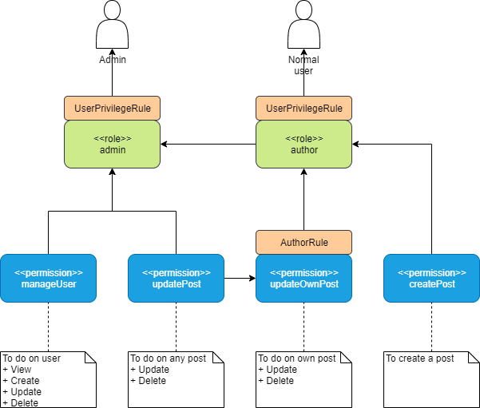
RBAC data design
RBAC data doesn’t relate to system function (it may be common mistake of access control design to create access permission same as user function)
Any logged in user can view post, so it is unnecessary to define permission for viewing post (we have AFC definition for viewing post).
We don’t assign permission/role to specified user in this system. We use rule (based on User#privilege) to determine if a user is an admin or not.
“admin” and “author” is default roles, which is applied to every user.

Slide 16
RBAC permission and role
public function actionInit()
{
$auth = Yii::$app->authManager;
$auth->removeAll();
// add the rule "author"
$authorRule = new AuthorRule();
$auth->add($authorRule);
// add "createPost" permission
$createPost = $this->createPermission('createPost', 'Create a post');
// add "updatePost" permission
$updatePost = $this->createPermission('updatePost', 'Update a post');
// add "updateOwnPost" permission
$updateOwnPost = $this->createPermission('updateOwnPost', 'Update own post', $authorRule);
// "updateOwnPost" will be used from "updatePost"
$auth->addChild($updateOwnPost, $updatePost);
// add "author" role and give this role the "createPost", "updateOwnPost" permissions
$author = $this->createRole('author', [$createPost, $updateOwnPost]);
// add the rule "userPrivilege"
$userPrivilegeRule = new UserPrivilegeRule();
$auth->add($userPrivilegeRule);
// add "manageUser" permission
$manageUser = $this->createPermission('manageUser', 'Manage user');
// add "admin" role and give this role the "manageUser", "updatePost" permission
// as well as the permissions of the "author" role
$admin = $this->createRole('admin', [$manageUser, $updatePost, $author], $userPrivilegeRule);
}
Source Code

Slide 17
RBAC rule
A rule is just for checking if current login user (specified by id) is matching with specified role/permission (difficult to understand).
Check for Author
class AuthorRule extends Rule
{
public $name = 'author';
/**
* @param string|int $user the user ID.
* @param Item $item the role or permission
* @param array $params parameters passed to
* ManagerInterface::checkAccess().
* @return bool
*/
public function execute($user, $item, $params)
{
return isset($params['post']) ?
$params['post']->created_by == $user : false;
}
}
Check for admin privilege
class UserPrivilegeRule extends Rule
{
public $name = 'userPrivilege';
public function execute($user, $item, $params)
{
if (!Yii::$app->user->isGuest) {
$privilege = Yii::$app->user->identity->privilege;
if ($item->name === 'admin') {
return $privilege == User::PRIVILEGE_ADMIN;
} elseif ($item->name === 'author') {
return $privilege == User::PRIVILEGE_ADMIN
|| $privilege == User::PRIVILEGE_NORMAL;
}
}
return false;
}
}
Source Code
Source Code

Slide 18
Table of Contents
Overview
Sample project: Company blog system
Access Control Filter
RBAC
RBAC data design
Permission and Role
Rule
user->can()
Implementation
Access control on actions (Backend, in general)
Access control applied on UI
Behavior based on access permission

Slide 19
Demo system
System setup
# Install depencencies.
composer install
# Create database
./yii migrate
# Create sample data for user and post
./yii initial-data
This system has two users
Admin
Account: user1, Password: password1
Normal user
Account: user2, Password: password2

Slide 20
Access control on actions (using ACF)
class PostController extends Controller
{
public function behaviors()
{
return [
'access' => [
'class' => AccessControl::className(),
'rules' => [
[
'allow' => true,
'actions' => ['index', 'view'],
'roles' => ['@'],
],
[
// In fact, we don't need to define this rule here, but can defined it in roles = @ above.
// I put it here just for an example.
'allow' => 'true',
'actions' => ['create'],
'roles' => ['createPost'],
],
[
'allow' => true,
'actions' => ['update', 'delete'],
'roles' => ['updatePost'],
'roleParams' => function() {
return ['post' => Post::findOne(['id' => Yii::$app->request->get('id')])];
},
],
],
],
];
}
}
‘roles’ is ACF keyword, not relate to RBAC role concept
This will be checked for both admin and author roles
Source Code

Slide 21
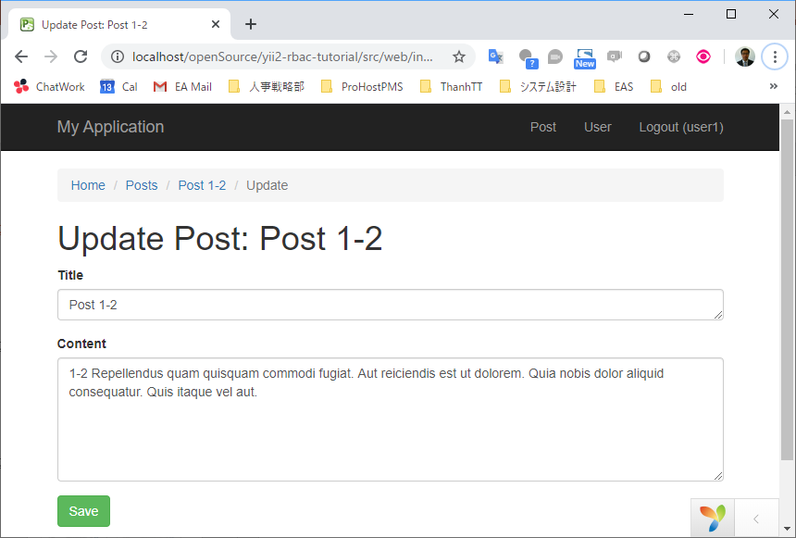
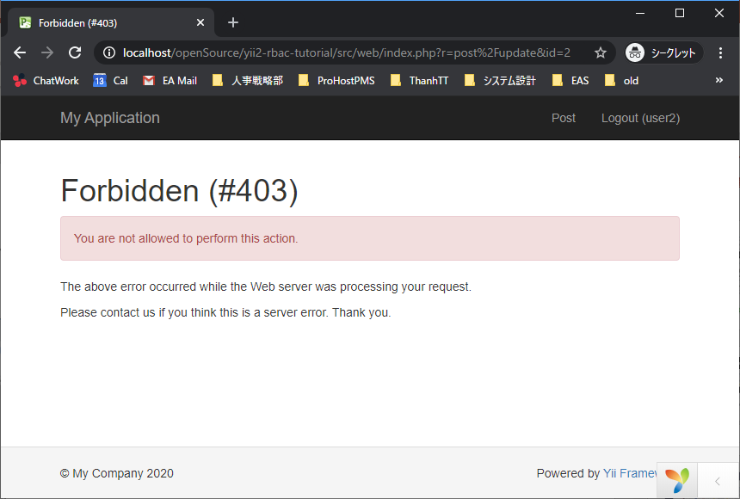
Demo of RBAC used with ACF
user1 can edit/delete any user’s post.
user2 cannot edit/delete other user’s post.

Slide 22
Access control applied on UI (1)
Source Code
For menu bar
$items = [];
if (Yii::$app->user->isGuest) {
$items[] = ['label' => 'Login', 'url' => ['/site/login']];
} else {
$items[] = ['label' => 'Post', 'url' => ['/post/index']];
if (Yii::$app->user->can('manageUser')) {
$items[] = ['label' => 'User', 'url' => ['/user/index']];
}
$items[] = $logoutMenuItem;
}

Slide 23
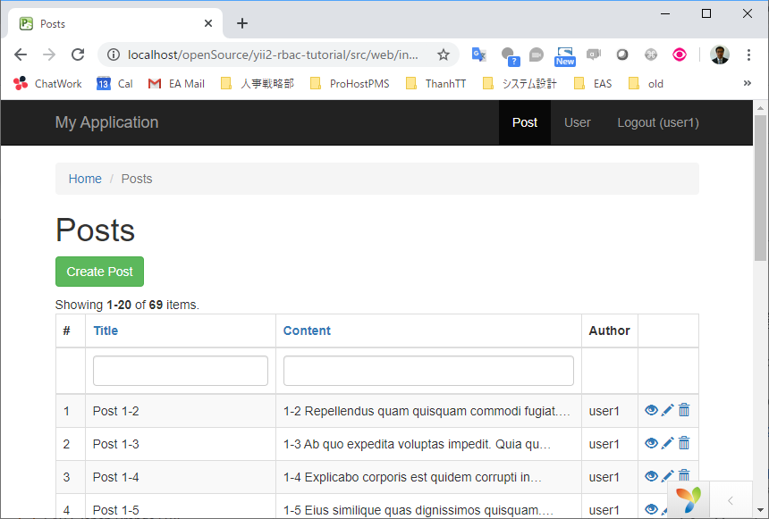
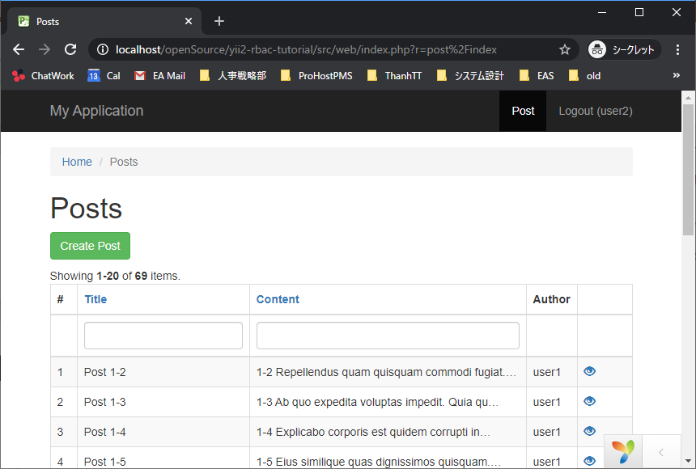
Demo of menu
user1 can access to user management from menu
user2 can’t access to user management from menu

Slide 24
Access control applied on UI (2)
Source Code
To control displaying of buttons on Post view page
<?php if (Yii::$app->user->can('updatePost')) { ?>
<?= Html::a('Update', ['update', 'id' => $model->id], ['class' => 'btn btn-primary']) ?>
<?= Html::a('Delete', ['delete', 'id' => $model->id], [
'class' => 'btn btn-danger',
'data' => [
'confirm' => 'Are you sure you want to delete this item?',
'method' => 'post',
],
]) ?>
<?php } ?>

Slide 25
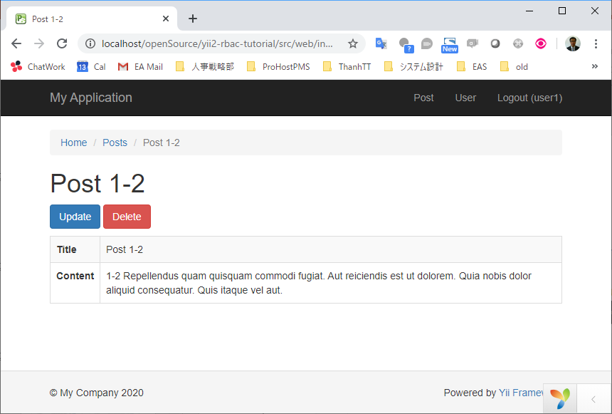
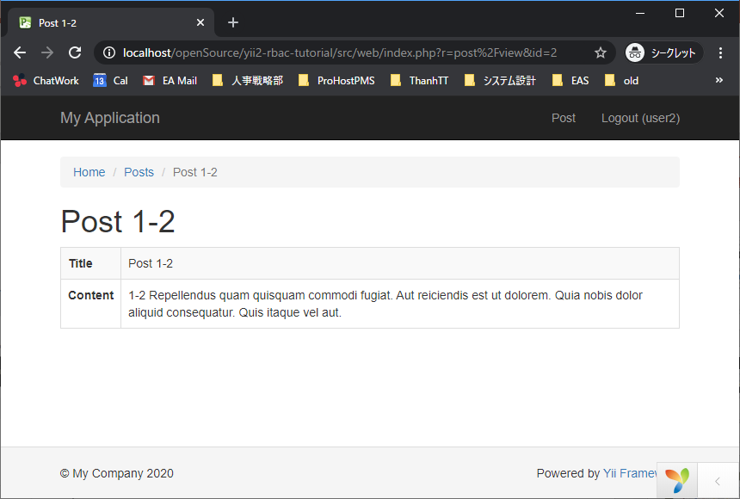
Demo of buttons
user1 has button to edit/delete any user’s post.
user2 can not edit/delete other user’s post.

Slide 26
Behavior based on access permission
Use Yii::$app->user->can() on business logic code

Slide 27
The End

