Slide 1

DATA 606 Capstone in Data Science
Wealth and Population Density Influences
on COVID-19 Cases and Vaccinations
Using Machine Learning
Phase I – Overview, Literature Review, Exploratory Data Analysis
Ken Noppinger
E-mail: knoppin1@umbc.edu

Slide 2
Overview
Goal: This research investigates the influence that wealth and population density have had on the COVID-19 pandemic in the United States.
Why:
The COVID-19 pandemic has had impacted the world with over 175 million cases globally over the past 15 months.
Factors that influenced the pandemic in the US should be understood. US case count is approaching 35 million people with over 600 thousand deaths.
What/How:
Unsupervised clustering will be used to group unlabeled county-level median income, population density, and COVID cases & vaccinations.
Cluster labels can then be used as features in downstream machine learning models to possibly predict impacts for future outbreaks.

Slide 3
Hypothesis
Questions:
Have wealthy counties been impacted differently by COVID-19?
Has county population density played a role in COVID-19?
Has county wealth and population density together influenced COVID-19 cases and vaccinations?
Stretch question: Can a clustering feature be derived to support predicting cases and vaccinations in future outbreaks?

Slide 4
Literary Research
Indonesian Study
Abdullah D;Susilo S;Ahmar AS;Rusli R;Hidayat R; “The Application of K-Means Clustering for Province Clustering in Indonesia of the Risk of the COVID-19 Pandemic Based on COVID-19 Data.” Quality & Quantity, U.S. National Library of Medicine, pubmed.ncbi.nlm.nih.gov/34103768/.
This study used K-Means to cluster provinces in Indonesia based on confirmed COVID-19 cases, deaths, and recoveries.
The clustering generated 3 groups that provided input to the Indonesian government in making policies on lockdowns to overcome the spread of the virus.

Slide 5
Literary Research
India Study
Sengupta, Pooja, et al. “An Analysis of COVID-19 Clusters in India.” BMC Public Health, BioMed Central, 31 Mar. 2021, bmcpublichealth.biomedcentral.com/articles/10.1186/s12889-021-10491-8.
This study used K-Means to cluster the 50 worst affected districts by case counts in India.
Data studied were COVID-19 cases, population density, and the number of specialty hospitals.
The clustering generated 3 groups that provided insights.
Cluster 1 burdened hospitals most heavily.
Cluster 3 was most effective in controlling the disease.

Slide 6
Literary Research
United States Study
Wu J, Sha S. Pattern Recognition of the COVID-19 Pandemic in the United States: Implications for Disease Mitigation. International Journal of Environmental Research and Public Health. 2021 Mar;18(5). DOI: 10.3390/ijerph18052493.
This study used K-Means and PCA to investigate at three time periods to uncover seasonal trends during the COVID-19 pandemic.
County-level total case data was used. Clustered by states.
Results:
Early phase – 3 clusters
Mid-Phase – 2 clusters
Late Phase – 4 clusters
Whole Period – 3 clusters

Slide 7
Implementation Approach
K-Means Machine Learning Algorithm
Select K points at random as centroids
Assign data points to the closest cluster based on Euclidean distance
Calculate centroid of all points within the cluster
Repeat these steps iteratively until convergence
Elbow Method
Used to determine the optimal number of clusters
Execute K-means for multiple K values and plot against the sum of squared distances from the centroid (loss function)
The elbow of the curve is where the curve visibly bends defining optimum K
Implementation
Apply process to income data, population density data, COVID cases and vaccinations.
Attempt combinations to determine useful clusters for consolidated data.
Add clusters as an additional feature and attempt supervised learning (as time permits) to create a prediction model.

Slide 8
Unit of Analysis
US County is the unit of analysis for this research.
This unit is represented in the data by the FIPS code
5-digit Federal Information Processing Standards (FIPS) code uniquely identifying counties and county equivalents in the United States.
Data sets are joined using the FIPS code (with corresponding county names)
Used to group data features such as population density, income, COVID cases, deaths, and vaccinations during analysis and machine learning.

Slide 9
Data - SOURCES
Data Set | Source | Link | Description
Median Incomes | Bureau of Economic Analysis US Department of Commerce | https://www.bea.gov/sites/default/files/2020-11/lapi1120.xlsx | This file provides median income estimates for all counties in the US. Note - 2019 estimates will be used.
Population | Economic Research Service US Department of Agriculture | https://www.ers.usda.gov/data-products/county-level-data-sets/download-data/PopulationEstimates.xls | This file provides population estimates for all counties in the US. Note - 2019 estimates will be used.
Land Area | US Census Bureau | https://www2.census.gov/library/publications/2011/compendia/usa-counties/excel/LND01.xls | This census data file will be used to extract county land area information needed to determine population densities.
Virus | Johns Hopkins University Center for Systems Science and Engineering (JHU CSSE) | https://github.com/CSSEGISandData/COVID-19/blob/master/csse_covid_19_data/csse_covid_19_daily_reports/06-11-2021.csv | This COVID-19 data file will be referenced from the Johns Hopkins Resource Center at Github. Note - the file is updated daily.
Vaccine | Centers for Disease Control and Prevention | https://data.cdc.gov/Vaccinations/COVID-19-Vaccinations-in-the-United-States-County/8xkx-amqh | This file provided by the CDC contains vaccination data for all counties in the US. Note - the file is updated daily.
GEOJSON | Plotly | https://raw.githubusercontent.com/plotly/datasets/master/geojson-counties-fips.json | This GEOJSON file contains the polygon definitions for counties by FIPS code and is used in generating choropleth maps.

Slide 10
DATA – Key Features
Data Set | Rows | Columns | Source Field/Feature | Feature Description | Field/Feature Used
Median Incomes | 3217 | 8 | Unnamed | US County name | County
 |  |  | 2019 | Median Income for County in 2019 | Income
Population | 3273 | 4 | FIPStxt | FIPS code | FIPS
 |  |  | State | US State name | State
 |  |  | Areaname | US County name | County
 |  |  | POP_ESTIMATE_2019 | 2019 Population for County | Population
Land Area | 3198 | 34 | STCOU | FIPS code | FIPS
 |  |  | Areaname | County name | County
 |  |  | LND110210D | Square mileage for County | Land_Area
Virus | 3986 | 14 | FIPS | FIPS code | FIPS
 |  |  | Admin2 | County name | County
 |  |  | Province_State | State name | State
 |  |  | Country_Region | County name | Country
 |  |  | Combined_Key | Combination of Admin2, Province_State, and Country_Region | Place
 |  |  | Confirmed | Cumulative count of COVID-19 cases for Combined_Key | Confirmed
 |  |  | Deaths | Cumulative count of COVID-19 deaths for Combined_Key | Deaths
Vaccine | 633184 | 14 | Date | Date of record (data retaining for most recent date only) | Date
 |  |  | FIPS | FIPS code | FIPS
 |  |  | Recip_State | State of vaccine recipients | State
 |  |  | Recip_County | County of vaccine recipients | County
 |  |  | Series_Complete_Yes | Count of vaccinated people in County | Vaccinated
 |  |  | Series_Complete_Pop_Pct | Percentage of vaccinated people in County | Vaccinated_Pct

Slide 11
DATA – Merging DATA sets

Slide 12
Data – Consolidated data set Features
Feature | Description
FIPS | Five-digit Federal Information Processing Standards code unique county identifier
County | US County name
State_Abbr | US State abbreviation
State | US State
Place | County, State, and Country combination
Land_Area | Land area for county (in square miles)
Population | Population for county (from 2019)
Pop_Sq_Mile | Population per square mile in county (derived field)
Income | Median income for county (from 2019)
Confirmed | Cumulative count of COVID-19 cases for county
Deaths | Cumulative count of COVID-19 deaths for county
Vaccinated | Cumulative count of COVID-19 vaccinated people in County (includes all vaccines)
Vaccinated_Pct | Percentage of vaccinated people in county
Cases_Sq_Mile | COVID-19 cases per square mile in county (derived field)
Deaths_Sq_Mile | COVID-19 deaths per square mile in county (derived field)
Vax_Sq_Mile | COVID-19 vaccinations per square mile in county (derived field)

Slide 13
Exploratory Data Analysis
US Counties: 3112
Key Feature Statistics:
Feature | Min | Max | Mean | Median
Income | $19,472 | $229,825 | $45,955 | $43,431
Land Area | 2 | 145,505 | 1,106 | 612
Population | 169 | 10,039,107 | 104,940 | 26,070
Pop. Sq. Mile | 0 | 71,340 | 270 | 45
Confirmed | 0 | 1,247,909 | 10,615 | 2,639
Cases Sq. Mile | 0 | 6,065 | 26 | 4
Vaccinated | 0 | 4,922,209 | 40,156 | 6,654
Vaccinated Pct | 0 | 99 | 30 | 31

Slide 14
Exploratory Data Analysis
Correlation Matrix
Feature | Income | Pop. Sq. Mile | Cases Sq. Mile | Vaccinated Pct
Income | 1.00 | 0.29 | 0.24 | 0.32
Pop. Sq. Mile | 0.29 | 1.00 | 0.97 | 0.09
Cases Sq. Mile | 0.24 | 0.97 | 1.00 | 0.09
Vaccinated Pct | 0.32 | 0.09 | 0.09 | 1.00
Investigate Relationships:
Population Per Square Mile and Cases Per Square Mile
Income and Cases Per Square Mile
Income and Vaccination Percentage

Slide 15
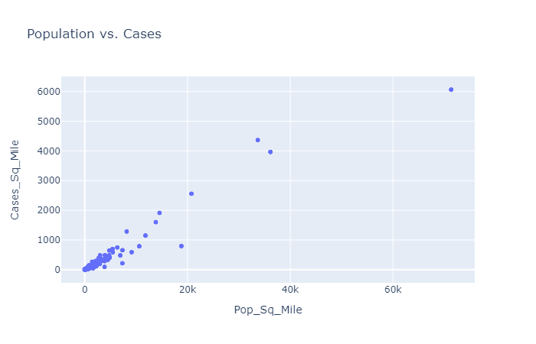
Exploratory Data Analysis
All Data

Slide 16
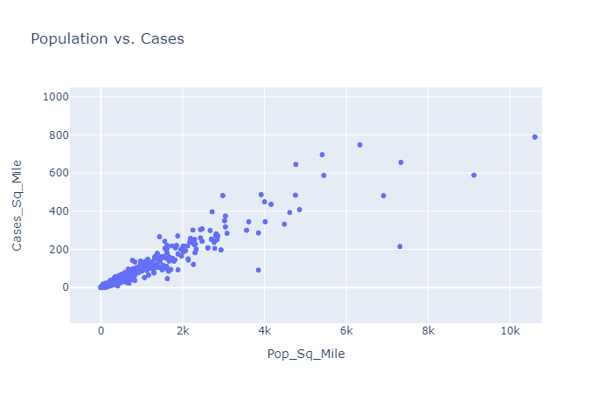
Exploratory Data Analysis
Zoomed In Data
Under 1000 Cases Per Square Mile and Under 10K Population Per Square Mile
Better display of linear relationship

Slide 17
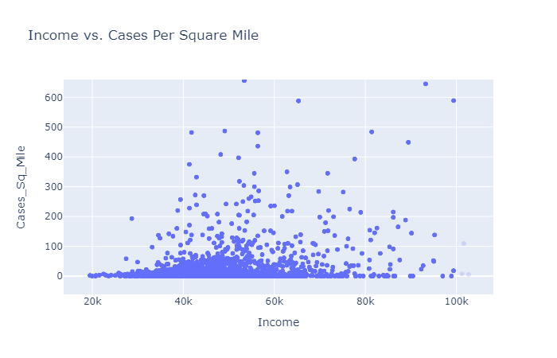
Exploratory Data Analysis
Zoomed In Data
Under 600 Cases Per Square Mile and Under 100K Income
Relationship not clear

Slide 18
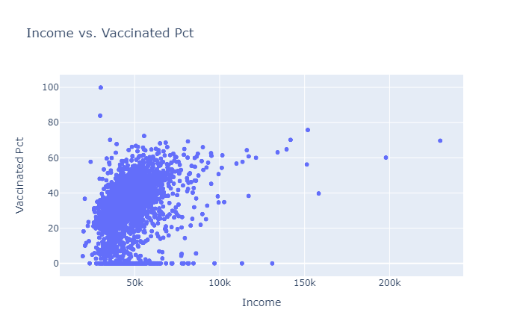
Exploratory Data Analysis
All Data
Hard to discern if vaccinations are higher as income increases
Relationship not clear

Slide 19
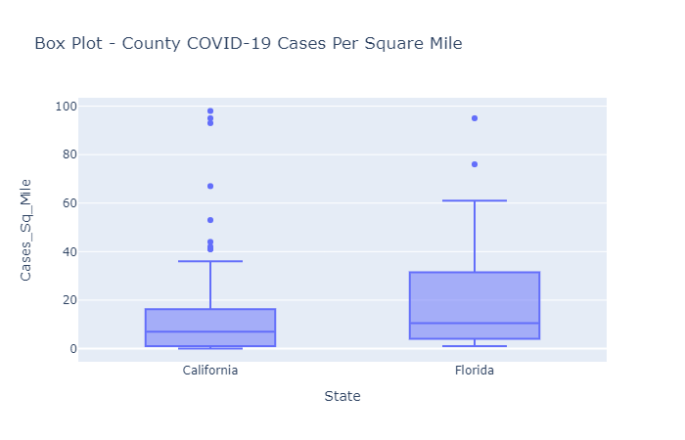
Exploratory Data Analysis
Focus Study on Subset
Use Two States
California – 58 Counties
Florida – 67 Counties
Note these states handled pandemic very differently
California – Locked Down
Florida – Open

Slide 20
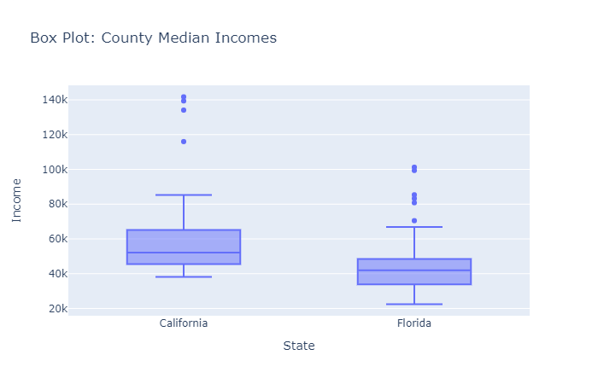
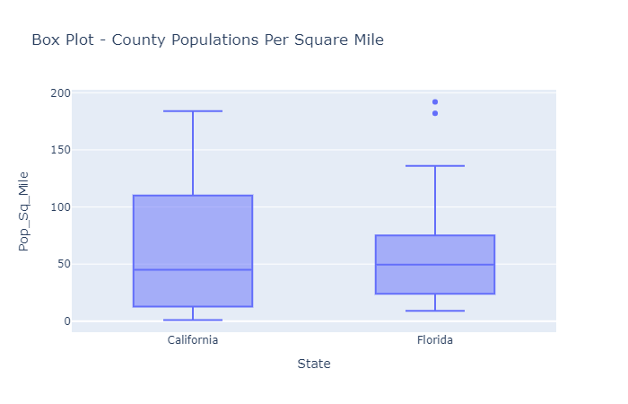
Exploratory Data Analysis
Income Comparison
Population Comparison

Slide 21
Exploratory Data Analysis
Correlation Matrix – California and Florida Subset
Feature | Income | Pop. Sq. Mile | Cases Sq. Mile | Vaccinated Pct
Income | 1.00 | 0.47 | 0.44 | 0.56
Pop. Sq. Mile | 0.47 | 1.00 | 0.92 | 0.32
Cases Sq. Mile | 0.44 | 0.92 | 1.00 | 0.38
Vaccinated Pct | 0.56 | 0.32 | 0.38 | 1.00
Investigate Relationships:
Population Per Square Mile and Cases Per Square Mile
Income and Cases Per Square Mile (stronger correlation)
Income and Vaccination Percentage (stronger correlation)

Slide 22
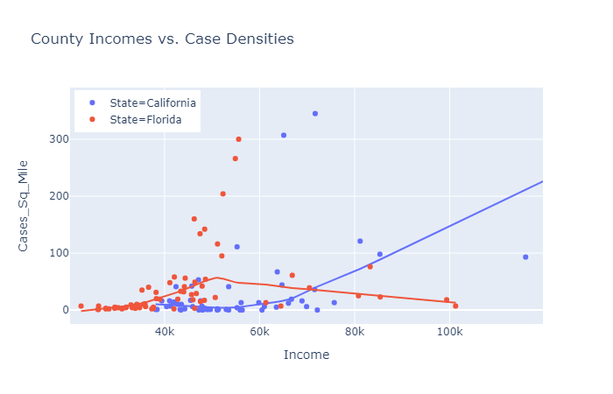
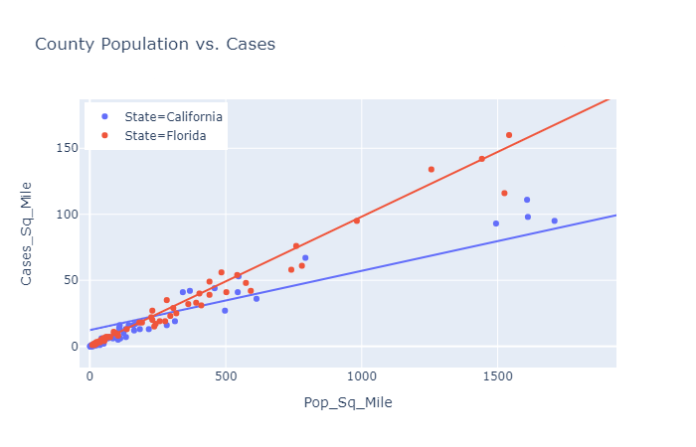
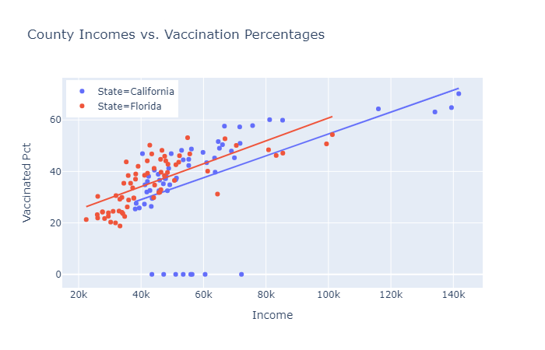
Exploratory Data Analysis

