Slide 1
Reading assignment prior to class
The Art of Approximation in Science and Engineering
https://www.dropbox.com/s/bmqwzc8qqt5lv9p/9017.pdf
https://news.ycombinator.com/item?id=18099596

Slide 2
Scaling, estimation, and transitions Data 601
9 out of 10 Data Scientists agree: you need more than 10 samples
Nov 1, 2018
Notes:
https://www.cac.cornell.edu/education/training/StampedeJan2015/Scalability.pdf

Slide 3

Course schedule and outline (scope)
Oct 25: Automation, Reports
Nov 1: Scaling up, Estimation
Nov 8: Elasticity, Cost/benefit
Nov 15:Property graphs
Nov 22: No class (Thanksgiving)
Nov 29: Docker
Dec 6: Ethics and Legality
Dec 13: Presentations
Aug 30: Overview Data Science
Sept 6: Python in Jupyter
Sept 13: Math (stats)
Sept 20: Regression
Sept 27: Clustering
Oct 4: Getting data
Oct 11: Substitute's choice
Oct 18: Data cleanup

Slide 4
Review of Openpyxl homeworks
See notebooks

Slide 5
Mid-term project dates
(Oct 4): start proposal for mid-term
(Oct 11): Proposal for mid-term project due; submit via Blackboard
Oct 13-17: I grade the proposal and provide feedback on proposal
Oct 18: Start mid-term project
Oct 27: participate in check-in with Ben, either via email or in person
Nov 1: Submit mid-term project for grading

Slide 6
Survey: busy?
Did you have a mid-term or extra work in the past week?

Slide 7
Observation: use descriptive variable names
for indx in range(100):
versus
for a in range(100):
I often use shortened versions to avoid collisions with reserved words

Slide 8
Observation: name the parameters
number_of_chickens=100
for indx in range(number_of_chickens):
versus
for a in range(100):

Slide 9
Observation: Minimum Viable Project
Rather than showing off everything you know,
the goal is to address the hypothesis quickly
https://en.wikipedia.org/wiki/Minimum_viable_product

Slide 10
Being right about claim is not the goal
When you test a claim, you can end up showing that either the claim is validated or invalidated. I'm not interested in finding "true" statements; I'm interested in the process by which you arrive at your conclusion.
Being consistently 100% successful (no failures) means you're either tackling simple problems (solution is known) or your data/analysis is not valid.

Slide 11
Projects schedule
Aug 30:
Sept 6:
Sept 13:
Sept 20:
Sept 27: preview
Oct 4: start proposal for mid-term
Oct 11: Submit proposal for mid-term project
Oct 18: Start mid-term project
Oct 25: reminder to check-in
Nov 1: Submit mid-term project; start proposal for final
Nov 8: Submit proposal for final
Nov 15: Final project assigned
Nov 22: No class (Thanksgiving)
Nov 29: reminder to check-in
Dec 6: Final project due
Dec 13: Presentations

Slide 12
Difference between mid-term and final
Final exam has an in-class presentation

Slide 13

Outline for this session
Estimation for resources
Why does scaling matter?
Activity: Influencing data scientist

Slide 14
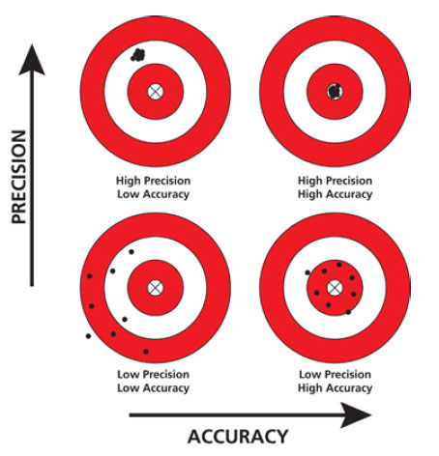
Context for estimation mindset
Estimation is not about getting precise answers
Accuracy matters more
Documentation of process is vital; otherwise your work looks like a guess
Notes:
http://www.edvotek.com/Micropipet

Slide 15
Demo: Fermi estimates
Watch / Do / Teach
Use quantitative guesses based on experience
Build a story that is relevant to the situation
Vote to select one of the following for Ben to walk through on the board:
How many people could you fit into this classroom?
How long would it take to count to one million?
How many hours will you sleep in a lifetime?
How many balloons would it take to cover the grounds of UMBC?
This skill is generic (used outside of data science)

Slide 16
Make a Fermi estimate
Watch / Do / Teach
Use quantitative guesses based on experience
Build a story that is relevant to the situation
Form a team of three people by counting off: 1, 2, 3, 4, 5, 1, 2, 3, ...
Your group will be assigned one of the three questions by Ben
How many people could you fit into this classroom?
How long would it take to count to one million?
How many hours will you sleep in a lifetime?
How many balloons would it take to cover the grounds of UMBC?
This skill is generic (used outside of data science)

Slide 17
Teach your Fermi estimate
Watch / Do / Teach
Use quantitative guesses based on experience
Build a story that is relevant to the situation
Find a partner who worked on a different problem
How many people could you fit into this classroom?
How long would it take to count to one million?
How many hours will you sleep in a lifetime?
How many balloons would it take to cover the grounds of UMBC?
This skill is generic (used outside of data science)

Slide 18
Use of SODOTO / learn do teach model
https://www.ncbi.nlm.nih.gov/pmc/articles/PMC4785880/

Slide 19
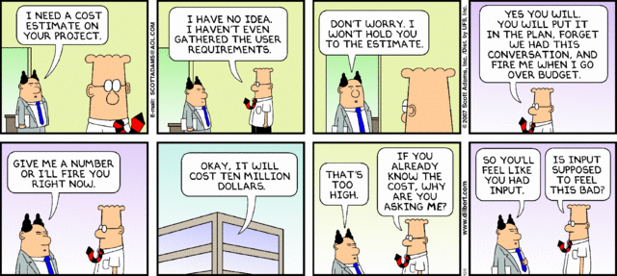
Estimation of time, compute, storage

Slide 20
Estimation of time, compute, storage
For any given problem in data science,
estimating time, compute, and storage will be vital.
How long will it take to develop an analytic? (people time)
How long will it take to run an analytic? (compute cycles)
"wall clock" time depends on which computer you're using
How much output will an analytic generate? (storage)
These estimates are iterative and improve with exposure.

Slide 21
When to exploit estimation
If the data is accessible, use that.
Then role of estimation is to provide a sanity check
Is the delivered data realistic?
Is this how much data I should expect to get?

Slide 22
Estimating absolute cost of storage and compute is difficult
When absolute estimates are challenging,
Determine whether relative estimates would be meaningful

Slide 23
Price estimates varied wildly
Storage: 1 TB for 1 year
Storage: 100 TB for 1 year
Provider | Cost [$/year]
Amazon | 276
Amazon | 60
Amazon | 432
Google | 282.62
Microsoft | 288
Microsoft | 45
Provider | Cost [$/year]
Amazon | 27600
Amazon | 125000
Amazon | 45600
Google | 28262.6
Microsoft | 561.6
Microsoft | 45000
This variance is why I requested the source URLs

Slide 24
Prices for data movement in/out of cloud
10 TB to the cloud
10 TB downloaded from the cloud
Provider | Cost [$]
Amazon | free
Amazon | 400
Google | free
Microsoft | free
Provider | Cost [$]
Amazon | 400
Google | 37.37
Microsoft | 870.6
I will be aggregating the results of your research for use in the next lecture

Slide 25
Why would cloud service providers incentivize data science and machine learning?
Commerical providers provide lots of tools,
many of them free (ie TensorFlow):
https://cloud.google.com/data-science/
https://cloud.google.com/datalab/
https://ai.google/education
https://cloud.google.com/training/data-ml

Slide 26
Outline for this session
Estimation for resources
Why does scaling matter?
Activity: Influencing data scientist

Slide 27
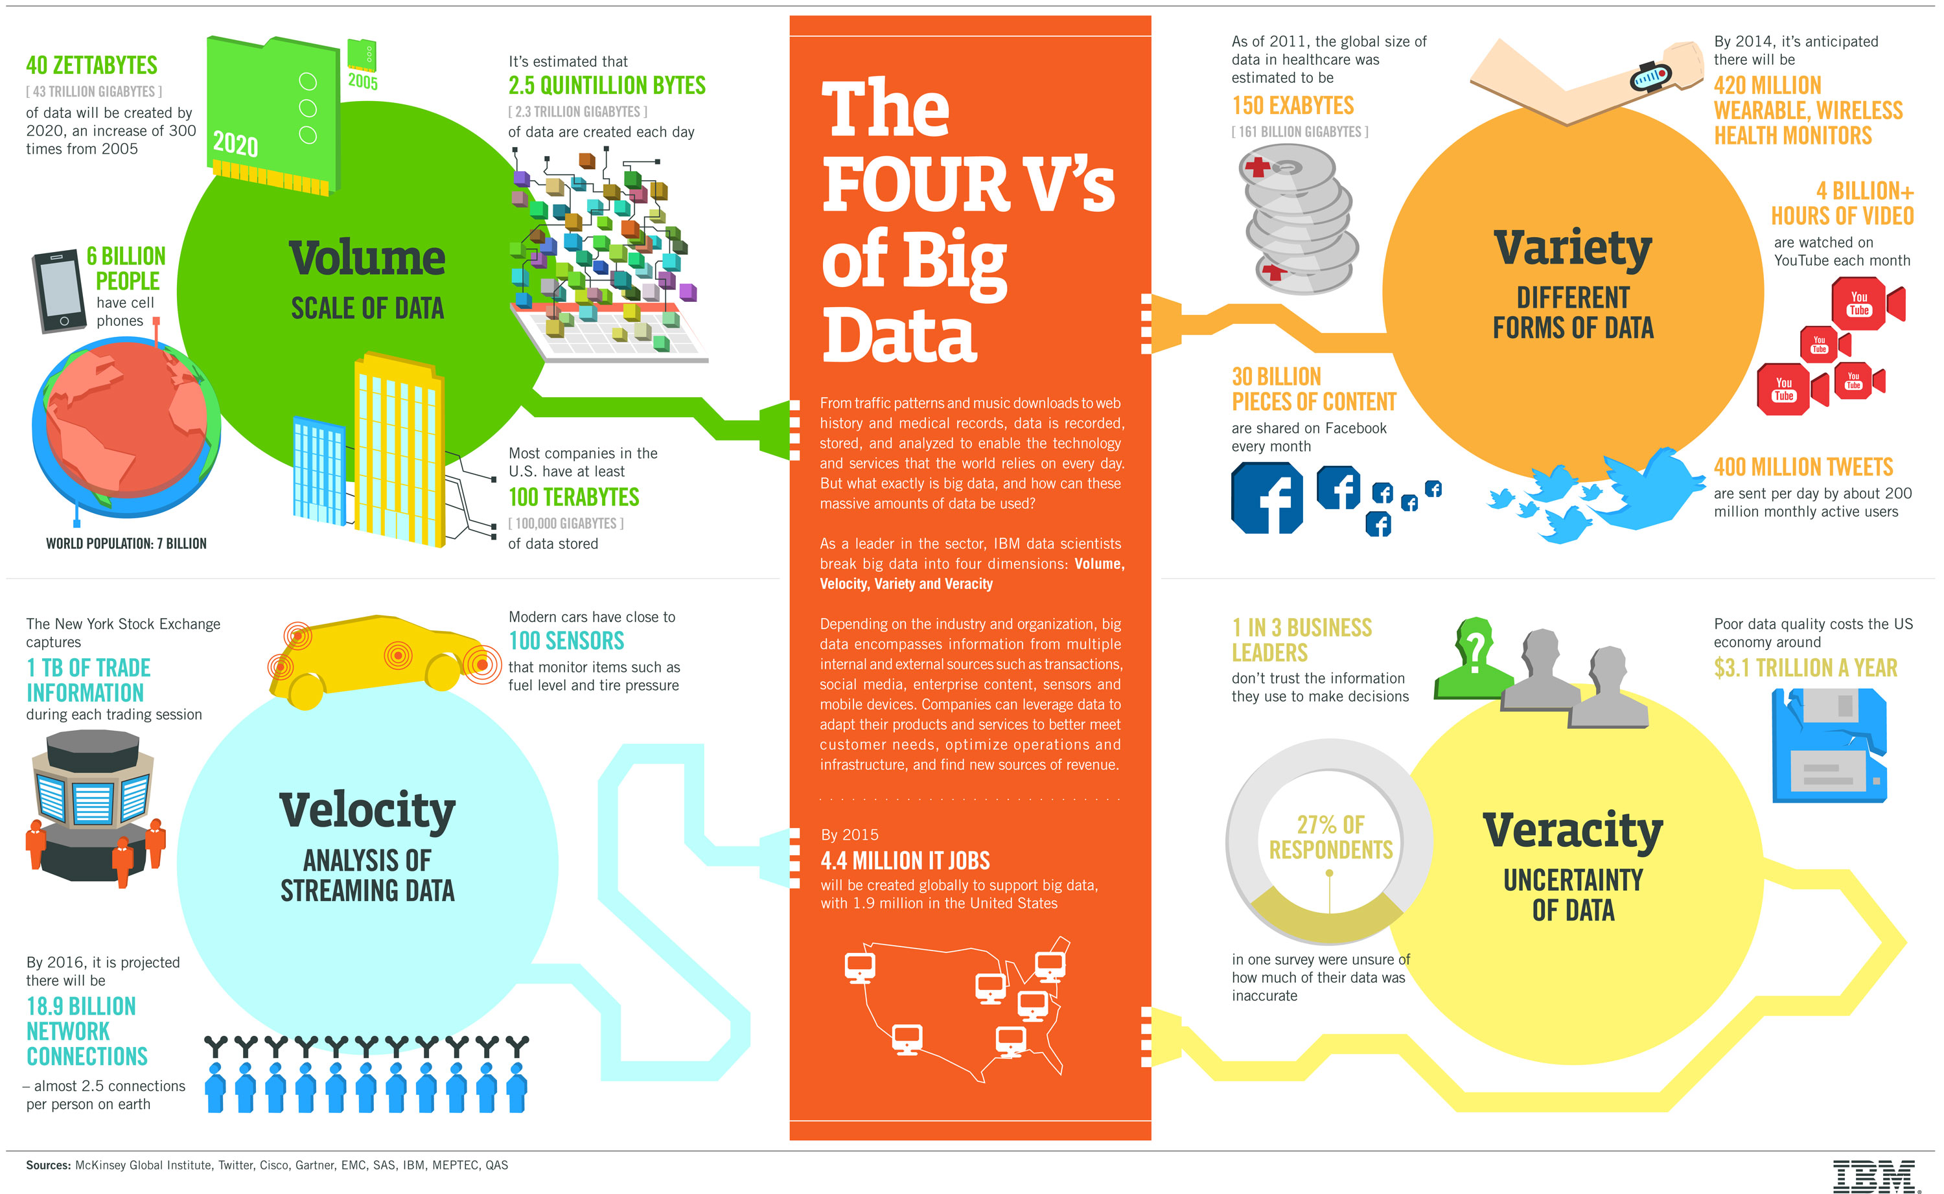
Standard definition and features of Big Data
https://www.ibmbigdatahub.com/infographic/four-vs-big-data

Slide 28
My definition of "Big Data"
More data than you're used to handling
size is relative to what you have experience with

Slide 29
Naïve expectation for scaling
$$$
cost
$
small
size
big

Slide 30
Twice the data does not mean twice the storage or twice the cost
Suppose I start with 10MB of data
Then my data set doubles in size to 20MB
If my hard drive has 200 GB of capacity,
--> no additional storage is needed
Suppose I start with 8TB of data
Then my data set doubles to 16TB
(Amazon currently sells a 12TB drive)
--> need to buy additional storage capacity

Slide 31
actual scaling of hardware
$$$
cost
$
small
size
big

Slide 32
Transitions are not continuous: step functions
Compute: number of processor cores is often powers of 2
A processor with 7 cores is not commercially available
Memory: RAM is sold in multi-GB sticks, powers of 2
13 GB of RAM isn't commercially available.
Storage: disk capacity is incremental (i.e. 1TB)

Slide 33
Switching paradigms is costly
Algorithms
Example: element-wise versus vectorized operations
Choice selection is based on assumptions about
data format
efficient use of hardware
Language: switching from Python to C
Data format: switching from CSV to HDF5

Slide 34
Why change: Not all problems are small Not all analytics are easy
Storage
capacity: GB to TB
file I/O performance
Compute capability:
Cores
RAM
Which language is appropriate
When to transition from Python to C to Assembly

Slide 35
Data science skills vary with scale of data
The same problem applied to
one page of data
one Excel spreadsheet
one hard drive of data
a single server with lots of drives
a data center
has drastically different challenges.
https://www.coursera.org/learn/data-manipulation

Slide 36
Consequence of scale: Bonferroni’s principle
If you look in more places for interesting patterns than your amount of data will support, you are bound to find garbage. [citation]
https://www.kdnuggets.com/2016/07/big-data-bible-codes-bonferroni.html
Examples:
Rhine paradox [citation]
George W. Bush administration's Total Information Awareness data-collection and data mining plan of 2002

Slide 37
Demo of Bonferroni’s principle
http://127.0.0.1:8888/notebooks/Bonferronis_principle.ipynb

Slide 38
(Summary) Scale matters
For each aspect of a system, there are discrete transitions
New challenges arise that don't exist at small scale

Slide 39
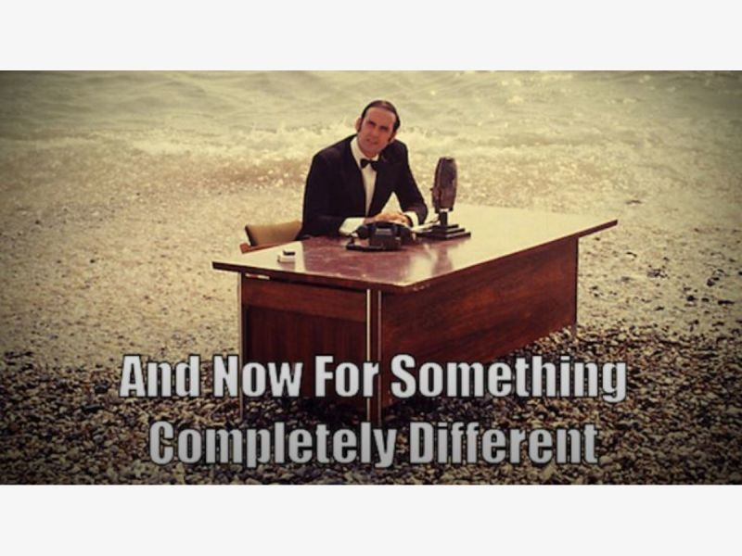

Slide 40
Outline for this session
Estimation for resources
Why does scaling matter?
Activity: Influencing data scientist

Slide 41

How I influence other Data Scientists
Identify weakness
Address that gap

Slide 42
Activity: gap filling
Building social relationships
Identifying motives of others
Navigating bureaucracy
Writing code
Learning new things
Writing reports
Writing documentation
Getting data
Cleaning data
Visualization
Presentations
Developing Strategy
Completing tasks
Negotiation
Collaboration
Math
Write down three of your weaknesses
as a data scientist
Write down three of your strengths
as a data scientist
Examples: ---->

Slide 43
Part 2 of gap filling
For each of your weaknesses,
find someone who has that same aspect listed as a strength
Different weaknesses may necessitate finding a different partner

Slide 44
Two ways to leverage this knowledge
If you know your own weaknesses, you can find partners to collaborate with who have those strengths
If you can identify the weaknesses of others, you can provide support to them and build a partnership

Slide 45
Outline for this session
Estimation for resources
Why does scaling matter?
Activity: Influencing data scientist
Scaling of data format; Changing algorithms
Changing software and hardware

Slide 46

Sometimes you expect to get lots of data but don't currently have it
If waiting on data to show up, don't let that delay your exploration.
To get started on creating a model and asking questions, create data that has features you'd expect the real data to have.
This data can be
scaled as needed

Slide 47
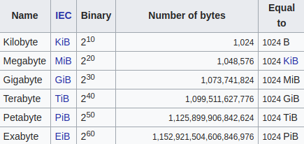
What is kB, MB, GB, TB?
Documents, pictures: kB to MB
A song: few MB
1 GB = 1000 MB
A few hundred pictures: 1 GB
A movie: few GB
1 TB = 1000 GB
Normal hard drive size: few TB
1 PB = 1000 TB
In 2013 the Titan super computer had 40 PB of storage [citation]
https://en.wikipedia.org/wiki/File_size

Slide 48
How to cause Jupyter to choke
Two ways to overload Jupyter:
Too much data for memory
Reading data from disk
Generating data at runtime
Too much processing

Slide 49
Data representation
CSV or XML or JSON works reasonably well for kB, MB, or even GB of files.
Problem: this only scales if your compute has sufficient memory

Slide 50
Plain text is uncompressed
SQLite (see python module)
Pickle (specific to Python)
HDF5 for storing large tabular datasets
HDF5 = Hierarchical Data Format version 5
Normal file system | HDF5
File system | HDF5 container
files | Data sets
folders | groups
Notes:
https://support.hdfgroup.org/HDF5/faq/whyhdf5.html
https://dziganto.github.io/out-of-core%20computation/HDF5-Or-How-I-Learned-To-Love-Data-Compression-And-Partial-Input-Output/

Slide 51
Operate on disk instead of in memory
HDF5 lets you store huge amounts of numerical data, and easily manipulate that data from NumPy.
For example, you can slice into multi-terabyte datasets stored on disk, as if they were real NumPy arrays. [citation]
h5py module does not return an in-memory numpy array. Instead it returns something that behaves like one, but isn't loaded into memory [citation]
Notes:
https://www.pytables.org/FAQ.html
https://www.hdfgroup.org/2015/09/python-hdf5-a-vision/

Slide 52
Sparse matrix representations
Normal matrix with n rows and m rows has n*m elements stored
Example: 20,000 words x 100 documents = 2,000,000
Most of the table entries are empty
--> there are more efficient ways of representing the data

Slide 53
Sparse matrix representations
DOK (Dictionary of keys)
LIL (List of lists)
COO (Coordinate list)
compressed sparse row (CSR) or compressed row storage (CRS)

Slide 54
Transitions: algorithms
Same algorithm applied to more data may not be effective
Suppose I have a list: [3, 5, 9, 2, 4, 8]
I want to find whether "2" is in the list
for this_val in list:
if (this_val == 2):
print(this_val)

Slide 55
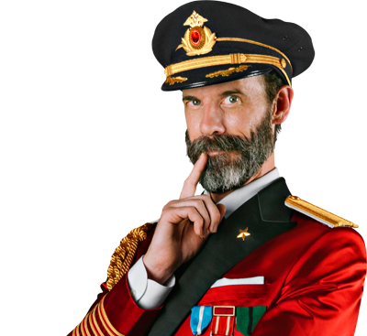
Big O notation for scaling of algorithms
Programs and applications are implementations of a concept intended to achieve a goal
A concept that has a set of steps is an algorithm
The amount of time or storage an algorithm takes to achieve the goal varies depending on input parameters
Analyzing more data takes longer

Slide 56
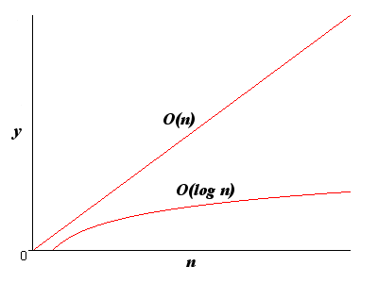
More data means it takes longer to get result but how much longer?
Big O notation quantifies worst case scaling
Examples:
worst-case running time of binary search is Θ(log n)
Worst-case running time of sequential search is Θ(n)
Notes:
https://www.packtpub.com/sites/default/files/downloads/4874OS_Appendix_Big_O_Cheat_Sheet.pdf

Slide 57
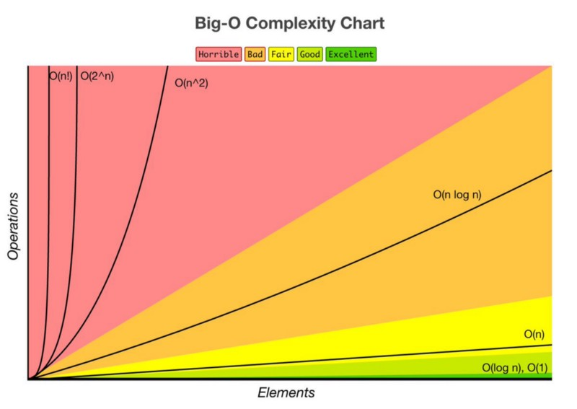
So what? I'm a data scientist, not a programmer
http://bigocheatsheet.com/

Slide 58
So what? I'm a data scientist, not a programmer
At small scale,
inefficiency is irrelevant
http://bigocheatsheet.com/

Slide 59
Demo: scaling of search
http://127.0.0.1:8888/notebooks/notebooks/sequential_vs_binary_sort.ipynb

Slide 60
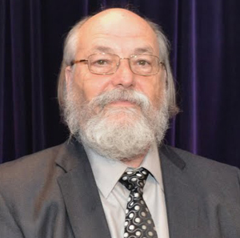
Simplicity is elegant
When in doubt,
use brute force.
http://atelier.inf.unisi.ch/~dalsat/sai/projects/2015/html/sw/ken_thompson.html
Notes:
http://atelier.inf.unisi.ch/~dalsat/sai/projects/2015/media/images/sw/ken_thompson.jpg

Slide 61
Pro-tip
Start with small sample of data
Test scaling before big run

