Slide 1
Watch https://www.youtube.com/watch?v=V0ucZ4ctof8
Goal: Find the Mario Maker level with the most plays and the most star ratings.
Problem: Collecting the data. Nintendo does not offer it in a giant spreadsheet. You can pull up a query that shows 100 or whatever at a time, but we need 10^6 rows to achieve the goal.
At around 4:35 or so he breaks down the query, explains how someone wrote a script to scrape the website (a polite script too, which is smart - it didn't overwhelm the servers or cause the IP address to get blocked) and then briefly explains some of the other neat things you can find within the data set before diving in to address the goal.

Slide 2
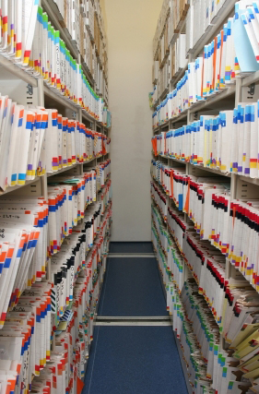
Class 6: Getting data
Data 601
Oct 4, 2018
Notes:
https://en.wikipedia.org/wiki/Web_scraping
https://en.wikipedia.org/wiki/Data_scraping
https://benbernardblog.com/web-scraping-and-crawling-are-perfectly-legal-right/
https://www.forbes.com/sites/ericgoldman/2015/03/24/qvc-cant-stop-web-scraping/

Slide 3

Course schedule and outline (scope)
Oct 25: Automation
Nov 1: Scaling up, Estimation
Nov 8: Elasticity, Cost/benefit
Nov 15: Property graphs
Nov 22: No class (Thanksgiving)
Nov 29: Evaluation
Dec 6: Ethics and Legality
Dec 13: Presentations
Aug 30: Overview Data Science
Sept 6: Python in Jupyter
Sept 13: Math (stats)
Sept 20: Regression
Sept 27: Clustering
Oct 4: Getting data
Oct 11: Substitute's choice
Oct 18: Data cleanup

Slide 4
You pick the data source for your project
from a list I provide, or provide a suggestion in your proposal.
Data discovery is outside scope of course, so I provide you data sources
You should pick a data source you have some background knowledge in
--> Enables use of a model and generation of hypotheses

Slide 5
What I care about for the mid-term project
Challenge: determine relevant scope appropriate to your skills while still pushing your experience
Report: A description of research methods can be called “coherent” and “complete” when readers understand the process well enough to replicate it themselves. [citation]
Analysis
Applies methods learned in class
Uses Python 3 in Jupyter notebook
Demonstrates process of data science, from gathering data to telling story through characterization and prediction
Visualization: Intuitive, relevant

Slide 6
Tip: Exploratory Data Analysis (EDA) check lists
https://simplystatistics.org/2015/03/03/the-elements-of-data-analytic-style-so-much-for-a-soft-launch/
https://data-knowledge.blogspot.com/2016/05/exploratory-data-analysis-checklist.html
https://rpubs.com/profversaggi/eda_checklist
https://bookdown.org/rdpeng/exdata/exploratory-data-analysis-checklist.html

Slide 7
Example proposal content
The source URL for the data is http://pinkmonkeys.edu/. There is no cost to accessing this data, though access does require creation of an account.
Accessing this data does not violate any laws. This data does not appear to have been previously analyzed based on a Google search.
A preliminary survey of the data indicates there are 10,000 rows, 20 columns, and the file is 500 kB.
Based on my experience with building chairs while on a service project in Antarctica in 2015, I hypothesis that there is a positive correlation between number of q-tips and size of bruises on pineapples.
As a backup if I encounter problems, I will get data from http://mysite.group and determine how many lasers are needed to ...

Slide 8
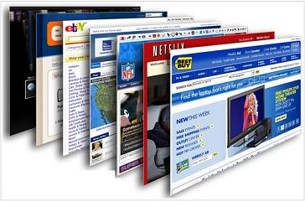
Online digital content
Normally presented via a GUI (web browser) for human interaction
Notes:
http://techviewes.blogspot.com/2014/08/capture-screenshots-of-long-webpages.html

Slide 9
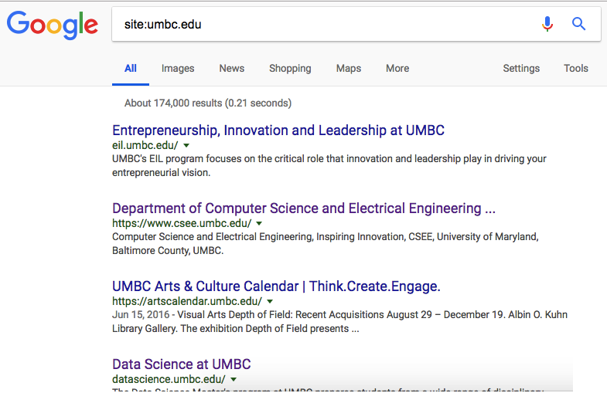
I want all the data
Google has indexed
trillions of web pages

Slide 10
Typical data sources
Web GUI – unstructured text, electronic format
Databases (SQL, HBase, Accumulo)
Semi-structured text and mixed media, i.e. Word/PDF documents
API (REST, SOAP)
Electronic documents (Word, Powerpoint, Excel)
Books, papers (hard copy) – unstructured text
A well-rounded data scientist can extract data from any source

Slide 11
Outcomes for this evening
By the end of today's class, you should be able to do the following:
Describe how your computer accesses content on the Internet
Scrape content from websites using Python libraries
Explain the moral and ethical issues of scraping
Demonstrate use of APIs
Extract content from documents (PDF, DOCX, RTF) and from webpages (HTML using BeautifulSoup)

Slide 12

How to computer: Internet version
Type in web address
Get Content
If that's all you know,
then that's all you can do
Notes:
http://kenfager.com/wordpress/?p=2413

Slide 13
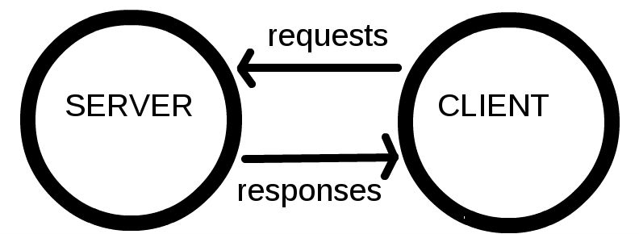
New Knowledge means New Vocabulary
Notes:
https://developer.mozilla.org/en-US/docs/Learn/Getting_started_with_the_web/How_the_Web_works

Slide 14
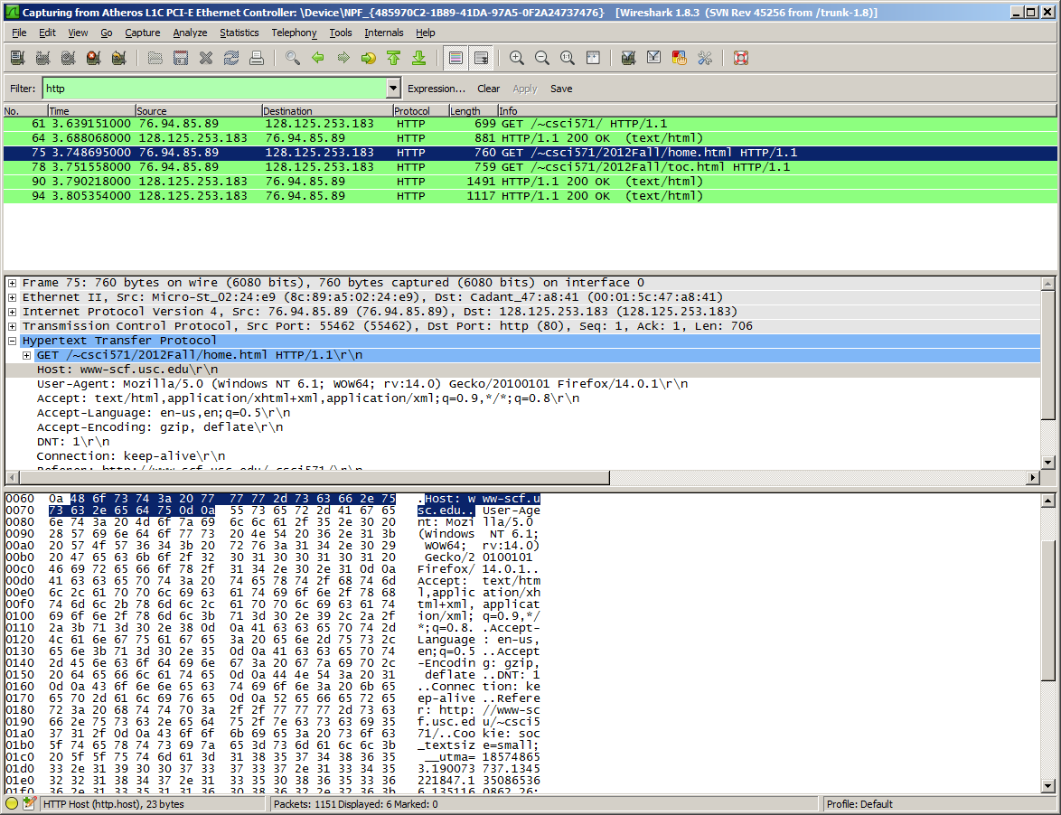
Packets contain information
Text
HTML: Hyper Text Markup Language
CSS: Cascading Style Sheets
JavaScript
Other media, i.e. sound, video, images
Notes:
https://motherboard.vice.com/en_us/article/jpgmxp/how-to-go-from-0-to-sniffing-packets-in-10-minutes

Slide 15
Process of getting a webpage
Client computer is connected to Internet and has an address
Person on client computer enters URL in web browser
URL is resolved to address of server
Using HTTP, browser sends a GET request to the server asking for the file https://mydomain.com/web-server.htm
Server sends content to client computer
Client computer renders the HTML content as a web page
Disclaimer: not describing ports, IP, DNS, TCP/IP, cookies, certs
Notes:
https://medium.com/@maneesha.wijesinghe1/what-happens-when-you-type-an-url-in-the-browser-and-press-enter-bb0aa2449c1a
https://web.stanford.edu/class/msande91si/www-spr04/readings/week1/InternetWhitepaper.htm

Slide 16
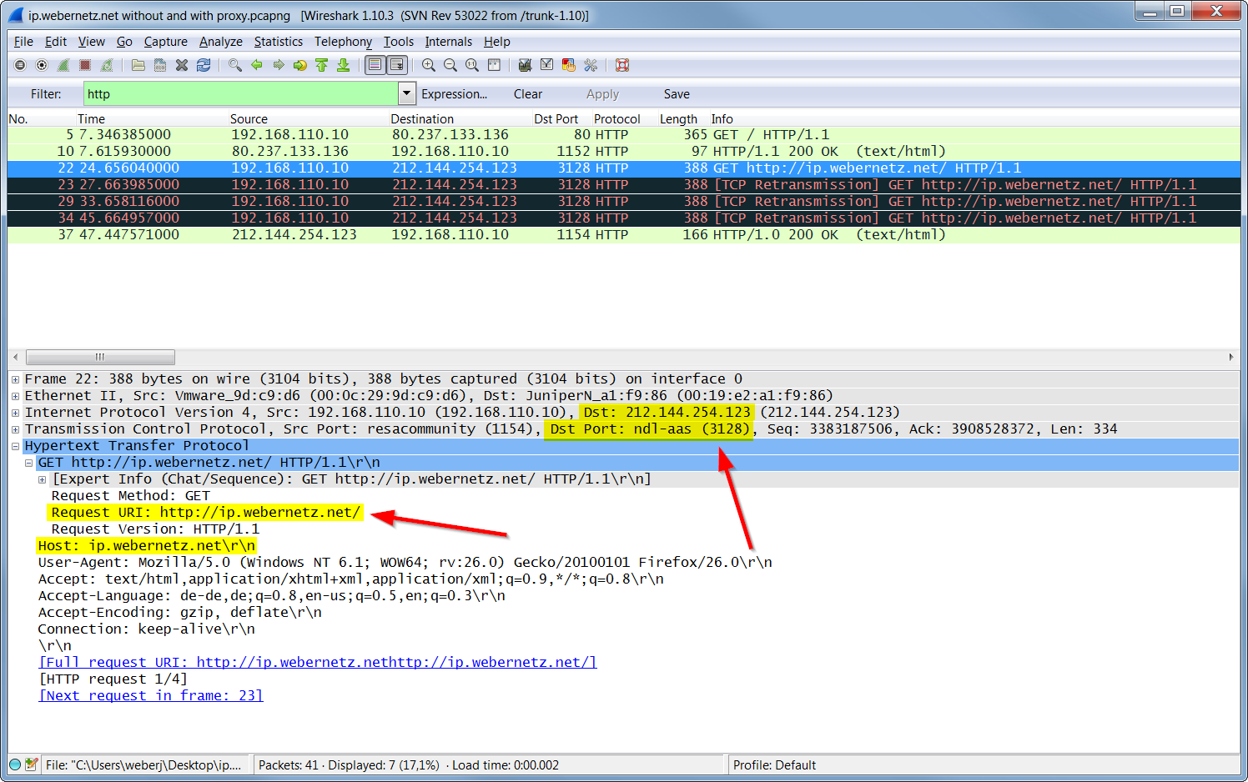
Notes:
https://gitlearning.wordpress.com/2017/01/23/wireshark-lab-http/

Slide 17
Using computers to do boring repetitive work
There are many software tools to automate getting data on the web
Curl
Wget
Requests
Scrapy
I will focus on text content

Slide 18
Legality of Content Scraping
Web Scraping = automated collection of content
Few sites make explicit statements about scraping
Example: https://www.50states.com/terms.htm
Web Crawlers
consume server resources (CPU, memory, power)
consume bandwidth
Access parts of sites not commonly accessed by humans
Notes:
https://benbernardblog.com/web-scraping-and-crawling-are-perfectly-legal-right/
https://www.forbes.com/sites/ericgoldman/2015/03/24/qvc-cant-stop-web-scraping/

Slide 19
Instructions for crawlers: Robots.txt
http://www.robotstxt.org/robotstxt.html
Based on your user agent string:
https://www.whatismybrowser.com/detect/what-is-my-user-agent
Example robots.txt files:
https://cs.stanford.edu/robots.txt
https://slashdot.org/robots.txt

Slide 20
Activity: discuss ethics of scraping content
In groups of three, consider your legal risks and moral issues:
At what scale does scraping become an issue?
Just a few pages of content versus an entire domain
Does your stance change based on who you are getting content from?
Small business versus large corporation
Does your position change based on the purpose of scraping?
For research versus for commercial interest

Slide 21
Tools for getting content: wget (22 years old!)
Normally a command in linux
supports HTTP, HTTPS and FTP
able to recover from a prematurely broken transfer
Examples:
wget www.fogcam.org
wget -m –-limit-rate=200k http://mysite.com
-m=mirror; rate limit to 200 kB/sec
Can follow links in content
Also available in Python - https://pypi.org/project/wget/
Notes:
https://daniel.haxx.se/docs/curl-vs-wget.html

Slide 22
curl
Normally a command in linux
Supports FTP, FTPS, Gopher, HTTP, HTTPS, SCP, SFTP, TFTP, TELNET, DICT, LDAP, LDAPS, FILE, POP3, IMAP, SMB/CIFS, SMTP, RTMP and RTSP
Example:
curl www.fogcam.org
Also available in Python as "import pycurl"
https://curl.trillworks.com/
http://pycurl.io/docs/latest/index.html
Notes:
https://daniel.haxx.se/docs/curl-vs-wget.html

Slide 23
Python: Requests
Send HTTP using Python, get webpage back
http://localhost:8888/notebooks/week6_getting_data/get_1_requests.ipynb

Slide 24
Python: Scrapy
Framework for creating a web crawler
https://doc.scrapy.org/en/latest/intro/tutorial.html
conda install -c conda-forge scrapy
A site intended for exploration: http://toscrape.com/
http://quotes.toscrape.com/
http://books.toscrape.com/

Slide 25
Having data for a browser is insufficient
Scraping tools get data from the Internet
Data for web browsers is not suitable for analysis
Activity: view source of https://www.umbc.edu/
In Chrome, View > Developer > View Source
In Firefox, Tools > Web Developer > Page Source

Slide 26
Parsing HTML using beautifulsoup
http://localhost:8888/notebooks/week6_getting_data/get_2_beautifulsoup.ipynb

Slide 27
Discussion: Refining a Hypothesis
Are people better off than their parents?

Slide 28
Activity: Create Guidelines for Brainstorming
What constitutes good guidelines for brainstorming?
When should evaluation of ideas occur?
How to balance different personalities?
How to remain focused?

Slide 29
Activity: Hypothesis generation
Data should be generative, not conclusive.
Great questions capture points of uncertainty about your story or probe long-held assumptions.
Identify stakeholders
What are the features in the data?
What are the goals of each stakeholder in the story?
What's the outcome of the story?
What's the opposite?
What's absurd?
What are the interactions among stakeholders?
Generate 3 to 4 ideas; then refine to be testable
Notes:
https://help.optimizely.com/Ideate_and_Hypothesize/Best_practices%3A_From_research_to_hypothesis_creation
https://openlab.citytech.cuny.edu/writingacrossthecurriculum/2016/10/03/generating-hypotheses-across-the-disciplines/

Slide 30
Scraping data isn't the only path
https://www.ssa.gov/oact/babynames/
Year and Popularity scale for a List of the Most Popular Names
Can we scrape the data?
https://www.ssa.gov/robots.txt
Do policies allow scraping?
https://www.ssa.gov/agency/websitepolicies.html

Slide 31
Sometimes data is made available for download
https://www.google.com/search?q=site%3Assa.gov+download+baby+names
https://www.google.com/search?q=site%3Assa.gov+api
In this case, we find the data is available for direct download:
https://www.ssa.gov/oact/babynames/limits.html
https://catalog.data.gov/dataset?tags=baby-names
https://www.ssa.gov/open/data/
https://www.ssa.gov/data/

Slide 32
Example of a simple API
http://swoogle.umbc.edu/SimService/
http://swoogle.umbc.edu/SimService/api.html
http://localhost:8888/notebooks/week6_getting_data/get_6_requests_use_simple_API.ipynb

Slide 33
Constrain access using API keys
https://sis.jhu.edu/api as an alternative to https://sis.jhu.edu/classes/
http://localhost:8888/notebooks/week6_getting_data/get_7_requests_use_API_with_key.ipynb

Slide 34
Working with data owners
Not all data is directly accessible
As a data scientist in a large organization, your team isn't the profit generator
The data scientist also isn't the knowledge owner
You have to convince people with data that you can help them
You have to convey ability to assist and ability to communicate at their level in their jargon

Slide 35
Role play activity: negotiating to find fear/hope
Part 1
Data owners move to one side of room,
data requesters move to other side
Review your prompts
Each group collaborates on strategy

Slide 36
Role play activity: negotiating to find fear/hope
Part 2
Find a partner from the other team that you haven't collaborated with recently
Engage your partner

Slide 37
(Activity) Negotiation with partner
Requester asks Owner, "do you have this data set?"
Owner says, "Yes"
Requester: "I want a copy of the data you have."
Owner: use an excuse
Requester: persist
Owner: indicate fear
Requester: how will you address the owner's fear?

Slide 38

Getting data from (electronic) documents
Not all data is on the Internet
Internal business records
Reports
Essays submitted by students of Data 601 section 4
http://localhost:8888/notebooks/week6_getting_data/text_1_extract_text_from_docx.ipynb
--> If you can losslessly convert your document to HTML, do that

Slide 39

When you don't have the data you need
Fake (synthetic) data
What variables would you need in your model?
What is the distribution of each variable?
Expected frequency of measurements?
Expected number of instances?
Expected data format (JSON, XML, CSV, HTML, DOCX)
Expected data type (date strings, text, numbers)
https://www.generatedata.com/ https://www.mockaroo.com/

Slide 40
How to use fake data
Write analysis before you have the data
Play with visualizations
Generate report layout
Negotiate with stakeholders so they have something to point at

Slide 41
Homework Assignment 1: Generate fake data
Write a Python notebook that generates a file containing the following data:
Email addresses
Phone numbers
Home Address
Person's name
Number of kids. Use realistic values.
Categorical variable: rent or own?
Annual income. Shape of distribution should be non-uniform.
Number of speeding tickets in past year. Shape of distribution should be non-uniform.
Year born. Use realistic values.
Generate data in 2 of the following 3 formats: XML, CSV, or JSON. Your choice!
Order of columns in CSV is not relevant.

Slide 42
I will not be available Oct 5 to Oct 12
I will be offline starting Friday
I will not be available until Oct 12
There will be a substitute on Oct 11: John Clemens
Homework that would normally be due Oct 10 will be due Oct 16 (Tuesday).
You are welcome to email me questions; I won't be replying until after Oct 12.

Slide 43
Homework 2: ragged CSV
A CSV with name, phone, and address
The address has variable content like street, state, zip
Submit a notebook that reads the CSV and produces a dataframe that has the information in an accessible format
The CSV is large, so do not include the full content in the notebook submitted for grading.
The CSV is large, so do not manually clean up the data
Data clean up does not have to be done using pandas – you can use regular expressions

Slide 44
Reading assignment for data cleaning
Introduction to Data Mining, Chapter 10; pages 651 to 659 (as numbered within the PDF.)

Slide 45
Consequences of Exploration
Exploration means you don't know.
Not all your investments get to customer
You will write code you discard
Perfection is a wasted on exploration
In contrast, product development focuses on what will reach customers in order to minimize costs.

Slide 46
Feedback from survey on homework
"I would definitely like more feedback on the reading assignments so I know what I'm doing wrong." --> The surveys were anonymous
"I was given a concept in class, then had to go learn how to do it at home."
Spend more time covering the basics of Python at the beginning of a semester
Design the questions to have different parts, with each part requesting a different step of the process, instead of a very open-ended request like the ones you would encounter in the field.

Slide 47
Mid-term project
Today (Oct 4): start proposal for mid-term
Oct 11: Proposal for mid-term project due; submit via Blackboard
Oct 13-17: I grade the proposal and provide feedback on proposal
Oct 18: Start mid-term project
Nov 1: Submit mid-term project for grading

Slide 48
Data Science doesn't always win
Having a correct and complete solution does not mean it gets selected
Decision makers can be swayed
By emotionally-driven stories
On the basis of prior relationships
To select a cheaper option.
It is vital to determine what convinces your audience before investing effort in Data Science analysis that uses code, data, math.
If your customer plays the lottery, they may not understand your numerical results

