Slide 1
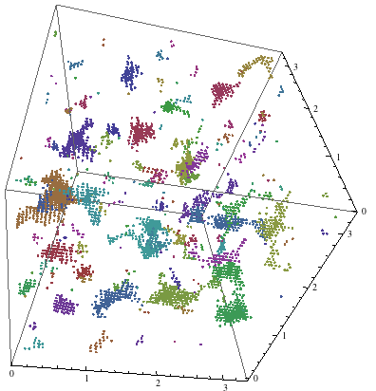
Class 5: clustering numerical data; document clustering
Sept 27, 2018
Data 601, section 4
In lecture 1 I said I wasn't going to cover LDA and TF-IDF.
I was wrong. I am covering them.
These notes are CC BY 4.0
Notes:
https://mathematica.stackexchange.com/questions/32738/clustering-3d-data-points-on-a-periodic-cubic-grid

Slide 2
Anonymous peer code review
I've printed two copies of your homework.
I've associated each printed copy with a numeric identifier.
I have the lookup table that correlates student name with number.
Each person gets two different homeworks to evaluate.
Evaluate each homework according to the rubric; write your comments on the homework.
Return the commented homework to me.
I will decode the numeric label to the respective student.
I will deliver the commented homework back to each student.
I will collect the commented homework at the end of class.

Slide 3
Rubric for peer review of code
Documentation: Is the code properly documented and commented?
(Possible answers: It needs more work / Somewhat / Yes it is great).
--> How should the documentation be better?
Error handling: Does the code handle errors properly?
(Possible answers: It needs more work / Somewhat / Yes it is great).
--> How should the error-handling be better?
Suggestions: Provide two suggestions for the author on how to improve the code.
Notes:
https://towardsdatascience.com/teaching-code-review-in-university-courses-using-peer-feedback-5625fe039f2a

Slide 4
Anonymous peer code review
I've printed two copies of your homework.
I've associated each printed copy with a numeric identifier.
I have the lookup table that correlates student name with number.
Each person gets two different homeworks to evaluate.
Evaluate each homework according to the rubric; write your comments on the homework.
Return the commented homework to me.
I will decode the numeric label to the respective student.
I will deliver the commented homework back to each student.
I will collect the commented homework at the end of class.

Slide 5
How do I find relevant analysis capabilities in Jupyter notebooks?
Tab completion in Jupyter notebooks (readline or pyreadline module)
Google search for desired capability
Review notebooks used in this class (posted to BlackBoard)

Slide 6
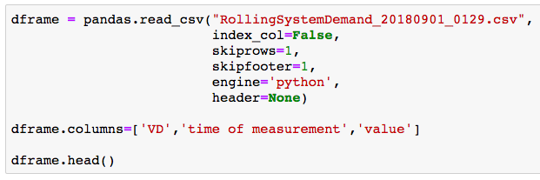
Complex commands do not just appear; I iteratively discover commands
I don't memorize these commands. I build them iteratively.
The final result is concise; it hides hours of detective work.

Slide 7
I use free software and free data
There's lots of commerical software available
Financially, I don't want to pay for software or data
Morally, I want to enable reproducability for other people
Notes:
https://www.gnu.org/philosophy/shouldbefree.en.html

Slide 8
Warnock's dilemma adapted for lecture
When I get no response from y'all, there are a couple hypotheses:
The information is correct, well-delivered that needs no follow-up commentary. There's nothing more to say except "Yeah, got it."
The information is complete and utter nonsense, and no one wants to waste the energy to even point this out.
No one heard/saw the information, for whatever reason.
No one understood the information, but won't ask for clarification, for whatever reason.
No one cares about the information, for whatever reason.

Slide 9
Homework review
Excel
http://localhost:8888/notebooks/homework_week4/excel_merge/Loading%20data%20from%20xlsx.ipynb
http://localhost:8888/notebooks/homework_week4/excel_merge/13906472%20loading%20data%20from%20xlsx.ipynb
http://localhost:8888/notebooks/homework_week4/excel_merge/ExcelMergeHW.ipynb
http://localhost:8888/notebooks/homework_week4/excel_merge/13950677%20Import_Excel_Data_Scatter_Plot_Scalable-3.ipynb
CSV join
http://localhost:8888/notebooks/homework_week4/join_tables/reference%20implementation%20-%20great%20voiceover%20-%2013969655%20joining_tables.ipynb
http://localhost:8888/notebooks/homework_week4/join_tables/reference%20implementation%20-%20concise%20-%2013978710%20jointablesw4.ipynb

Slide 10

Course schedule and outline (scope)
Aug 30: Overview Data Science
Sept 6: Python in Jupyter
Sept 13: Math (stats)
Sept 20: Regression
Sept 27: Clustering
Oct 4: Getting data
Oct 11: Substitute's choice
Oct 18: Data cleanup
Oct 25: Automation
Nov 1: Evaluation, cross-validation, overfitting
Nov 8: Scaling up
Nov 15: Property graphs
Nov 22: No class (Thanksgiving)
Nov 29: Elasticity, Cost/benefit
Dec 6: Ethics and Legality
Dec 13: Presentations

Slide 11
Course schedule and outline (projects)
Aug 30:
Sept 6:
Sept 13:
Sept 20:
Sept 27: preview
Oct 4: start proposal for mid-term
Oct 11: Substitute; Submit proposal for mid-term project
Oct 18: Start mid-term project
Oct 25: reminder to check-in
Nov 1: Submit mid-term project; start proposal for final
Nov 8: Submit proposal for final
Nov 15: Final project assigned
Nov 22: No class (Thanksgiving)
Nov 29: reminder to check-in
Dec 6: Final project due
Dec 13: Presentations

Slide 12
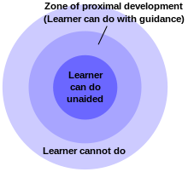
Mid-term project
Data resources
Rubric for proposal
Rubric for project
Desired outcome is :o
"the role of education is to give students experiences that are within their zones of proximal development, thereby encouraging and advancing their individual learning such as skills and strategies."
Notes:
https://en.wikipedia.org/wiki/Zone_of_proximal_development

Slide 13

Customer didn't think it was possible, so they didn't bother asking
Notes:
https://kramers.com/story-time

Slide 14
Outcomes for this evening
By the end of today's class, you should be able to do the following:
Load function from .py file in a .ipynb notebook
Explain difference between agglomerative and divisive clustering
Use k-Means to identify subsets of data
Identify common "stop words"
Write simple regular expressions

Slide 15
Load function from .py file in a .ipynb notebook
http://localhost:8888/notebooks/week5_clustering/use_a_function_in_a_notebook.ipynb

Slide 16
Last week: supervised
classification: start with pre-determined classes with example members
clustering: figure out groups of similar objects
This week: unsupervised
Notes:
http://www.cs.princeton.edu/courses/archive/spr11/cos435/Notes/clustering_intro_kmeans_topost.pdf

Slide 17
Map of Machine Learning topics
Machine Learning
Supervised
User provides "right answer" as example data
Unsupervised
No labeled data provided
Regression
Predict real valued output
Classification
Predict discrete valued output
clustering
Linear
regression
Logistic
regression
Decision
tree
Neural
network (DL)
k-Nearest
Neighbors (kNN)

Slide 18
Machine Learning
Unsupervised
No labeled data provided
clustering
For a better overview tree, see
Techniques of Cluster Algorithms in Data Mining
October 2002; Data Mining and Knowledge Discovery 6(4):303-360
DOI: 10.1023/A:1016308404627
Hierarchical
clustering
Partitional
clustering
Divisive
Agglomerative
K-Means
Notes:
Techniques of Cluster Algorithms in Data Mining
October 2002; Data Mining and Knowledge Discovery 6(4):303-360
DOI: 10.1023/A:1016308404627
Images is from https://www.alanfielding.co.uk/multivar/ca.htm

Slide 19
Application for clustering: Search engine supplies similar topics
http://yippy.com/ is a metasearch site that groups results into "nearby" topics
Activity: in your web browser, go to yippy.com and search for
data science
Notes:
https://www.hindawi.com/journals/tswj/2015/931258/

Slide 20
Application for clustering: Customer or Market segmentation
important for optimization of marketing strategies.
Better targeting of consumers through behavioral analysis of purchases, timing, which channel gets accessed, customer attributes
Notes:
https://www.kaggle.com/nafisur/customer-segmentation-analysis-cluster-analysis

Slide 21
Application for clustering: Detecting anomalies
Group valid activity to enable outlier detection
monitoring if a tracked data point switches between groups over time can be used to detect meaningful changes in the data.
Notes:
https://www.datascience.com/blog/k-means-clustering

Slide 22
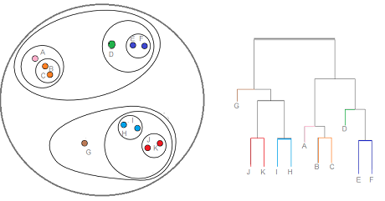
Clustering approaches
Partitional algorithms: Construct various partitions and then evaluate them by some criterion
Hierarchical algorithms: Create a hierarchical decomposition of the set of objects using some criterion
Notes:
Text is from https://www.cs.cmu.edu/~tom/10601_fall2012/slides/clustering.pdf
overview: https://youtu.be/Xvwt7y2jf5E
Image is from https://www.statisticshowto.com/hierarchical-clustering/

Slide 23
Clustering approaches
Partitional algorithms: Construct various partitions and then evaluate them by some criterion
Hierarchical algorithms: Create a hierarchical decomposition of the set of objects using some criterion
Bottom-up (Hierarchical Agglomerative Clustering): starting with isolated points, merged two items at a time into a new cluster by calculating a dissimilarity between each merged pair and the other samples.
Top-down (Hierarchical Divisive Clustering): Starting with a single set, split into two distinct parts according to some degree of similarity.
Notes:
Text is from https://www.cs.cmu.edu/~tom/10601_fall2012/slides/clustering.pdf
Image is from https://www.statisticshowto.com/hierarchical-clustering/

Slide 24
Clustering approaches
Partitional algorithms: Construct various partitions and then evaluate them by some criterion
Notes:
Text is from https://www.cs.cmu.edu/~tom/10601_fall2012/slides/clustering.pdf
Image is from https://www.statisticshowto.com/hierarchical-clustering/

Slide 25
Activity: you already know how to cluster
Given a scatter plot and a guess for k, identify which points should be assocaited with k groups

Slide 26
A formalized approach: K-means algorithm
Guess number of clusters, k
Guess location of cluster centers
Loop following until converged
Expectation step: assign points to the nearest cluster center using a distance measurement
Maximization step: set the cluster centers to the mean
Example distance measurement:
Residual Sum of Squares: minimize sum of squared distances of each point to its centroid
Notes:
http://www.cs.princeton.edu/courses/archive/spr11/cos435/Notes/clustering_intro_kmeans_topost.pdf
https://jakevdp.github.io/PythonDataScienceHandbook/05.11-k-means.html

Slide 27
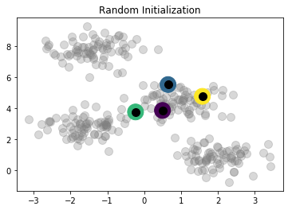
[[ 0.49671415 3.8617357 ] [ 0.64768854 5.52302986] [-0.23415337 3.76586304] [ 1.57921282 4.76743473]]
http://localhost:8888/notebooks/week5_clustering/jakevdp_kmeans_iterations.ipynb

Slide 28
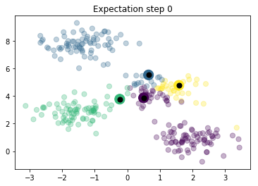
Identify which points are associated with centroids

Slide 29
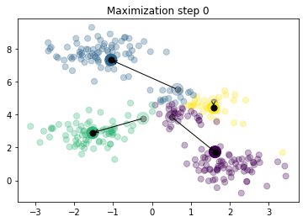
[[ 1.61788404 1.73021643] [-1.05544832 7.31289 ] [-1.53049092 2.89441674] [ 1.58028607 4.4210127 ]]

Slide 30
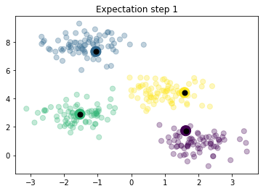
Identify which points are associated with centroids

Slide 31

[[ 1.98258281 0.86771314] [-1.37324398 7.75368871] [-1.57084703 2.85535402] [ 0.97007666 4.41532732]]

Slide 32
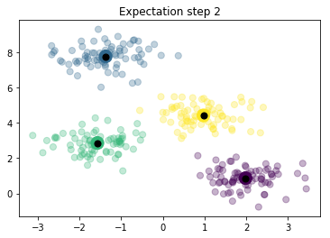
Identify which points are associated with centroids

Slide 33

[[ 1.98258281 0.86771314] [-1.37324398 7.75368871] [-1.58438467 2.83081263] [ 0.94973532 4.41906906]]

Slide 34
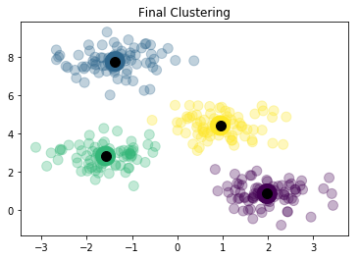
Based on convergence

Slide 35
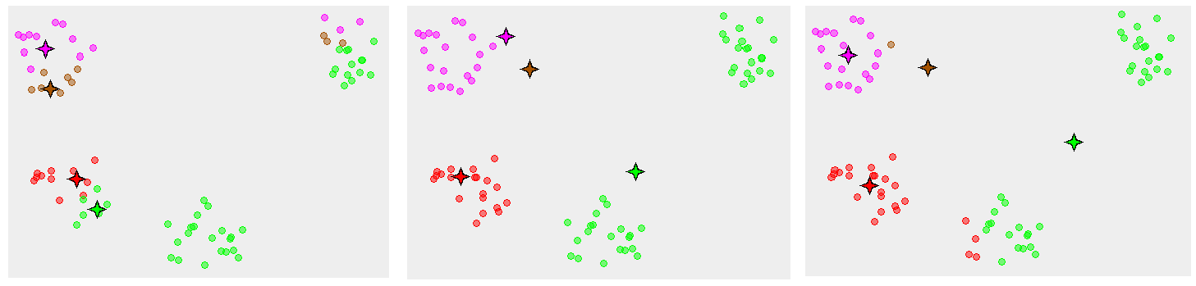
Avoid local minima by using multiple initial guesses for centroids

Slide 36
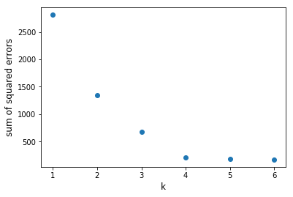
What k is best? Find the elbow
Compare within-cluster sum of squares for multiple k values
Caveat: this is a visual estimation method; fancier approaches are available
http://localhost:8888/notebooks/week5_clustering/jakevdp_kmeans_iterations_elbow.ipynb

Slide 37
Given k clusters, how to identify labels?
Options:
summarize the distribution of attribute values
learn a decision tree from the clusters; then the relevant attributes are identified by the decision tree model
Figuring out labels for data is challenging
Notes:
https://doi.org/10.1007/978-3-319-20910-4_2
Witschel H.F., Loo S., Riesen K. (2015) How to Support Customer Segmentation with Useful Cluster Descriptions. In: Perner P. (eds) Advances in Data Mining: Applications and Theoretical Aspects. ICDM 2015. Lecture Notes in Computer Science, vol 9165. Springer, Cham

Slide 38
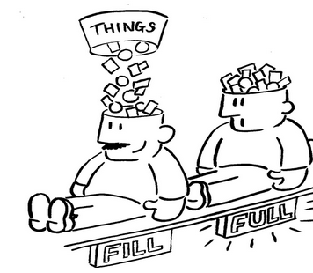
All done
Notes:
http://myemail.constantcontact.com/Is-your-brain-full-.html?soid=1105866149032&aid=fKlm9pjEiwk

Slide 39

Notes:
https://sayingimages.com/just-kidding-meme/

Slide 40
What if the data isn't numeric?

Slide 41
Suppose you have 1000 documents
Examples: web pages, PDFs, Word documents
Don't have time to manually read each
Can documents be clustered? By what attributes?
Metrics like word count, average word length probably aren't useful

Slide 42
Written text is unstructured data
structured data typically has defined data types and is organized into patterns, making search and analysis easy
Unstructured data lacks data types and patterns
(There's also semi-structured data, ie JSON and XML.)
Notes:
https://www.quora.com/What-are-Structured-semi-structured-and-unstructured-data-in-Big-Data

Slide 43
But what about grammatical rules? Spelling?
Natural language (ie English, Spanish, Hindi, Mandarian) each have rules for construction.
Rules have exceptions.
Spelling has variations.
Spelling can be incorrect.
Mapping human communication to machine understandable content is the domain of Natural Language Processing
Notes:
https://stanfy.com/blog/natural-language-processing-why-the-machines-still-struggle-to-understand-us/
https://math.stackexchange.com/questions/170902/why-cant-we-use-memoization-to-parse-unambiguous-context-free-grammars-in-linea

Slide 44
A quick example
Claim: sentences end with a period.
--> to split a document into sentences, simply split the string on periods.
Example:
"This is a fun description of nothing. Another example of sound is provided by my radio. The rug is red."
How many sentences are present in the example?

Slide 45
A quick example of the complexity
Claim: sentences end with a period.
--> to split a document into sentences, simply split the string on periods.
Another example:
"My doctor is Dr. Stark who knows stuff, e.g., medicine, is smart. I apply the K.I.S.S. principle: Keep It Simple, Stupid."
The naïve approach isn't sufficient.
Notes:
https://en.wikipedia.org/wiki/KISS_principle

Slide 46
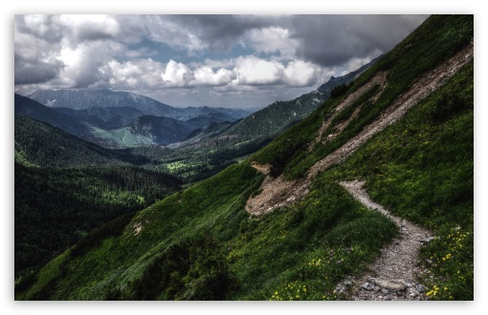
Notes:
http://wallpaperswide.com/mountain_path-wallpapers.html

Slide 47
Activity: Find a string in a text document
Go to https://library.umbc.edu/
Search the page using "ctrl + f"
Search for the string "room"

Slide 48
Find a string in a text document
Go to https://library.umbc.edu/
Search the page using "ctrl + f"
Search for the string "room"
(rhetorical questions)
What if we needed to find every email address in a document?
What if we needed to find every phone number in a document?

Slide 49
Patterns in text
We are familiar with email addresses: aok@umbc.edu
Phone numbers look something like 410-455-2232

Slide 50
Patterns in text
We are familiar with email addresses: aok@umbc.edu
A sequence of letters or numbers, then @, then more letters and numbers, a period, and two or more letters.
Phone numbers look something like 410-455-2232
Three numbers, a space or dash, three numbers, a space or dash, then four more numbers.

Slide 51
Regular Expressions
A way to represent digits: \d
Phone number: \d\d\d-\d\d\d-\d\d\d\d\
Another way to represent digits: [0-9]
http://localhost:8888/notebooks/week5_clustering/introduction_to_regular_expressions.ipynb

Slide 52
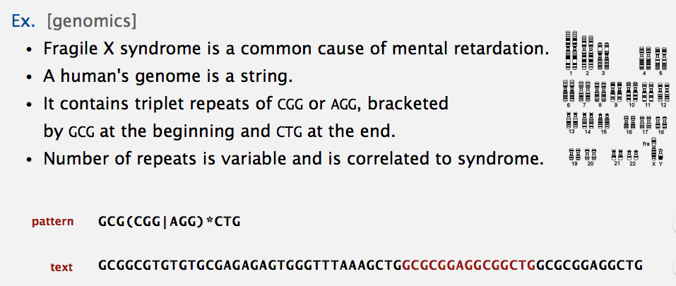
RegEx apply where ever text exists
Notes:
https://algs4.cs.princeton.edu/lectures/54RegularExpressions.pdf

Slide 53
Regular Expression references
https://regexper.com/
https://regexr.com/
https://github.com/ziishaned/learn-regex
https://qntm.org/files/re/re.html
https://www.regexpal.com/
https://www.debuggex.com/
https://www.regular-expressions.info/
https://stackoverflow.com/tags/regex/info
https://regex101.com/
Cheatsheets:
https://ryanstutorials.net/regular-expressions-tutorial/regular-expressions-cheat-sheet.php
http://www.cbs.dtu.dk/courses/27610/regular-expressions-cheat-sheet-v2.pdf
https://www.cheatography.com/davechild/cheat-sheets/regular-expressions/

Slide 54
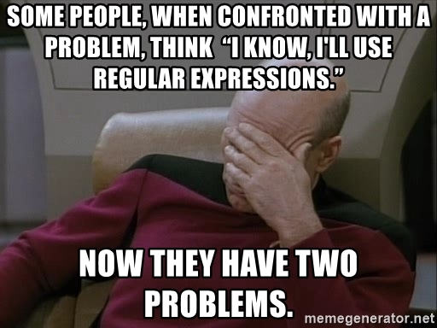
https://en.wikiquote.org/wiki/Jamie_Zawinski
Notes:
https://memegenerator.net/instance/14176209/picardfacepalm-some-people-when-confronted-with-a-problem-think-i-know-ill-use-regular-expressions-n

Slide 55
When RegEx is insufficient, use a parser
RegEx applies to Regular Languages
HTML is not a Regular Language
See also
https://stackoverflow.com/questions/6751105/why-its-not-possible-to-use-regex-to-parse-html-xml-a-formal-explanation-in-la
https://blog.codinghorror.com/parsing-beyond-regex/
https://stackoverflow.com/questions/11905506/regular-expression-vs-string-parsing
https://blog.honeybadger.io/replacing-regular-expressions-with-parsers/

Slide 56
Now that we know how to find complex strings in text,
How would we identify which words are relevant in a document?
Notes:
http://brandonrose.org/clustering
https://towardsdatascience.com/clustering-algorithms-for-customer-segmentation-af637c6830ac
https://www.datascience.com/blog/k-means-clustering
https://mubaris.com/2017/10/01/kmeans-clustering-in-python/

Slide 57
Activity: which words in this text are irrelevant?
I go to the store. A car is parked. Many cars are parked or moving. Some are blue. Some are tan. They have windows. In the store, there are items for sale. These include such things as soap, detergent, magazines, and lettuce. You can enhance your life with these products. Soap can be used for bathing, be it in a bathtub or in a shower. Apply the soap to your body and rinse. Detergent is used to wash clothes. Place your dirty clothes into a washing machine and add some detergent as directed on the box. Select the appropriate settings on your washing machine and you should be ready to begin. Magazines are stapled reading material made with glossy paper, and they cover a wide variety of topics, ranging from news and politics to business and stock market information. Some magazines are concerned with more recreational topics, like sports card collecting or different kinds of hairstyles. Lettuce is a vegetable. It is usually green and leafy, and is the main ingredient of salads. You may have an appliance at home that can quickly shred lettuce for use in salads. Lettuce is also used as an optional item for hamburgers and deli sandwiches. Some people even eat lettuce by itself. I have not done this. So you can purchase many types of things at stores.

Slide 58
Activity: which words in this text are irrelevant?
I go to the store. A car is parked. Many cars are parked or moving. Some are blue. Some are tan. They have windows. In the store, there are items for sale. These include such things as soap, detergent, magazines, and lettuce. You can enhance your life with these products. Soap can be used for bathing, be it in a bathtub or in a shower. Apply the soap to your body and rinse. Detergent is used to wash clothes. Place your dirty clothes into a washing machine and add some detergent as directed on the box. Select the appropriate settings on your washing machine and you should be ready to begin. Magazines are stapled reading material made with glossy paper, and they cover a wide variety of topics, ranging from news and politics to business and stock market information. Some magazines are concerned with more recreational topics, like sports card collecting or different kinds of hairstyles. Lettuce is a vegetable. It is usually green and leafy, and is the main ingredient of salads. You may have an appliance at home that can quickly shred lettuce for use in salads. Lettuce is also used as an optional item for hamburgers and deli sandwiches. Some people even eat lettuce by itself. I have not done this. So you can purchase many types of things at stores.

Slide 59
short words are less useful?
That naïve heuristic has exceptions:
Cat
Dog
Gun
Ben
http://localhost:8888/notebooks/week5_clustering/nltk_for_text_processing.ipynb

Slide 60
Stop words
There are many lists of stop words available, i.e.
https://gist.github.com/sebleier/554280
http://xpo6.com/list-of-english-stop-words/
the specific list of stop words isn't priority

Slide 61
We can clean documents! Now what?
Next up: identifying words that are more unique to documents

Slide 62
Term Frequency-Inverse Document Frequency
Tf-idf makes rare words more prominent and effectively ignores common words.
http://localhost:8888/notebooks/week5_clustering/tfidf_old.ipynb
Notes:
https://www.oreilly.com/library/view/feature-engineering-for/9781491953235/ch04.html

Slide 63
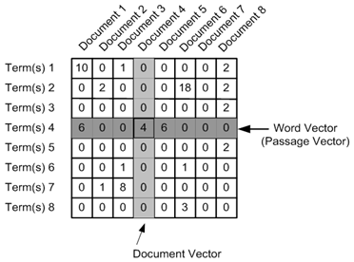
document-term matrix
Notes:
http://brandonrose.org/clustering

Slide 64
K-means applies to documents
See http://brandonrose.org/clustering

Slide 65
Topic modeling for unstructured text documents
LDA: Latent Dirichlet Allocation

Slide 66

"Unreasonable" Parsing
header separated by commas
First data column separated by :
Subsequenct columns separated by |
Notes:
https://www.unlv.edu/event/storytime-barrick-museum-1

Slide 67
Ambiguous but not conflicting
Assignments have been ambiguous
Haven't been able to figure out how to create conflicting requirements

Slide 68
Coding Homework Warmup
Warmup: convert date-time to day of week
def convert_datetime_to_dayofweek(datetime_string):
"""
>>> convert_datetime_to_dayofweek('Jun 1 2005 1:33PM')
'Wednesday'
>>> convert_datetime_to_dayofweek('Oct 25 2012 2:17AM')
'Thursday'
"""
# your code goes here
return dayofweek

Slide 69
Fix the function
I provide a function
The function has no errors.
But the function also doesn't do what I want.
You fix it
You submit the fixed function in a .py file via Blackboard

Slide 70
Task
Review mid-term project rubric and data sources posted to Blackboard under "Course Content" > "Mid-term project"
Send your questions to me via email: benpayne@umbc.edu

Slide 71
Reading assignment
Read Sections 1,2,3,6 of
http://opim.wharton.upenn.edu/~sok/idtresources/python/regex.pdf
Summarize what you learned in a half page (more than 100 words, less than 270).
Do not include your name.
Submit your text to me via Blackboard. Submit the content as text. Do not submit a docx or PDF or an image.

Slide 72
[Not an assignment] Article on understanding Python errors
https://swcarpentry.github.io/python-novice-inflammation/07-errors/

Slide 73
Prep for next week by watching
https://www.youtube.com/watch?v=V0ucZ4ctof8
Creator's Goal: Find the Mario Maker level with the most plays and the most star ratings.
Creator's Problem: Collecting the data. Nintendo does not offer it in a giant spreadsheet. You can pull up a query that shows 100 or whatever at a time, but we need 10^6 rows to achieve the goal.
At around 4:35 the creator breaks down the query, explains how someone wrote a script to scrape the website (a polite script too, which is smart - it didn't overwhelm the servers or cause the IP address to get blocked) and then briefly explains some of the other neat things you can find within the data set before diving in to address the goal.

Slide 74
References
See chapter 4 in https://www-bcf.usc.edu/~gareth/ISL/ISLR%20Seventh%20Printing.pdf page 127
https://towardsdatascience.com/the-5-clustering-algorithms-data-scientists-need-to-know-a36d136ef68
https://mubaris.com/2017/10/01/kmeans-clustering-in-python/
http://brandonrose.org/clustering
https://jakevdp.github.io/PythonDataScienceHandbook/05.11-k-means.html
LDA using GenSim: https://towardsdatascience.com/topic-modeling-and-latent-dirichlet-allocation-in-python-9bf156893c24

