Slide 1

Data cleanup and Anomalies (Week 8)
Oct 18, 2018
Notes:
https://www.analyticsindiamag.com/10-best-data-cleaning-tools-get-data/

Slide 2

Outline for this evening
Schedule for semester
Activity: anonymous code review
Mid-term project schedule
Scope of "Cleaning" and context
Sanity checks
Anomalies and Outliers
Missing data
Homework

Slide 3

Course schedule and outline (scope)
Oct 25: Automation, Reports
Nov 1: Scaling up, Estimation
Nov 8: Elasticity, Cost/benefit
Nov 15: Property graphs
Nov 22: No class (Thanksgiving)
Nov 29: Evaluation
Dec 6: Ethics and Legality
Dec 13: Presentations
Aug 30: Overview Data Science
Sept 6: Python in Jupyter
Sept 13: Math (stats)
Sept 20: Regression
Sept 27: Clustering
Oct 4: Getting data
Oct 11: Substitute's choice
Oct 18: Data cleanup

Slide 4
Activity: anonymous peer review of code; 1 of 3
I've printed two copies of your homework.
I've associated each printed copy with a numeric identifier.
I have the lookup table that correlates student name with number.
Each person gets two different homeworks to evaluate.
Evaluate each homework according to the rubric; write your comments on the homework.
Return the commented homework to person using lookup table.

Slide 5
Rubric for peer review of code
Documentation:
Is the thought process of the author clear in the documentation?
Does the code documentation and comments convey intention?
(Possible answers: It needs more work / Somewhat / Yes it is great).
--> How should the author better make clear their intention using documentation?
Should documentation be in code comments or markdown?
Write down any questions you have for the author of the code
Suggestions:
Provide two suggestions for the author on how to improve the code.
This can be in terms of style (variable names), documentation, or implementation

Slide 6
Activity: anonymous peer review of code; 2 of 3
I've printed two copies of your homework.
I've associated each printed copy with a numeric identifier.
I have the lookup table that correlates student name with number.
Each person gets two different homeworks to evaluate.
Evaluate each homework according to the rubric; write your comments on the homework.
Return the commented homework to person using lookup table.

Slide 7
Lookup table for step 2 of 3
Rachel = A5924
Yuting = A9582
Jarrod = A4208
Mehmet = A4232
Alistair = A5662
Esther = A2144
Pranshu = A4256
Yimen = A6863
Emily = A1353
Sweta = A5674
Geetika = A2683
Fitsum = A8257
David = A9829
Rashi = A4929
Phil = A2985
Josephine = A2562

Slide 8
Lookup table for step 3 of 3
Rachel = B5932
Yuting = B9583
Jarrod = B4829
Mehmet = B5366
Alistair = B3535
Esther = B5178
Pranshu = B4563
Yimen = B9885
Emily = B9422
Sweta = B2145
Geetika = B2432
Fitsum = B3242
David = B5567
Rashi = B3224
Phil = B5532
Josephine = B5387

Slide 9
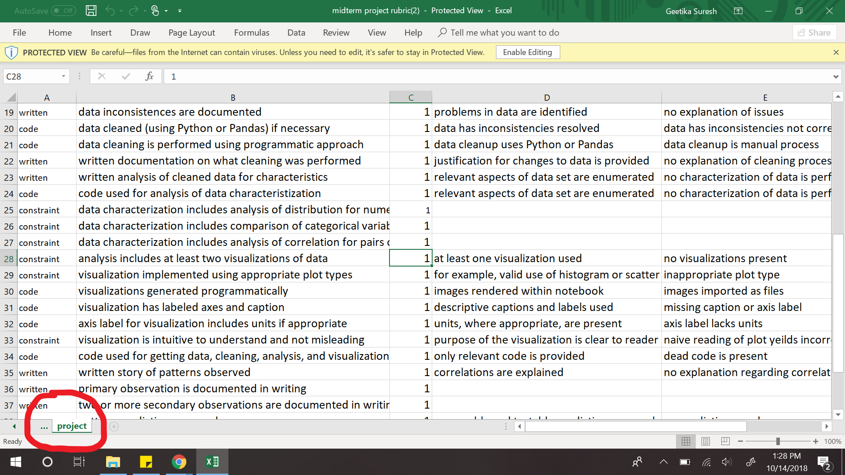
Survey: Project Rubric issues in Excel?

Slide 10
Mid-term project dates
(Oct 4): start proposal for mid-term
(Oct 11): Proposal for mid-term project due; submit via Blackboard
Oct 13-17: I grade the proposal and provide feedback on proposal
Today, Oct 18: Start mid-term project
by Oct 27: participate in check-in with Ben, either via email or in person
Nov 1: Submit mid-term project for grading

Slide 11
Mid-term report
A description of research methods can be called “coherent” and “complete” when readers understand the process well enough to replicate it themselves. [citation]
Analysis:
Applies methods learned in class
Uses Python 3 in Jupyter notebook
Demonstrates process of data science, from gathering data to telling story through characterization and prediction
Visualization: Intuitive, relevant

Slide 12


I am
Confused
Stuck
Working on it
Done!
And I have struggled for more than 30 minutes
Seek guidance from Ben
Turn in via Blackboard
Provide the notebook
you have created so far

Slide 13
Observation 1 from mid-term project proposals
Low variance in data sources: 4 of 15 (26%) students are using
https://data.baltimorecity.gov/Public-Safety/BPD-Part-1-Victim-Based-Crime-Data/wsfq-mvij/data

Slide 14
Observation 1 from mid-term project proposals
Low variance in data sources: 4 of 15 students are using
https://data.baltimorecity.gov/Public-Safety/BPD-Part-1-Victim-Based-Crime-Data/wsfq-mvij/data
Blackboard > Course Materials > Mid-term project > URLs of potential data resources
--> 53 data sources
What's the chance of (4 of 15 students using 1 of 53 sources) being random?

Slide 15
Doing the math
If I have 15 dice and each die has 53 side, how often will I get a situation where 4 of the 15 outcomes are the same?
http://localhost:8889/notebooks/week8_cleaning_data/53_sided_die.ipynb
0.00742, or 0.742% of the time
My hypothesis: http://data.baltimoresun.com/news/violent-crime-2017/
When creating a hypothesis there's no incentive to be "valid" (rather than invalid) as long as the analysis is valid

Slide 16
Observation 2 from mid-term project proposals
Sampling:
Is there too much data for your computer?
Or are you simply dropping data that doesn't appear to fit your needs?
Pro-tip: Shuffle rows before sampling to deal with sorted data
# Randomly sample 70% of your dataframe df_percent = df.sample(frac=0.7) # Randomly sample 34 elements from your dataframe df_elements = df.sample(n=34)
Notes:
https://stackoverflow.com/questions/15923826/random-row-selection-in-pandas-dataframe

Slide 17
What is in Scope for "data cleanup"
Sanity checks
Anomaly identification
Missing data
Data formatting

Slide 18
What you should walk away with tonight
Be able to explain at least four sanity checks on data
Apply remediation techniques for missing entries in data
Identify outliers (anomalies) in data and document the action (or inaction taken)

Slide 19

Cleaning data is an investment
Before cleaning data, make sure outcome is relevant to your customers
Fake data can be useful
to help enumerate requirements and expectations

Slide 20
Can you proceed without cleaning data?
Suppose you can load the data into a dataframe.
--> Don't jump immediately into getting a result
Even when data can be read into your application, additional cleaning may be needed
Cleaning and analytic development is an iterative process of finding issues and resolving them while also creating the desired outcome (without introducing bias)

Slide 21

Be Skeptical; Don't trust your data
Is author a source I can contact if I have questions or concerns?
Does data appear to be regularly updated and checked for errors?
Does data come with information as to how it was acquired and what types of samples were used in its acquisition?
Is there another source of data that can verify and validate this dataset?
Given my overall knowledge of the topic, does this data seem plausible?
Source: page 128 of "Data Wrangling with Python"

Slide 22
Outline for this evening
Schedule for semester
Activity: anonymous code review
Mid-term project schedule
Scope of "Cleaning" and context
Sanity checks
Anomalies and Outliers
Missing data
Homework

Slide 23
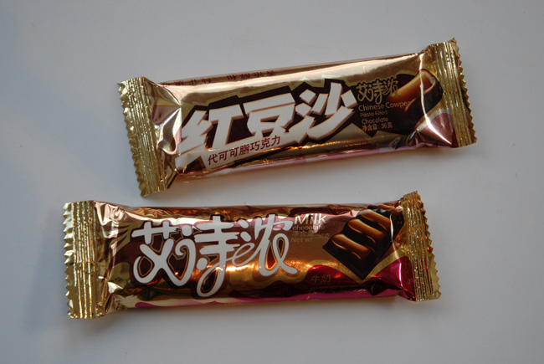

sanity checks for numerical variables
is the data self-consistent?
Sensical?
Is numerical variable within a bounded range?
Cost of candy bar is $132,402 USD
Cost of a sofa is $0.0042
For numerical variables, sort or find max and min

Slide 24
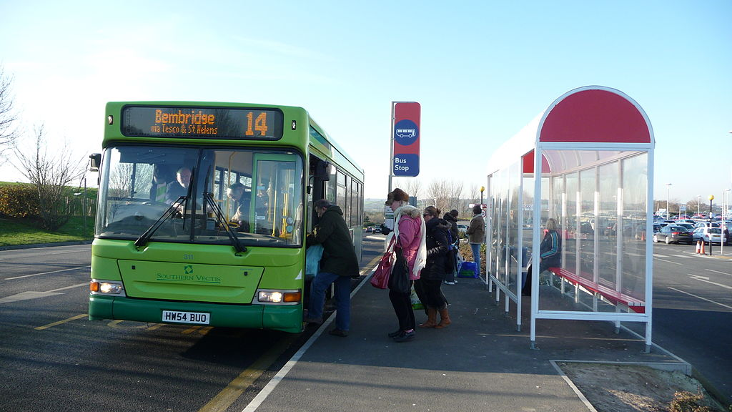
sanity checks for numerical variables
Variance too wide or not as wide as expected
15 of 28 bus arrival times between 3:09:12pm and 3:09:34pm
For numerical variables,
measure variance

Slide 25
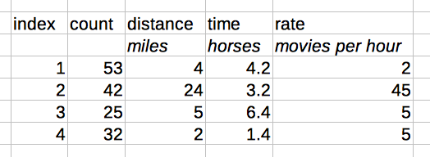
sanity checks for numerical variables
Check units of all columns to make sure they are meaningful

Slide 26
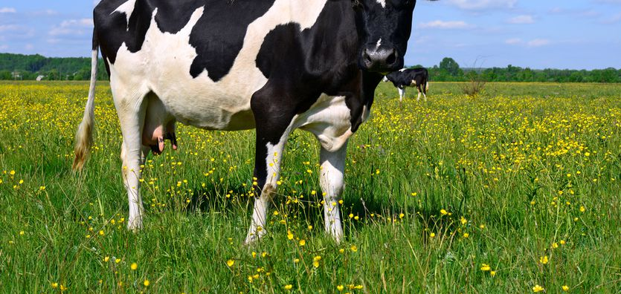
sanity checks for numerical variables
Are values non-sensical?
Negative values (i.e. a length)
Fractional values for counting (i.e., there are 4.28 cows)
Percentages of a whole that exceed 100% (i.e., 153% of the chapters in a book)
For numerical variables, sort or find max and min

Slide 27
sanity checks for numerical variables
Are values unusual?
Ages of 100 people, but only ages are 10,20,30,40
For numerical variables,
a histogram would show this if bin count is appropriate

Slide 28
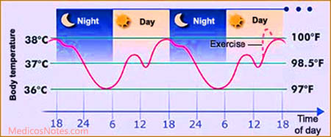
sanity checks for numerical variables
Values that oscillate (usually temporal variation)
https://en.wikipedia.org/wiki/Diurnal_temperature_variation
https://en.wikipedia.org/wiki/Diurnal_cycle
http://notes.medicosnotes.com/2016/05/normal-body-temperature-and-its.html

Slide 29

Activity: Brainstorm sanity checks for text
First, enumerate common text variables
as a group on the whiteboard

Slide 30
Activity: Brainstorm sanity checks for text
First, enumerate common text variables
as a group on the whiteboard
What constraints would you expect for these?
What exceptions would be indicators of problems?

Slide 31
Example sanity checks for text
Street Address: 59@4 Thomas Street
Name: Alice, Be#$, Kate
Name: Buck, Robert, 4' cable, Cindy
Categorical: Yes/No/Cats
Lists elements
List of names: ['Bob', 'Mary', 524]
List of colors: ['Blue', 'Red', 'Orange', 'Fruit']
List of states: ['Missouri', 'Wisconsin', 'Mexico']
List sizes: len(list_of_days_in_week) indicates 9
Data that claims to be XML, but is actually JSON
Data that claims to be text and is actually binary or otherwise encoded

Slide 32
Categorical variables: are there rare outcomes?
for this_column in df.columns:
print("==== ",this_column,
"has",df[this_column].nunique(),"unique entries ====")
print(df[this_column].value_counts().head(10))

Slide 33
What to do when sanity checks indicate issue?
Fix minor formatting issues i.e., with Regular Expressions (document your process)
Revisit the data collection process

Slide 34
Data cleaning: 1 is an exception, 2 is a pattern
Consistency of data comparing before cleanup with after cleanup: the cleaning shouldn't have altered essential aspects of the data
The point is that there is not a "right" choice.
Document your action and your justification.
Publicize decisions you made and publicize your documentation of how you arrived at the decision

Slide 35

Review of sanity checks
Is numerical variable within a bounded range?
Variance too wide or not as wide as expected
Check units of all columns to make sure they are meaningful
Are values non-sensical?
Are values unusual?
Values that oscillate (usually temporal variation)
Text anomalies

Slide 36
Outline for this evening
Schedule for semester
Activity: anonymous code review
Mid-term project schedule
Scope of "Cleaning" and context
Sanity checks
Anomalies and Outliers
Missing data
Homework

Slide 37
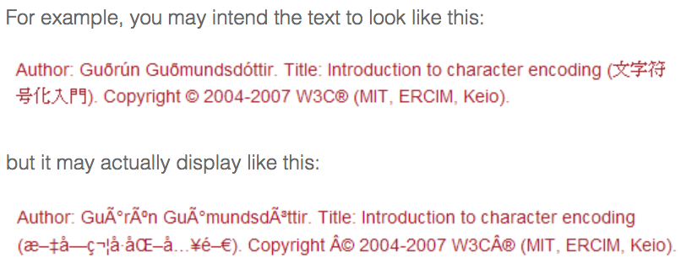
"Unreadable" files due to encodings
Source: https://www.w3.org/International/questions/qa-what-is-encoding

Slide 38
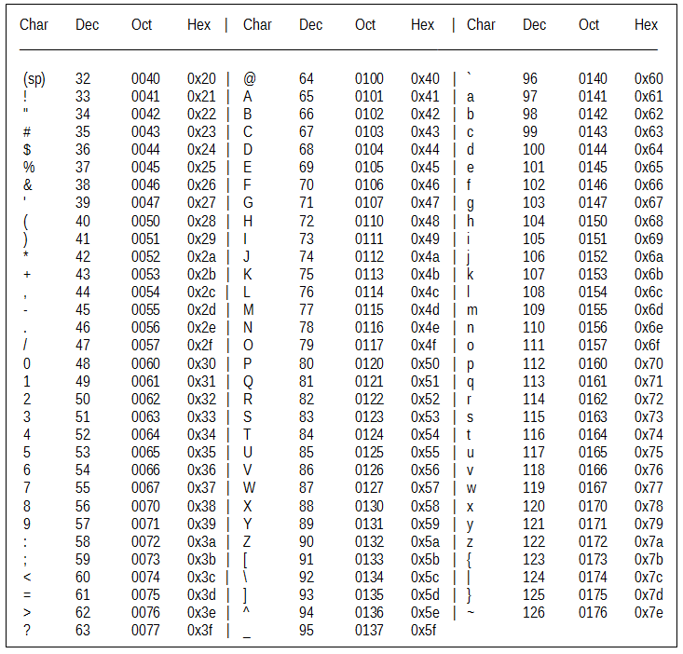
ASCII, UTF, Unicode
ascii code represents 8 bytes data.
--> ASCII was you could only have 256 different characters.
UNICODE represents 16 bytes data for supporting more characters.
Unicode which allowed for up to 65,536 different characters.
Languages such as Japanese and Arabic have thousands of characters.
UTF-8 is a compromise character encoding that can be as compact as ASCII (if the file is just plain English text) but can also contain any unicode characters (with some increase in file size). UTF stands for Unicode Transformation Format. The '8' means it uses 8-bit blocks to represent a character.
Notes:
http://writeulearn.com/ansi-code-unicode/

Slide 39
Relevance to you, the data scientist
https://donatstudios.com/CSV-An-Encoding-Nightmare
https://www.joelonsoftware.com/2003/10/08/the-absolute-minimum-every-software-developer-absolutely-positively-must-know-about-unicode-and-character-sets-no-excuses/

Slide 40
"Unreadable" files due to encodings
Try calling read_csv with
encoding='latin1',
encoding='iso-8859-1'
encoding='cp1252'
(these are some of the various encodings found on Windows) citation
df= pd.read_csv('Region_count.csv',encoding ='latin1')
Also, there's chardet
And see
https://docs.python.org/3/library/codecs.html#standard-encodings

Slide 41
Detecting anomalies: Is the data what I think it is?
Demo of Zipf's law notebook on text documents
http://localhost:8888/notebooks/week6_getting_data/text_6_analysis_of_all_documents.ipynb
https://en.wikipedia.org/wiki/Zipf%27s_law
Notes:
http://www.ee.columbia.edu/~xanadu/talks/IT-dolphins-04-1-05.pdf
https://www.peterrussell.com/Dolphin/DolphinLang.php
https://pdfs.semanticscholar.org/0b11/8d1ab730be9ddb3e29fcb811d4a9ff396658.pdf
http://www.eve.ucdavis.edu/gpatricelli/McCowan_et_al_2005.pdf
https://arxiv.org/abs/1205.0321

Slide 42
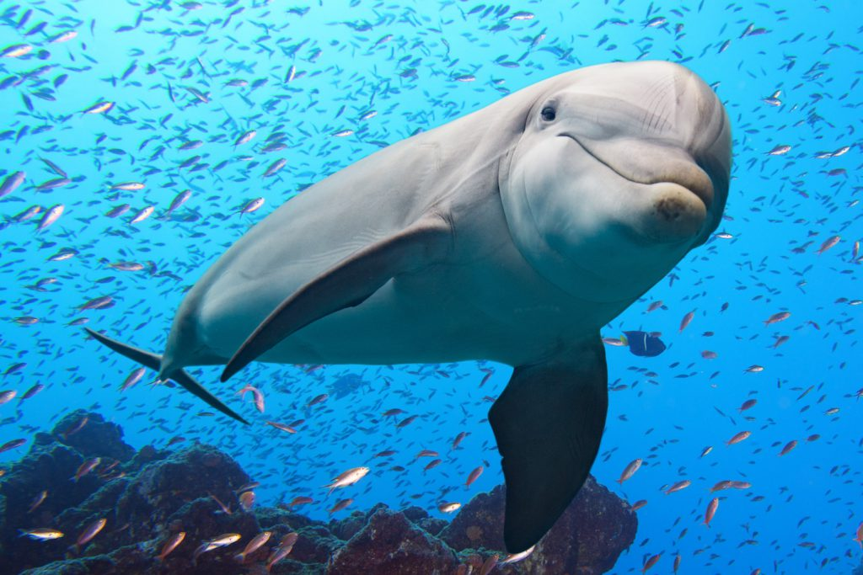
Detecting anomalies: Is the data what I think it is?
https://en.wikipedia.org/wiki/Zipf%27s_law
Use information theory to determine whether other animals convey information in their communication!
Links to papers are in
"notes" part of this slide
Notes:
http://www.ee.columbia.edu/~xanadu/talks/IT-dolphins-04-1-05.pdf
https://www.peterrussell.com/Dolphin/DolphinLang.php
https://pdfs.semanticscholar.org/0b11/8d1ab730be9ddb3e29fcb811d4a9ff396658.pdf
http://www.eve.ucdavis.edu/gpatricelli/McCowan_et_al_2005.pdf
https://arxiv.org/abs/1205.0321

Slide 43
Detecting anomalies: Is the data what I think it is?
In each language, some letters (or sounds) are more common than others
https://en.wikipedia.org/wiki/Letter_frequency
Demo a notebook that shows this from standard text
http://localhost:8888/notebooks/week8_cleaning_data/letter_frequency_in_text.ipynb

Slide 44
Detecting anomalies: Is the data what I think it is?
https://en.wikipedia.org/wiki/Benford%27s_law
the frequency distribution of leading digits in many real-life sets of numerical data. The law states that in many naturally occurring collections of numbers, the leading significant digit is likely to be small
Demo a notebook that shows this
http://localhost:8889/notebooks/week8_cleaning_data/loans_benford.ipynb

Slide 45
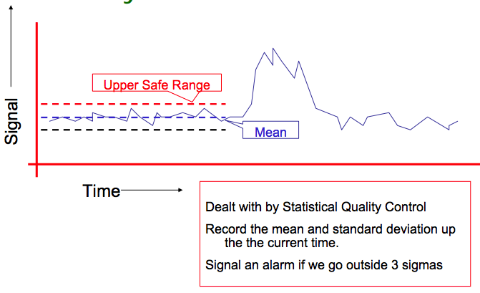
Time-series anomaly detection
Source: https://www.autonlab.org/_media/tutorials/biosurv01.pdf
Notes:
https://docs.microsoft.com/en-us/azure/machine-learning/studio-module-reference/time-series-anomaly-detection https://www.autonlab.org/tutorials/biosurv.html
https://www.autonlab.org/_media/tutorials/biosurv01.pdf

Slide 46
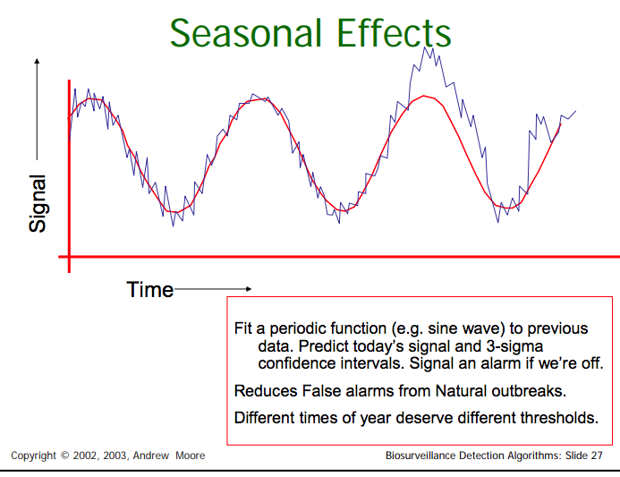
Source: https://www.autonlab.org/_media/tutorials/biosurv01.pdf
Notes:
https://docs.microsoft.com/en-us/azure/machine-learning/studio-module-reference/time-series-anomaly-detection https://www.autonlab.org/tutorials/biosurv.html
https://www.autonlab.org/_media/tutorials/biosurv01.pdf

Slide 47
Good overview of methods
https://blog.statsbot.co/time-series-anomaly-detection-algorithms-1cef5519aef2
Notes:
https://docs.microsoft.com/en-us/azure/machine-learning/studio-module-reference/time-series-anomaly-detection

Slide 48
Dealing with Anomalies
You want to clean your data, not manipulate or change it
Be able to justify removal.
Be explicit in your final conclusions if you removed outliers to normalize your data.
This is both an ethical issue and a trust issue
Source: page 167 of "Data Wrangling with Python"

Slide 49
Visual clean up
https://python-graph-gallery.com/134-how-to-avoid-overplotting-with-python/
Visual design matters to your story
https://www.darkhorseanalytics.com/blog/data-looks-better-naked

Slide 50
Pro-tip: Make headers human readable
Data cleanup includes helping your own interpretation
df.columns=['speed in mph', 'height in ft']

Slide 51
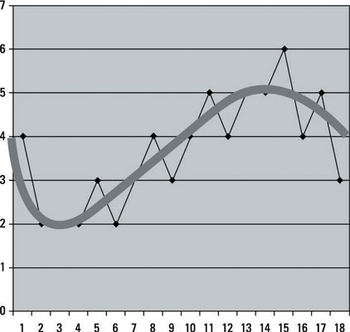
Smoothing data
https://en.wikipedia.org/wiki/Smoothing
https://www.mathworks.com/help/curvefit/smoothing-data.html
find the signal in the noise by discarding variance which is considered noisy
Notes:
https://www.dummies.com/programming/big-data/data-science/how-to-use-data-smoothing-in-predictive-analytics/

Slide 52
Smoothing data
When is it useful?
Exponential smoothing assigns exponentially more weight, or importance, to recent data points than to older data points. [source]
What are the dangers?
Excessively smoothed models have a high bias (not close to truth), even if they have low variance, and too rough models have high variances, and low bias (close to truth).
https://stats.stackexchange.com/questions/144013/smoothing-when-to-use-it-and-when-not-to

Slide 53
Outline for this evening
Schedule for semester
Activity: anonymous code review
Mid-term project schedule
Scope of "Cleaning" and context
Sanity checks
Anomalies and Outliers
Missing data
Homework

Slide 54
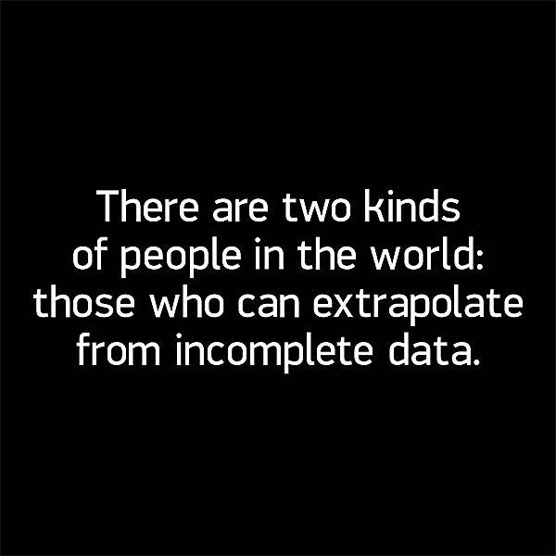
Missing data
Notes:
https://www.thinkgeek.com/product/15cc/

Slide 55
Missing data
Great walk through:
https://pandas.pydata.org/pandas-docs/stable/missing_data.html#missing-data
What to do about missing data? Options:
Proceed as is
Fill in with fixed value
Fill using adjacent values
Interpolation

Slide 56
First, characterize: Measure sparsity
http://localhost:8888/notebooks/week8_cleaning_data/loans_visualize_sparseness.ipynb

Slide 57
What to do with NaN entries?
Drop all columns where every value is NaN
df=df.dropna(how='all',axis=1)
http://localhost:8888/notebooks/week8_cleaning_data/data_cleanup_of_loans.ipynb
Replace NaN with numeric value out of bounds
df=df.fillna(-1)

Slide 58
If distribution of variable is known
If variable adheres to known distribution, sample replacement values or supplement insufficient data from that distribution
Be careful: missing values may have a bias, so simply inspecting the existing entries may yield a distribution that isn't representative

Slide 59
Interpolation of missing variables based on adjacent values
df.interpolate()

Slide 60
AirBnB machine learning needs clean data
Goal: Binary classification of fraud/not fraud
fraud prediction models using numerical and categorical
Use k nearest neighbors to find adjacent entities
Then fill in missing values based on adjacent values
https://medium.com/airbnb-engineering/overcoming-missing-values-in-a-random-forest-classifier-7b1fc1fc03ba

Slide 61
Outline for this evening
Schedule for semester
Activity: anonymous code review
Mid-term project schedule
Scope of "Cleaning" and context
Sanity checks
Anomalies and Outliers
Missing data
Homework

Slide 62
How to be a successful data scientist
Have multiple projects active at all times (though not too many)
Be able to split attention
Enables cross pollination of ideas
If something fails/is waiting/terminates, you can switch to something else
Don't spread yourself too thinly
Deliver results early and often
Constant dialog and feedback
Be able to explain value to organization

Slide 63
Python pro-tip: name your parameters

Slide 64
Homework: HTML in XML characterization
I provide you with an XML file; some of the fields contain HTML
Use a module to parse the XML (do not write an XML parser)
Use BeautifulSoup4 to parse the HTML
For each HTML page, report the number of links (<a href="">) in the page
Advanced students (if you're bored):
use an alternative method (i.e., regular expressions or Python's find) to validate the count of HTML links per page reported by BeautifulSoup4

Slide 65
Design your approach to solving the problem
On a piece of paper, write down actions you'll need to take
Determine the dependencies among the actions you need to take
In what order should the steps be?
If you have time before leaving, take the listed actions using your computer

