Slide 1

Easter Eggs in Coding !!!1!
By Raiyaan Tareen (LUG 4/1/2026)

Slide 2
Table of Contents
What is an Easter Egg in Coding?
Easter Eggs in Video Games
Easter Eggs in Programming
Easter Eggs in Hardware/Firmware
How to Make Your Own Easter Eggs

Slide 3

What is an Easter Egg?
A hidden message, image, or feature hidden in software (i.e. Excel, Mariokart), or any electronic medium.
Term was coined around 1980 by Steve Wright, then-Director of Software Development @ Atari.

Slide 4
What is an Easter Egg? (Cont.)
Not all Easter Eggs are harmless fun, some may cause vulnerabilities due to lack of documentation.
Easter Eggs have important cultural impacts influencing:
User Experiences
Marketing & Brand Identity
Creativity within the Development Community
Legacy & Tradition

Slide 5
Easter Eggs In Video Games
First *TRUE* Instance of an Easter Egg was actually in the 1973 Video Game “Moonlander”
Since there Conception, TONS of Easter Eggs have been created and implemented within video games
CHEAT CODES & ARGs ARE NOT EASTER EGGS!!!

Slide 6
Examples of Easter Eggs in Video Games
“Xyzzy” in Colossal Cave Adventure (Remember this)
“Chris Houlihan’s Room” in A Link to the Past
“Psycho Mantis Reads Your Mind” in Metal Gear Solid
The Konami Code:
Literally any COD Zombies Easter Egg

Slide 7
Easter Eggs in Programming
Computer Software Easter Eggs are secret responses that occur as a result of an undocumented set of commands
In the early days of computing (80s-90s), Easter Eggs were widely celebrated and created but after the 2000s large corporations like Microsoft party pooped and banned them for “Security Reasons”

Slide 8
Examples of Easter Eggs in Programming
“EMACs Doctor” In the EMACs IDE
“Sudo make me a sandwich” in Unix CLI
“Secret Commands” in the Google Browser
Placeholder Variables: “Plugh”, “XYZZY”, “FOOBAR”
“Import this” in Python

Slide 9
Easter Eggs in Hardware/Firmware
Easter Eggs aren’t only reserved for software, plenty of hardware developers join in on the fun too
Easter Eggs in Hardware are much more rare, more resources have to be allocated.
Easter Eggs can also be found in Firmware but are just as rare as Hardware eggs due to Memory constraints and trigger mechanisms

Slide 10
Examples of Easter Eggs in Hardware/Firmware
Silicon (Chip) Art (Russian CVAX, Waldo)
PCB Silkscreen Secrets (Vias arrangements)
Oscilloscope Games in Firmware
Macintosh SE Team Photo
Silicon Graphics O2 Flight Sim

Slide 11
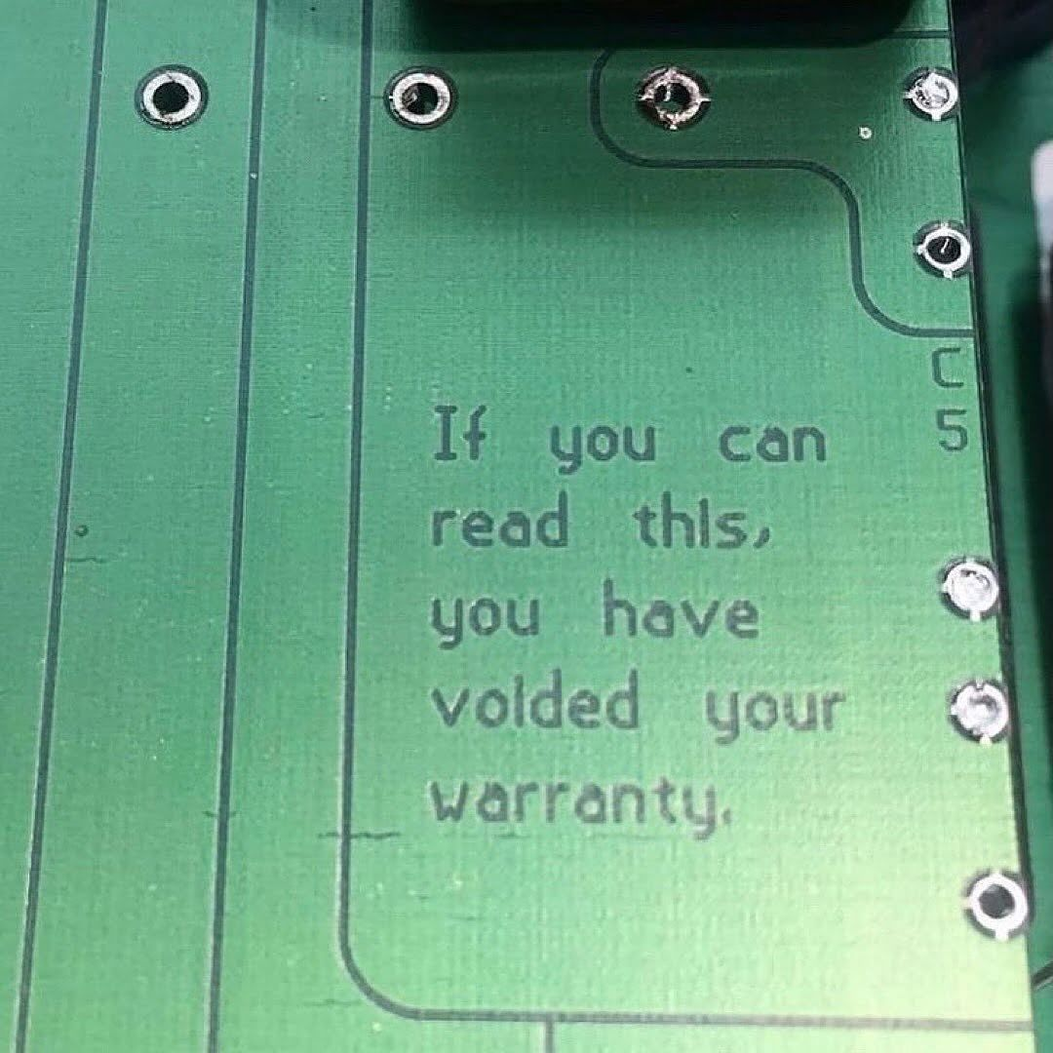
Text placed on the solder mask of a PCB

Slide 12
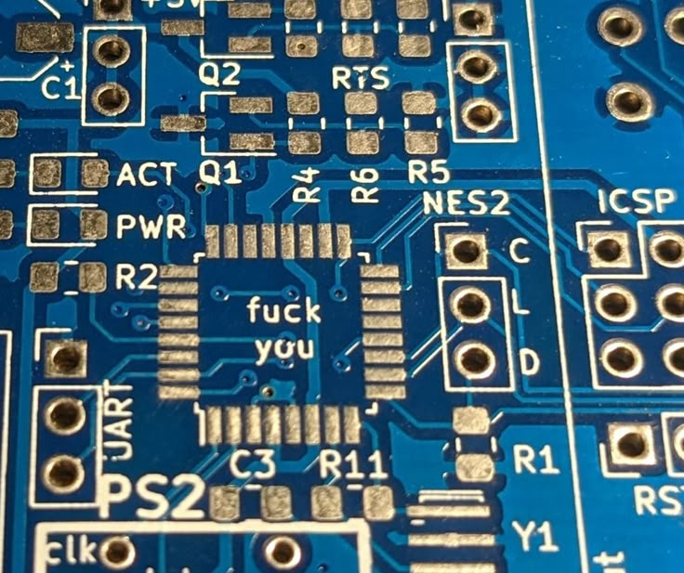
Hidden silkscreen text

Slide 13
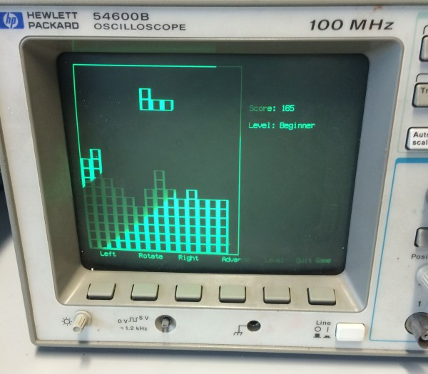
HP Tetris Oscilloscope Game

Slide 14
How to Make Your Own Easter Eggs
Two rules:
DO NOT Compromise your system for the bit
Have fun!

Slide 15
!Sources!1!!
[1] Wikipedia Contributors, “Easter egg (media),” Wikipedia, Oct. 19, 2019. https://en.wikipedia.org/wiki/Easter_egg_(media)
[2]TechBuzzOnline Contributors, “Exploring Programming Easter Eggs: A Complete History and Implementation Guide,” techbuzzonline, Apr. 03, 2025. https://techbuzzonline.com/programming-easter-eggs-history-implementation-guide/
[3] “Easter Eggs in Code: Fun, Festivity, and a Few Serious Bugs,” Home, Apr. 18, 2025. https://managershaven.com/2025/04/18/easter-eggs-in-code-fun-festivity-and-a-few-serious-bugs/
‌
‌
‌

Slide 16
!Sources!1!! (Cont.)
[1] “Chris Houlihan’s Room,” Zelda Dungeon Wiki, 2025. https://www.zeldadungeon.net/wiki/Chris_Houlihan%27s_Room
[2] eeggs.com, “Easter Eggs - Eeggs.com,” Eeggs.com, 2026. https://eeggs.com
‌
‌
‌
‌
‌

