Slide 1


Link Prediction on Real and Synthetic Complex Networks
Department of Information Engineering
Master Candidate: Umberto Michieli
Supervisors:
Leonardo Badia (Università degli Studi di Padova)
Carlo Cannistraci (Technische Universität Dresden)
10/09/2018

Slide 2
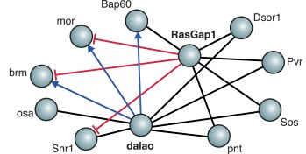

Topological Link Prediction (LP)
C
Problems:
Link forecast
Partial information
Reconstruction
?
A
B
?
D
F
E
Online social networks
Biology
Covert networks

Slide 3
Thank you for the attention!

