Slide 1
Introduction
Umberto Gotti
Software Engineer
Contractor
Email: => OpenOlat
Kurze Vorstellungsrunde für die Kursteilnehmer

Slide 2
Introduction: Course Contents
- .NET landscape (.Net Core, .Net Framework, .Net Standard, .Net Native).
- Multi-platform software development: Xamarin/Xaml/MVVM.
- Continuous integration, delivery and deployment with Git/TFS.
- Introduction to testing automation: Unit, Integration, Acceptance, Other forms of testing (load, GUI, penetration).
- Mocking.
- Integration with a server component (Web API on IIS).
- Elements of clean coding.
- Elements of refactoring.
- Introduction to multi-tasking and parallelism.
- Increment-based software development: „x“ releases.

Slide 3
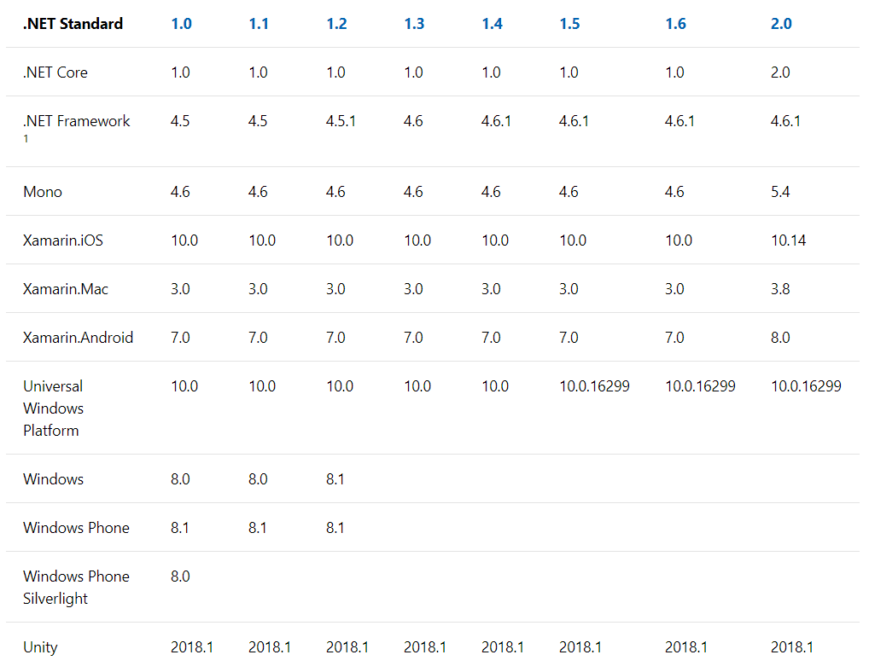
Introduction: .NET Standard

Slide 4
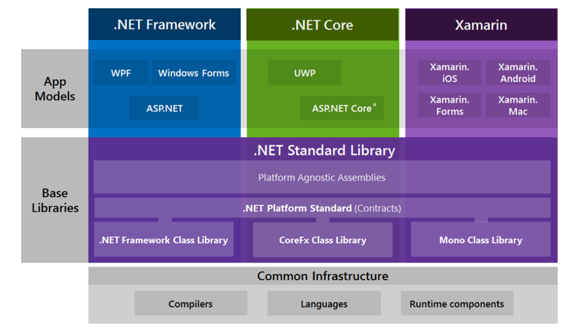
Introduction: .NET Ecosystem

Slide 5
Introduction: Framework
Visual Studio Community (Windows)
Visual Studio (Mac)
Team Foundation Server Express (and dependencies)
VirtualBox (+ Windows ISO)
GitHub
Chrome/Insomnia/Fiddler
- All available here: https://drive.google.com/open?id=14vcIS58lfHji5daNFGzj5bTTceiylhfV

Slide 6
Introduction: Objectives
Full-stack Software Development.
DevOps: CI/CD/One-Click-to-Production.

