Slide 1
Lesson 1: Xamarin Forms
Label
Button
StackLayout
Grid

Slide 2
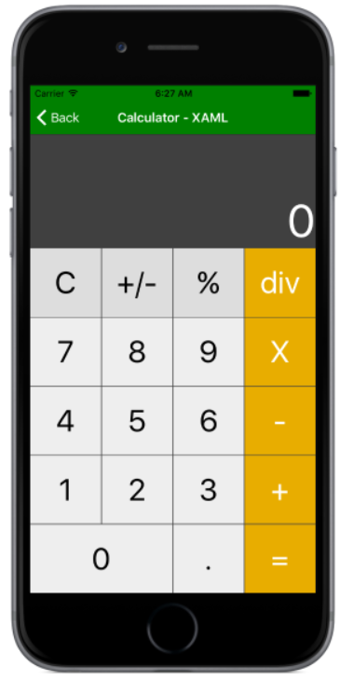
Lesson 1: Xamarin Forms
Exercise 1:

Slide 3
Lesson 1: Xamarin Forms
Exercise 1:
  a) Create GUI
  b) Implement operators + and =
  c) Finalize implementation
  d) ?

Slide 4
Lesson 1: Xamarin Forms
BoxView
ListView
TableView
Navigation

Slide 5
Lesson 1: Xamarin Forms
Exercise 2:
Create a Xamarin application made up of three pages:
- MainPage with a list of TextCell and a button. Clicking on one of the displayed entries will move to the DetailPage. Clicking on the button will navigate the user to the NewEntryPage
- DetailPage with a custom list containing 4 labels and a return button (back to the MainPage).
- NewEntryPage with TableView allowing the user to provide 6 pieces of information and a button which stores the new entry and allows the user to go back to the MainPage.

Slide 6
Lesson 2: Preparation
Finalize exercise 1
Install and configure TFS (on VM?)
Finalize exercise 2

