Slide 1
Assignment 4:
Broadcasting Methods
Ang Deng, Akshay Nagendra, Paul Yates

Slide 2
Assignment Summary
In this assignment we will let the students implement the broadcasting methods learned in class
Reliable Broadcast
FIFO Broadcast
Causal Broadcast
Working with practical implementations of these algorithms beyond the simple pseudocode will give students a deeper and more lasting understanding of how they should work

Slide 3
Requirements and Specifications
Language: Python 2.7
Skeleton code is provided with instructions on where to insert the missing broadcast algorithm code
E.g. the network layer socket setup will already be there
The student must demonstrate successful completion of the algorithm by submitting correct code and output logs which satisfy the requirements of the broadcast algorithm used
For causal broadcast, students must also submit proof that their implementation is correct via an explanation (PDF) and any supporting files

Slide 4
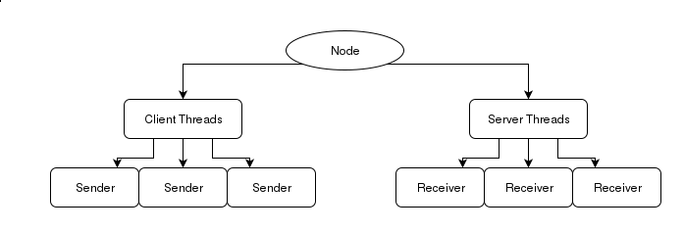
Skeleton Code Features: Server/Client Node Model
Each system is modeled as a node which acts as both a server and a client
Each node sends all of its messages as a client, and receives all messages as a server
Low-level sending and receiving is provided by the skeleton code
Python implementation using threads

Slide 5
Skeleton Code Features: Read/Write Logs
An input file corresponding to each node contains the messages to be sent and their timestamps
Messages must be sent only when the node’s tick or clock value is >= than the timestamp for a message
When each message is delivered by a node, it must be written to an write/delivery log unique for that node with the following information
Node Clock Value/Tick Value
Tag of Message
Message Contents

Slide 6
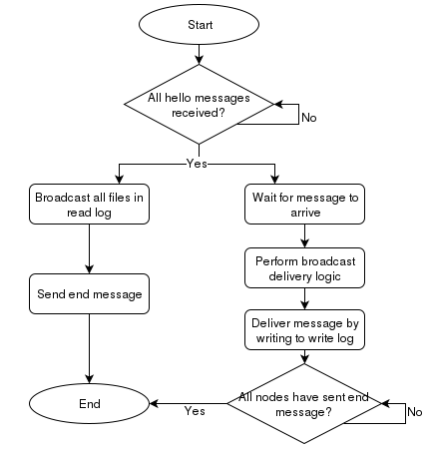
Flowchart for Client/Server Model

Slide 7
Skeleton Code Features: Channel Delay and Failure
If desired, a channel delay feature may be enabled
Each transmission takes a random amount of time (bounded to 3 seconds)
This affects order of message received
FIFO and Causal rules must still be obeyed
Broken channels are defined by the input file
Each node may have some of its communication channels fail
Broadcast algorithms should still be successful as long as there exists at least one send and receive path between all nodes

Slide 8
Solution: Reliable and FIFO Broadcast
For Reliable Broadcast, students must implement:
Unique Tags
Broadcast and Receive Handler
If a message is received for the first time, it is delivered and re-broadcasted if not sent from receiving node itself
Each message should appear once and only once in the output file
For FIFO Broadcast, students must implement:
Unique tags with sequence numbers that increase from broadcast to broadcast
Must complete and use r_delivery_handler()
Students may notice that they can potentially use same reliable broadcast function for send
Each message should appear in sequence number order (per sender node) in the output file

Slide 9
Solution: Causal Broadcast
For Implementation:
Whenever a message is broadcasted, all previous delivered messages must be sent alongside and the prevDelivered list must be emptied
Whenever receiving a message list from f_deliver, any message that hasn’t been c_delivered is delivered to the application layer and appended to the prevDelivered list
Sample Verification
Whenever a message is broadcasted, record it and the current state of prevDelivered
If all messages are delivered after all the messages in their corresponding prevDelivered list, then the implementation would be correct and maintain causal behavior

Slide 10
Thank you!
Demo Video (time permitting)
Any questions?

