Slide 1
RWClustering
C++ Implementation of Rajaraman-Wong Clustering
Akshay Nagendra <akshaynag@gatech.edu>
Paul Yates <paul.maxyat@gatech.edu>
April 26th, 2018

Slide 2
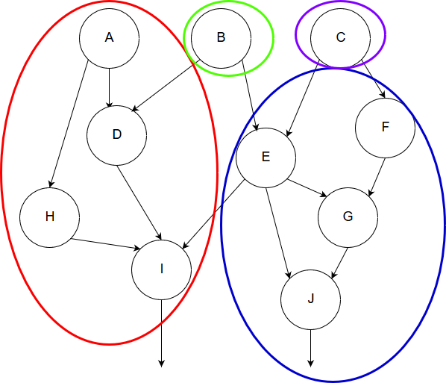
What is Clustering and Why Do We Do It?
Clustering: Method of grouping gates together in a circuit to simplify complex circuit netlists
Clustered netlists can be used as the input for partitioning and placement

Slide 3
Rajaraman-Wong Clustering
Focuses on minimizing the critical path delay when forming clusters on a directed acyclic graph (DAG)
Allows a gate to appear in multiple clusters (overlap)
Area cost
Two Phases
Labelling: Compute a “label” per node that corresponds to longest time to that node when considering clustering
Clustering: Form certain node clusters by starting with POs and adding any necessary input clusters

Slide 4
Program Execution Flow
START
Process input BLIF file and generate node list
Sort nodes using topological sorting
Construct delay matrix (if applicable)
END
Generate output files and GUI (if applicable)
Form necessary clusters beginning at POs
Compute label and cluster for each node

Slide 5
Implementation: Data structures
C++ and C++ STL libraries used to run all steps of the Rajaraman-Wong clustering algorithm
Object-oriented classes to store node and cluster information
Specialized traversal algorithms for topological sorting using visited flags, sparse matrices, C++ vectors and sets
GUI implemented using Python 2.7 Tkinter/Turtle graphics library and cshell script for running the C++ and the Python code

Slide 6
Results (Inter cluster delay = 3, Max cluster size = 8)
Circuit Netlist | Node Count | Cluster Count | Max Path Delay | Topolog. Sorting Time (sec) | Matrix Initialization (sec) | Labelling Time (sec) | Clustering Time (sec) | Total Execution Time (sec)
b17_opt.blif | 25719 | 16147 | 72 | 0.003 | 27 | 5 | 9 | 74.003
b22_opt.blif | 18789 | 11950 | 110 | 0.002 | 16 | 2 | 4 | 58.002
b20_opt.blif | 12991 | 8197 | 103 | 0.001 | 11 | 1 | 2 | 39.001
s13207.blif | 9396 | 2985 | 88 | 0.001 | 0.999 | 0.337 | 0.076 | 2.414
s9234.blif | 6055 | 2090 | 88 | 0.00079 | 2 | 0.188 | 0.035 | 2.223
Note: These runs were executed on ecelinsrvw.ece.gatech.edu

Slide 7
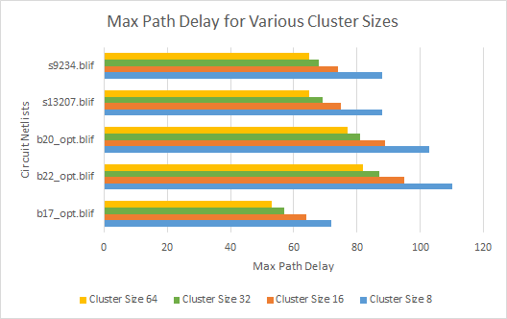
Max Path Delay vs. Cluster Size Analysis

Slide 8
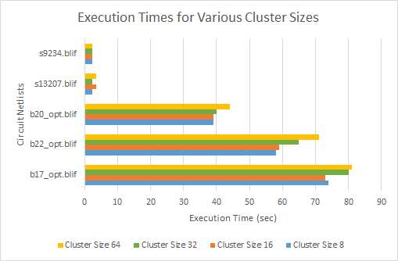
Execution Time vs. Cluster Size Analysis

Slide 9
Performance Analysis
Execution time and performance is not only a function of node count, but also the complexity of the circuit
Our implementation is more susceptible to higher degrees of complexity (bX_opt.blif circuits), compared to the simpler (sX.blif circuits)
Additional features such as different matrix implementations help reduce the latency of the program

Slide 10
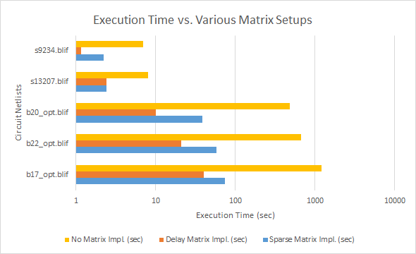
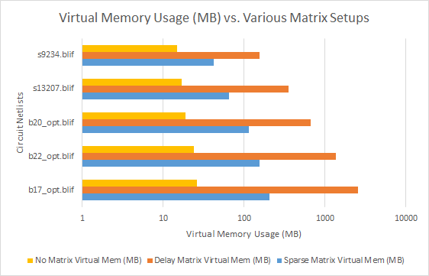
Matrix Implementation Analysis
Larger the matrix dimensions for the delay matrix, the better runtime performance can be achieved at a very high memory usage cost

Slide 11
Benefits of the Design
RWClustering supports many features and extensions geared towards enabling a user to explore the clustering problem space
Matrix configurations can be selected to prioritize specific goals (e.g. runtime, memory usage, etc.)
Extensions include
Lawler labelling and clustering for comparison with Rajaraman-Wong
Experimental, overlap-avoidance clustering code to minimize area cost with Rajaraman-Wong
Python interactive GUI for sufficiently small circuits

Slide 12
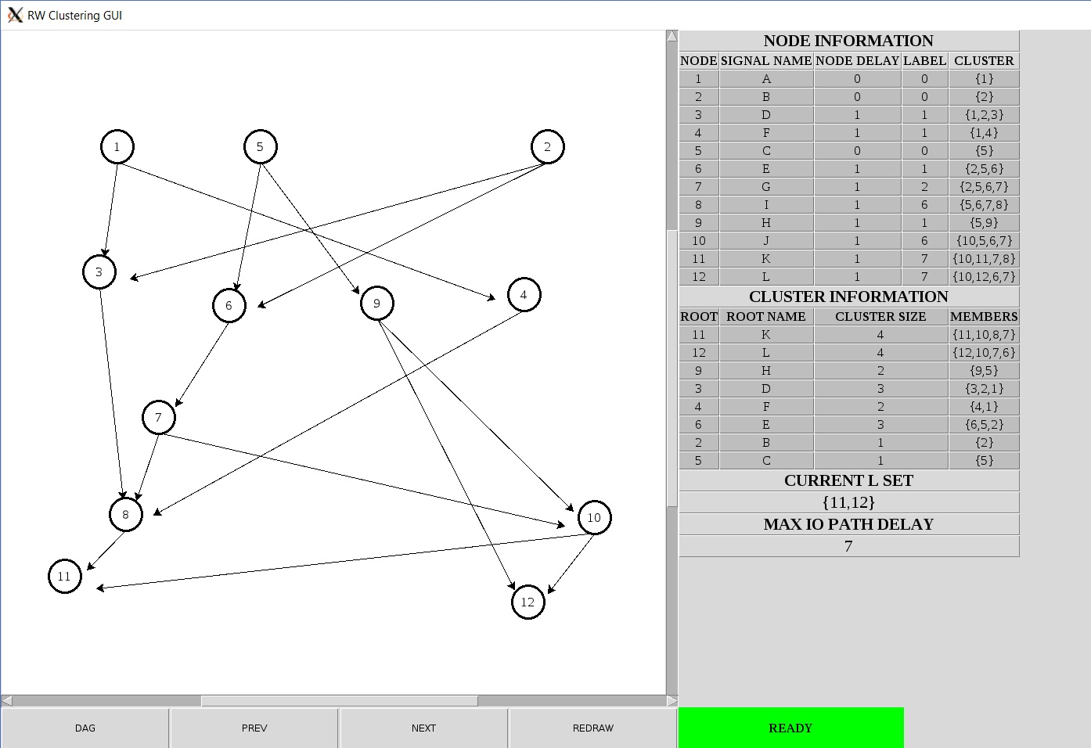
GUI (RWGUI)

Slide 13
Future Work
Further optimization of algorithms
E.g. optimize the “On-The-Fly”, No Matrix delay determination for better runtime performance
Robust testing of the experimental code to see if it holds true for all acyclic digital circuit netlists
Port RWGUI to a more sophisticated GUI platform such as OpenGL, Qt, or ElectronJS
Python Tkinter/Turtle was picked due to ecelinsrvw.ece.gatech.edu having support for this graphics library

Slide 14
Further Resources
For more information about RWClustering, please consult the following:
RWClustering/docs/RWGUIManual.docx Manual on how to operate the interactive GUI
RWClustering/docs/FinalReport.docx: Report on the RWClustering application with in-depth details about the algorithms used, features, extensions, and analyses
RWClustering/README.txt: Textfile containing instructions on how to run the project infrastructure

