Slide 1

In-memory Caching in HDFS
Lower latency, same great taste
Andrew Wang | awang@cloudera.com
Colin McCabe | cmccabe@cloudera.com

Slide 2



Query
Alice
Result set
Hadoop cluster

Slide 3

Alice
Fresh data

Slide 4

Fresh data

Slide 5

Alice
Rollup

Slide 6
Problems
Data hotspots
Everyone wants to query some fresh data
Shared disks are unable to handle high load
Mixed workloads
Data analyst making small point queries
Rollup job scanning all the data
Point query latency suffers because of I/O contention
Same theme: disk I/O contention!

Slide 7
How do we solve I/O issues?
Cache important datasets in memory!
Much higher throughput than disk
Fast random/concurrent access
Interesting working sets often fit in cluster memory
Traces from Facebook’s Hive cluster
Increasingly affordable to buy a lot of memory
Moore’s law
1TB server is 40k on HP’s website

Slide 8
Alice
Page cache

Slide 9
?
Alice
Repeated query

Slide 10
Alice
Rollup

Slide 11
Extra copies
Alice

Slide 12

Extra copies
Alice
Checksum verification

Slide 13
Design considerations
Explicitly pin hot datasets in memory
Place tasks for memory locality
Zero overhead reads of cached data

Slide 14
Outline
Implementation
NameNode and DataNode modifications
Zero-copy read API
Evaluation
Microbenchmarks
MapReduce
Impala
Future work

Slide 15
Outline
Implementation
NameNode and DataNode modifications
Zero-copy read API
Evaluation
Microbenchmarks
MapReduce
Impala
Future work

Slide 16
Architecture
The NameNode schedules which DataNodes cache each block of a file.
NameNode
DataNode
DataNode
DataNode

Slide 17
Architecture
DataNodes periodically send cache reports describing which replicas they have cached.
NameNode
DataNode
DataNode
DataNode

Slide 18
Cache Locations API
Clients can ask the NameNode where a file is cached via getFileBlockLocations
NameNode
DFSClient
DataNode
DataNode
DataNode

Slide 19
Cache Directives
A cache directive describes a file or directory that should be cached
Path
Cache replication factor
Stored permanently on the NameNode
Also have cache pools for access control and quotas, but we won’t be covering that here

Slide 20
mlock
The DataNode pins each cached block into the page cache using mlock.
Because we’re using the page cache, the blocks don’t take up any space on the Java heap.
DataNode
mlock
Page Cache
DFSClient
read

Slide 21
Zero-copy read API
Clients can use the zero-copy read API to map the cached replica into their own address space
The zero-copy API avoids the overhead of the read() and pread() system calls
However, we don’t verify checksums when using the zero-copy API
The zero-copy API can be only used on cached data, or when the application computes its own checksums.

Slide 22
Skipping Checksums
We would like to skip checksum verification when reading cached data
DataNode already checksums when caching the block
Requirements
Client needs to know that the replica is cached
DataNode needs to notify the client if the replica is uncached

Slide 23
Skipping Checksums
The DataNode and DFSClient use shared memory segments to communicate which blocks are cached.
DataNode
read
Page Cache
Shared Memory
Segment
DFSClient
mlock

Slide 24
Outline
Implementation
NameNode and DataNode modifications
Zero-copy read API
Evaluation
Single-Node Microbenchmarks
MapReduce
Impala
Future work

Slide 25
Test Cluster
5 Nodes
1 NameNode
4 DataNodes
48GB of RAM
Configured 38GB of HDFS cache per DN
11x SATA hard disks
2x4 core 2.13 GHz Westmere Xeon processors
10 Gbit/s full-bisection bandwidth network

Slide 26
Single-Node Microbenchmarks
How much faster are cached and zero-copy reads?
Introducing vecsum (vector sum)
Computes sums of a file of doubles
Highly optimized: uses SSE intrinsics
libhdfs program
Can toggle between various read methods

Slide 27
Throughput

Slide 28
ZCR 1GB vs 20GB

Slide 29
Throughput
Skipping checksums matters more when going faster
ZCR gets close to bus bandwidth
~6GB/s
Need to reuse client-side mmaps for maximum perf
page_fault function is 1.16% of cycles in 1G
17.55% in 20G

Slide 30
Client CPU cycles

Slide 31
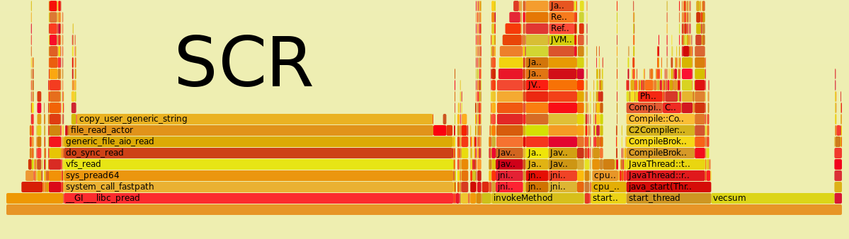
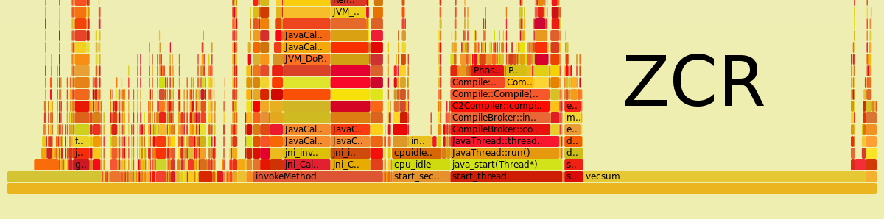
Why is ZCR more CPU-efficient?

Slide 32
Why is ZCR more CPU-efficient?

Slide 33
Remote Cached vs. Local Uncached
Zero-copy is only possible for local cached data
Is it better to read from remote cache, or local disk?

Slide 34
Remote Cached vs. Local Uncached

Slide 35
Microbenchmark Conclusions
Short-circuit reads need less CPU than TCP reads
ZCR is even more efficient, because it avoids a copy
ZCR goes much faster when re-reading the same data, because it can avoid mmap page faults
Network and disk may be bottleneck for remote or uncached reads

Slide 36
Outline
Implementation
NameNode and DataNode modifications
Zero-copy read API
Evaluation
Microbenchmarks
MapReduce
Impala
Future work

Slide 37
MapReduce
Started with example MR jobs
Wordcount
Grep
Same 4 DN cluster
38GB HDFS cache per DN
11 disks per DN
17GB of Wikipedia text
Small enough to fit into cache at 3x replication
Ran each job 10 times, took the average

Slide 38
wordcount and grep

Slide 39
wordcount and grep
Almost no speedup!

Slide 40
wordcount and grep
~60MB/s
Not I/O bound
~330MB/s

Slide 41
wordcount and grep
End-to-end latency barely changes
These MR jobs are simply not I/O bound!
Best map phase throughput was about 330MB/s
44 disks can theoretically do 4400MB/s
Further reasoning
Long JVM startup and initialization time
Many copies in TextInputFormat, doesn’t use zero-copy
Caching input data doesn’t help reduce step

Slide 42
Introducing bytecount
Trivial version of wordcount
Counts # of occurrences of byte values
Heavily CPU optimized
Each mapper processes an entire block via ZCR
No additional copies
No record slop across block boundaries
Fast inner loop
Very unrealistic job, but serves as a best case
Also tried 2GB block size to amortize startup costs

Slide 43
bytecount

Slide 44
bytecount
1.3x faster

Slide 45
bytecount
Still only ~500MB/s

Slide 46
MapReduce Conclusions
Many MR jobs will see marginal improvement
Startup costs
CPU inefficiencies
Shuffle and reduce steps
Even bytecount sees only modest gains
1.3x faster than disk
500MB/s with caching and ZCR
Nowhere close to GB/s possible with memory
Needs more work to take full advantage of caching!

Slide 47
Outline
Implementation
NameNode and DataNode modifications
Zero-copy read API
Evaluation
Microbenchmarks
MapReduce
Impala
Future work

Slide 48
Impala Benchmarks
Open-source OLAP database developed by Cloudera
Tested with Impala 1.3 (CDH 5.0)
Same 4 DN cluster as MR section
38GB of 48GB per DN configured as HDFS cache
152GB aggregate HDFS cache
11 disks per DN

Slide 49
Impala Benchmarks
1TB TPC-DS store_sales table, text format
count(*) on different numbers of partitions
Has to scan all the data, no skipping
Queries
51GB small query (34% cache capacity)
148GB big query (98% cache capacity)
Small query with concurrent workload
Tested “cold” and “hot”
echo 3 > /proc/sys/vm/drop_caches
Lets us compare HDFS caching against page cache

Slide 50
Small Query

Slide 51
Small Query
I/O bound!
2550 MB/s
17 GB/s

Slide 52
Small Query
3.4x faster,
disk vs. memory

Slide 53
Small Query
1.3x after warmup, still wins on CPU efficiency

Slide 54
Big Query

Slide 55
Big Query
4.2x faster, disk vs mem

Slide 56
Big Query
Cannot schedule for page cache locality
4.3x faster, doesn’t fit in page cache

Slide 57
Small Query with Concurrent Workload

Slide 58
Small Query with Concurrent Workload
7x faster when small query working set is cached

Slide 59
Small Query with Concurrent Workload
2x slower than isolated, CPU contention

Slide 60
Impala Conclusions
HDFS cache is faster than disk or page cache
ZCR is more efficient than SCR from page cache
Better when working set is approx. cluster memory
Can schedule tasks for cache locality
Significantly better for concurrent workloads
7x faster when contending with a single background query
Impala performance will only improve
Many CPU improvements on the roadmap

Slide 61
Outline
Implementation
NameNode and DataNode modifications
Zero-copy read API
Evaluation
Microbenchmarks
MapReduce
Impala
Future work

Slide 62
Future Work
Automatic cache replacement
LRU, LFU, ?
Sub-block caching
Potentially important for automatic cache replacement
Compression, encryption, serialization
Lose many benefits of zero-copy API
Write-side caching
Enables Spark-like RDDs for all HDFS applications

Slide 63
Conclusion
I/O contention is a problem for concurrent workloads
HDFS can now explicitly pin working sets into RAM
Applications can place their tasks for cache locality
Use zero-copy API to efficiently read cached data
Substantial performance improvements
6GB/s for single thread microbenchmark
7x faster for concurrent Impala workload

Slide 65
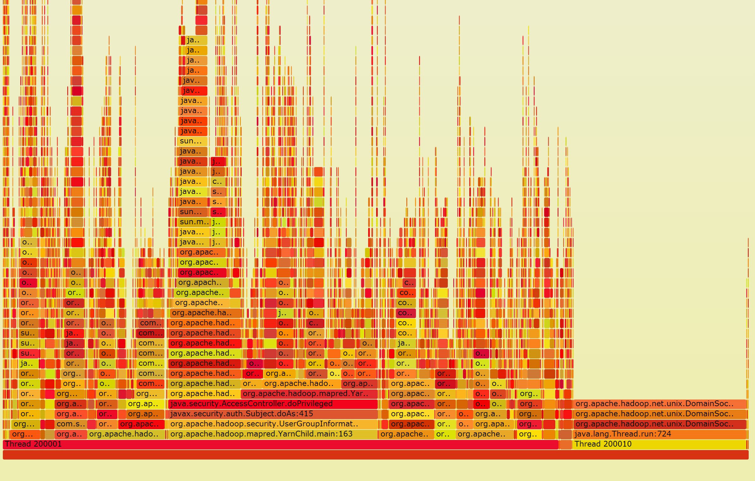

Slide 66
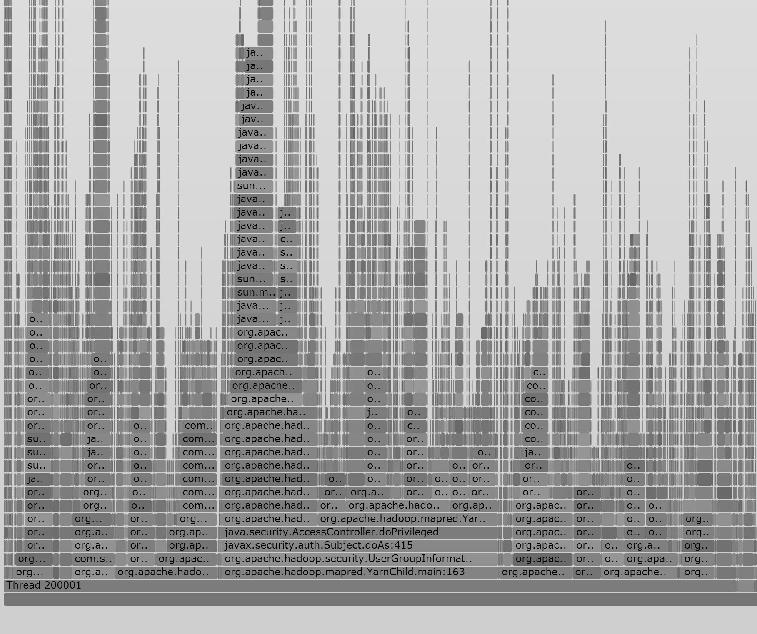

Slide 67
bytecount
Less disk parallelism

